Slide 1

Russia’s invasion of Ukraine: medium-term implications for European and global gas markets
Kong Chyong
Cambridge Judge Business School
University of Cambridge
2022 CEEPR & EPRG International Energy Policy Conference
Brussels
1 Sept 2022

Slide 2
Key questions
How might we see global energy supply and demand evolve with a prolonged shut down of Russian gas to Europe?
Will new sources of gas come on stream to replace lost Russian volumes?
2

Slide 3
Q1: How might we see global energy supply and demand evolve with a prolonged shut down?
It takes more than a decade to ramp up production to replace Russian gas;
Analysis of future LNG projects, their economics, potential security of supply issues and contractual models that would fit with European decarbonization narratives;
Outlook for LNG demand (non-Europe) and its price responsiveness.
3

Slide 4
Ramping up LNG exports takes time
Source: BP (2021); Eikon Terminal
Reminder: Russian gas to Europe is ca. 155 bcm (2021)
US expansion still ongoing (Cheniere/Sabine Pass T1 started in 2016)
4

Slide 5
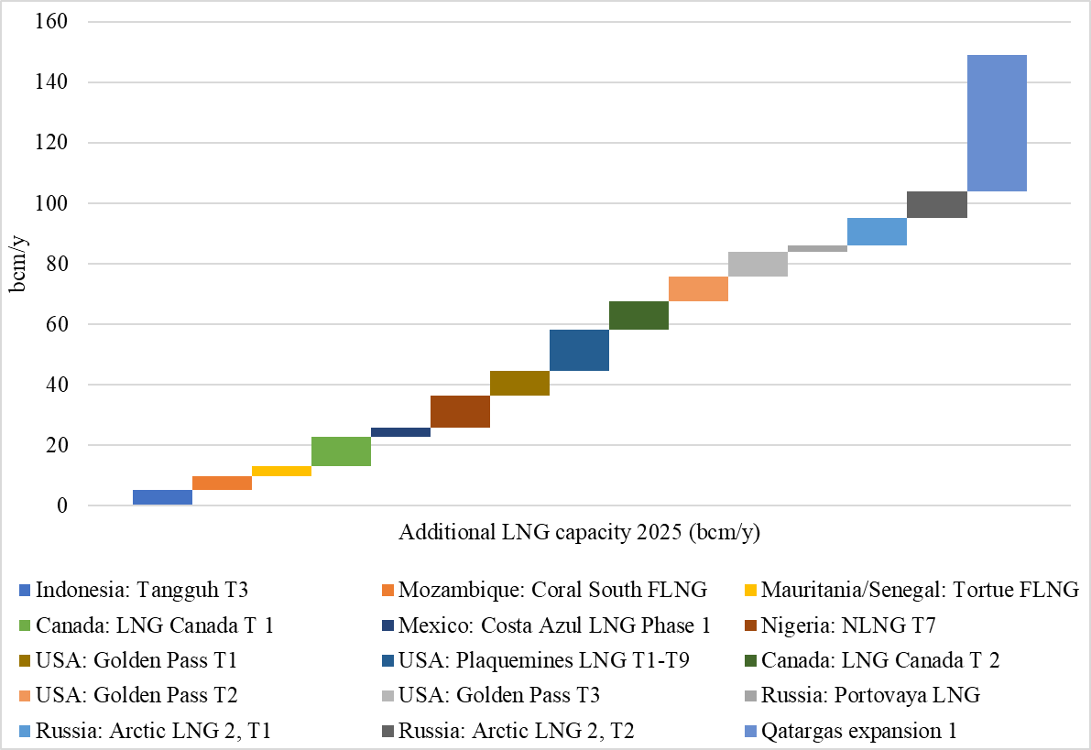
Global LNG capacity addition and demand growth by 2025
IEA’s most recent (Jul-22) incremental LNG demand assessment
Source: Eikon terminal
5

Slide 6
Global LNG capacity addition and demand growth by 2025
IEA’s most recent (Jul-22) incremental LNG demand assessment
RU Artic T2 won’t come online due to sanctions
Qatari LNG expansion timeline too ambitious
Source: Eikon terminal
6

Slide 7
Global LNG capacity addition and demand growth by 2025
IEA’s most recent (Jul-22) incremental LNG demand assessment
Source: Eikon terminal
7

Slide 8
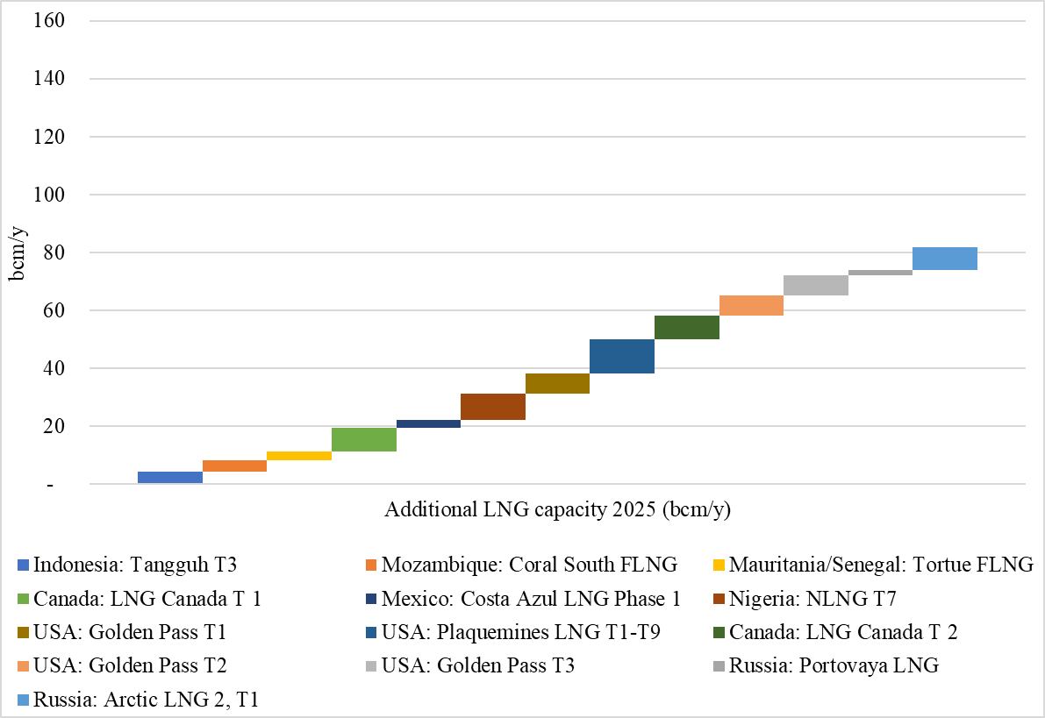
Global LNG capacity (derated) addition and demand growth by 2025
IEA’s most recent (Jul-22) incremental LNG demand assessment
Source: Eikon terminal
8

Slide 9
Price impacts on gas demand forecasts
Source: IEA (2022)
9

Slide 10
LNG contracts signed in 2021&H1-22
Europe + Portfolio = ca. 50 bcm, or 32% of RU gas export (2021).
Source: IEA (2022)
10

Slide 11
LNG contracts signed in 2021&H1-22
IEA analysis implies that on top of additional measures European utilities will need to contract with IOCs for the flex LNG volume & buys spot cargoes
Source: IEA (2022)
11

Slide 12
Q2: Will new sources of gas come on stream to replace lost RU volumes?
Yes, LNG is in abundance but requires long-term contracts (volume guarantee for banks to finance these projects);
Contractual models that would fit with European decarbonization narratives while keeping gas prices stable and competitive enough to refuel European (i.e., German) industry;
More important question – when and with what capacity will (if ever) Russia come back to the global energy markets?
12

Slide 13
Non-FID LNG projects (bcm/y)
Reminder: Russian gas to Europe is ca. 155 bcm (2021)
Source: Eikon terminal
13

Slide 14
Non-FID LNG projects (bcm/y)
Reminder: Russian gas to Europe is ca. 155 bcm (2021)
Source: Eikon terminal
14

Slide 15
Russia’s pivot to Asia & global LNG
For this to happen, we need a geopolitical settlement between Russia, Europe and USA akin to the Yalta Conference of 1945
Source: IEA (2022)
15

Slide 16
Some concluding remarks/questions
A systematic cost-benefit analysis of industrial DSR capability and costs against the notion of “protected customers” under the EC gas SoS regulation is required ASAP.
What gas-based industrial processes can we replace (electrify and/or decarbonize with H2) quickly and at what cost?
How many heat pumps between now and 2030 can we install in residential buildings?
16

