Slide 1
Rethinking Electricity Market Design: transitioning to high renewable electricity
David Newbery, EPRG,
University of Cambridge
CEEPR & EPRG European Energy Policy Conference
Brussels
1st September 2022

Slide 2
2022 Background
British Energy Security Strategy sets targets: by 2030 expect
50 GW off-shore wind (11 GW now) => more than one 10MW turbine every day
40 GW solar PV (13 GW now)
25-30 GW on-shore wind (13 GW now)
fully decarbonised electricity by 2035
no onshore wind in E&W “but will consult .. on developing local partnerships for … communities who wish to host new onshore wind”
Review of Electricity Market Arrangements Consultation
“do not consider that existing market arrangements are likely to deliver our ambition for a decarbonised and secure electricity system by 2035 at least possible cost to consumers”
National Grid ESO
Holistic network design (integrated planning for off-shore wind)
Little chance of reaching targets without major change
D Newbery
2

Slide 3
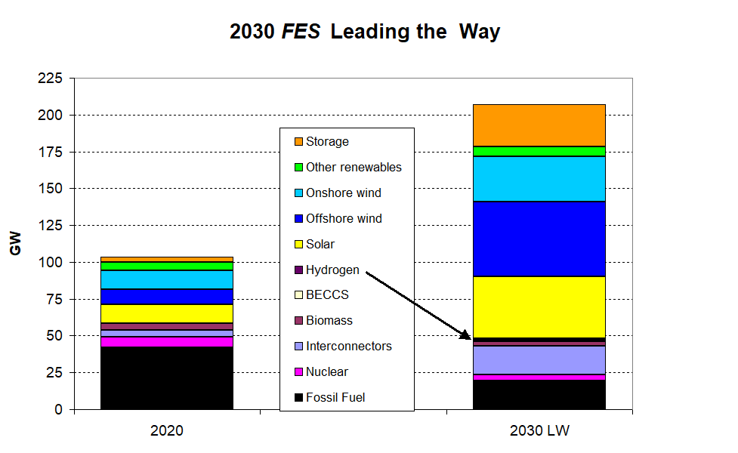
UK renewable electricity capacity to treble by 2030
134
GW
46
GW
Source: FES 2022
Notes:
Electricity\FES\FES21 electricity

Slide 4
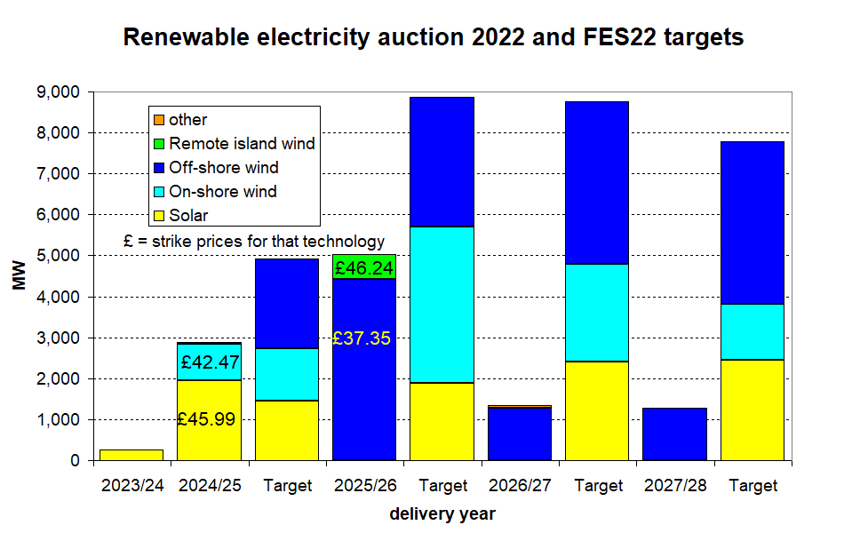
July 2022 renewables auction
Procurement falling short of targets

Slide 5
Messages
Net zero requires massive investment
Low-C is capital intensive
the key to lowering cost is lowering cost of capital by reducing risk
lengthy periods of low prices => contracts cover cost
Renewables – support needs reform
Contracts hedge against uncertainty but respond to spot prices
=> Hybrid markets:
competition for the market (auction long-term contracts)
then competition in the market
Networks: large part of total cost – built in response to generation
Least system cost => coordinate location of T&G

Slide 6
REMA consultation July 2022
“market forces alone are currently unable to deliver our objectives”
=> Change market design and network planning for the Transition
Incremental or radical? Tried or novel?
avoid major revenue changes resisted by incumbents
provide efficient incentives to invest and dispatch
future proof for volatile prices and excess supply
What are the best options?
What can be changed immediately?
Contract design and grandfathering solves most problems

Slide 7
Network costs: benefits of coordination
National Grid ESO Holistic Network Design for offshore wind:
Optimised cost to deliver 50 GW offshore wind = £54 bn
Compares current responsive to coordinated approach
Saves £8bn compared with just connecting each OWF separately
July 22 CfD auction price= £37.35/MWh for off-shore wind
Cost of off-shore = £2.23 billion/GW (BEIS 2020)
Cost of HND network to deliver off-shore = £1.83 bn./GW
=> network costs add extra 80% to off-shore turbine cost => £68/MWh?
On-shore wind strike price = £42.47/MWh = much cheaper?
Coordinating location of new on and off-shore wind and network likely to reduce system costs considerably
D Newbery
7

Slide 8
Eirgrid/SONI comparisons
Eirgrid/SONI (2021) Shaping our electricity future for island of Ireland
Compares four approaches to planning networks
Developer-led is BAU as in GB – 63% reflects higher curtailment
Generation-led is TSO-steered and cheaper
12.2 GW vs 14.95 GW to meet 70% target (Offshore higher capacity cactor)
Technology-led: more HVDC and power electronics reduce curtailment
Demand-led assumes large load can be directed – unlikely
Approach | On-shore wind GW | off-shore wind GW | PV GW | network cost millions | RE costs millions | total | RE in 2030
Generation-led | 5.8 | 5.2 | 1.2 | € 853 | € 20,314 | € 21,167 | 70%
Developer-led | 10.2 | 2.15 | 2.6 | € 2,308 | € 20,409 | € 22,717 | 63%
Technology-led | 10.2 | 2.15 | 2.6 | € 2,144 | € 20,409 | € 22,553 | 70%
Demand-led | 10.2 | 2.15 | 2.6 | € 670 | € 20,409 | € 21,079 | 70%
D Newbery
8

Slide 9
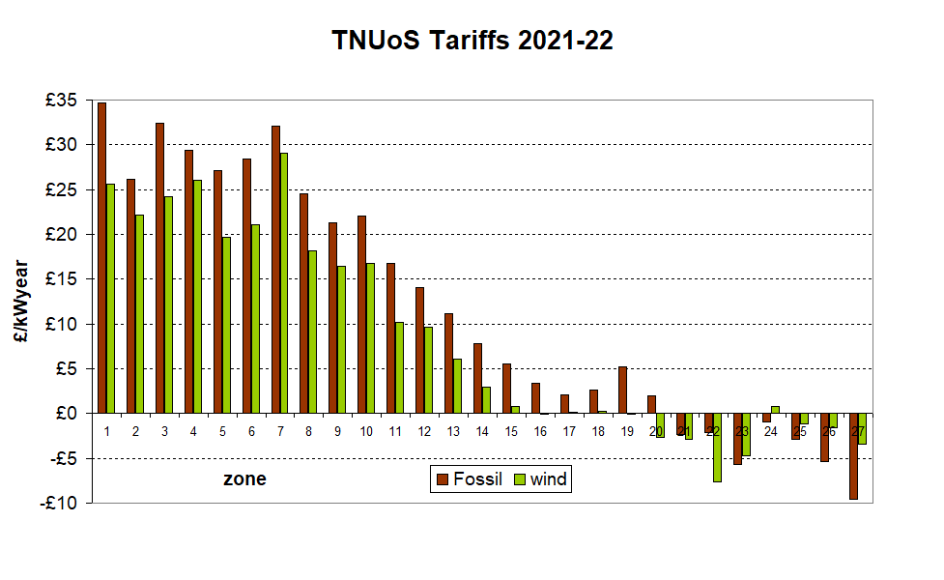
Current transmission charging methodology
Problem: local hourly pattern of different technologies not reflected in Annual Load Factor (ALF)
Problem: charges annually reset, discourages substantial necessary changes
Paid if available
at peak

Slide 10
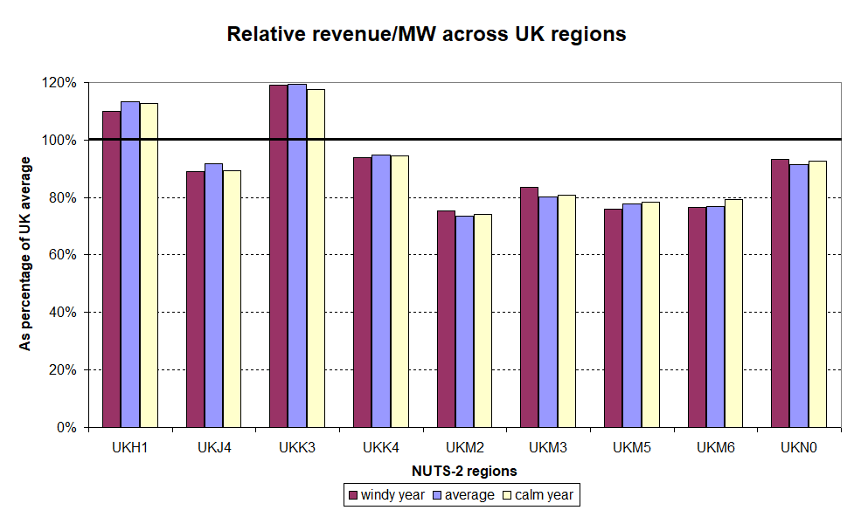
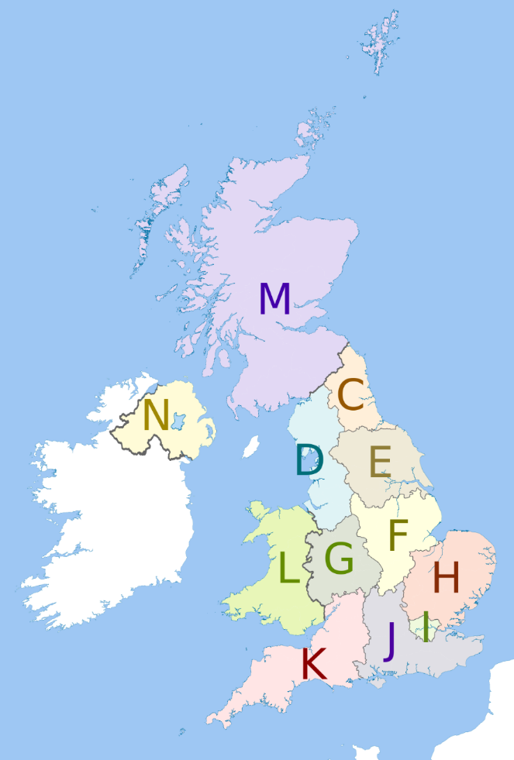
Wind output and value/MW vary with location and hourly

Slide 11
Is the answer nodal pricing (LMPs)?
Energy Systems Catapult argues for nodal pricing
Ofgem: reviewing network charges since 1990
Project TransmiT 2008
Targeted Charging Review 2019
Response to distorting “embedded benefits”
Network Access and Forward-Looking Charges
reduce connex charges, standardise non-firm access
TNUoS Call for Evidence - Next Steps 2022
NGESO Network Options Assessment: rising constraint costs
Locational energy pricing in the GB power market

Slide 12
What is nodal pricing (LMP)?
Locational Marginal Price = cost to deliver 1 extra MW to a node
= Energy cost + congestion cost + marginal loss
Proven in US, NZ, Peru, Texas,… for decades
Payback in moving to LMP < 2 years in large systems
Requires Central optimal security-constrained dispatch
for a sufficient fraction to give reliable LMPs
Recomputed up to dispatch (at 5 min resolution)
PJM introduced over weekend. Harder part is setting up central dispatch
Removes need for redispatch and balancing
But requires suitable hedges
D Newbery
12

Slide 13
Flawed arguments against LMP
Market power: inc-dec game => collapse of PJM=> LMP
=> Automated mitigation, long-lived complex offers reduce incentive to manipulate bids
Barriers for unlocking flexibility
local DSR encouraged by opting in to LMPs
Market liquidity
Churn > 3.6 for US RTO/ISO systems seems adequate
Investment risk
Need good hedging instruments – required anyway to reduce costs
Complexity
PJM clears 11,000 nodes, EUPHEMIA struggles with 40
Problem on linear pricing, rapid computational advances allow rapid solution
Locational price differentiation
Already exists in GB with no obvious objection
Consumer default is zonal average LMPs (as at present)
Eicke & Schittekatte, 2022
D Newbery
13

Slide 14
Guiding location decisions: two approaches
Current GB system: set TNUoS each year; generation chooses location
TNUoS based on zonal average shadow LMPs
Minor change:
NG (FSO?) predicts least system cost entry by node to plan network expansion and resulting future (shadow) hourly LMPs
Offers long-term tradable TNUoS contracts based on technology-specific predicted (shadow) hourly output-weighted LMPs
Nodal TNUoS = hub TNUoS less NPV of future LMPs
effectively decides what strong signals to send now on where to locate each technology
Or could offer non-firm access for defined periods (as in island of Ireland)
Radical changes
LMPs, ESO offers Financial Transmission Rights (FTRs) for incumbents
Create Independent Network Design Authority (INDA)
Secures consents for best sites for entry and network expansion
Sites auctioned at optimal date for connection and output contract
need long-term TNUoS contract as above for single renewables auction price
D Newbery
14

Slide 15
Reforming VRE support
Aim: minimise cost of finance while ensuring market responsiveness
Pay for capacity not output for efficient location choice and cheaper finance
Costs are up-front, running costs independent of market prices
Efficient network access charges guide efficient location
Efficient spot prices guide output (when not to generate)
good hedging contracts reduce risk and cost
Designing long-term low-risk VRE contract
Current VRE contracts pay fixed price s for metered output
Standard CfD independent of output
=> Generate if price>variable cost, not if not (buy cheaper from the market)
=> Make contracted amount = forecast output/MW of wind/PV
Limit number of full operating hours to remove location distortion
E.g. 40,000 MWh/MW
Self or mandated curtailment – still paid if forecast potential output positive
Auction to determine strike price s for new contracts
Newbery
15
Notes:
Capacity markets are market wide payment mechanisms
Strategic Reserves are targeted on certain plant

Slide 16
Reform sequencing
Immediate (low hanging fruit):
Yardstick CfDs for RES at the next auction round
need to be compatible with future LMPs
long-term TNUoS contracts for all new connections
with suitable charges for VRE based on forecast (shadow) LMPs
existing connections can be offered longer-term contracts or current system
allow on-shore wind in England and Wales – as already in Scotland, NI
Longer term:
Introduce LMPs and central dispatch
FSO/INDA plans for least cost expansion of all technologies
charged to find acceptable sites for on-shore wind
lower priced electricity to local area, districts compete over benefit share
auction sites with permits
D Newbery
16

Slide 17
Conclusions: market design
Zero carbon electricity: high capital cost, low variable cost
Long-term hedges to lower finance cost (missing futures markets)
Hedges: cover independent of actual output => respond to market
=> CfD with FiT for VRE needs change
capacity not output support to hedge up-front costs for low WACC
better location and dispatch signals guided by market, not support, prices
hedge set not by metered output but forecast output (yardstick pricing)
contract specified for full operating hours, not years
Long-term TNUoS contracts on forecast LMPs
FTRs plus grandfathering for smooth transition and hedging
Move to LMP or equivalent and voluntary central dispatch
Coordinate generation and transmission location/timing
D Newbery
17

Slide 18
References and spare slides
David Newbery, EPRG,
University of Cambridge
CEEPR & EPRG European Energy Policy Conference
Brussels
1st September 2022

Slide 19
References
BEIS, 2020. Generation Cost Report, at https://www.gov.uk/government/publications/beis-electricity-generation-costs-2020
BEIS Review of Electricity Market Arrangements: Consultation Document at https://www.gov.uk/government/consultations/review-of-electricity-market-arrangements
Eicke, A. & T Schittekatte, 2022. Fighting the wrong battle? A critical assessment of arguments against nodal electricity prices in the European debate, MITEI-WP-2022-01
Newbery, D., 2021. National Energy and Climate Plans for the island of Ireland: wind curtailment, interconnectors and storage, Energy Policy 158, 112513, 1-11. https://doi.org/10.1016/j.enpol.2021.112513 also EPRG WP2020 at https://www.eprg.group.cam.ac.uk/eprg-working-paper-2020/.
Newbery, D., 2021. Designing efficient Renewable Electricity Support Schemes, at https://www.eprg.group.cam.ac.uk/eprg-working-paper-2107/
Newbery, D., 2020. Club goods and a tragedy of the commons: the Clean Energy Package and wind curtailment, at https://www.eprg.group.cam.ac.uk/eprg-working-paper-2036/
D Newbery
19

Slide 20
Acronyms
CfD: Contract for Difference
CRM Capacity Remuneration Mechanism
ESO Electricity System Operator (separated from Nat Grid, thus NGESO)
FiT: Feed-in Tariff
FSO Future System Operator – publicly owned evolution fromESO
FTR Financial Transmission Right
INDA Independent Network Design Authority
LMP Locational Marginal Price
LT Long term
OWF Off-shore wind farm
PJM Pennsylvania-New Jersey-Maryland interconnection (now wider)
REMA: Review of electricity market arrangements
RTO Regional Transmission Operator (as in US)
SEM: Single electricity market of the island of Ireland
TNUoS Transmission Network Use of System
VRE: variable renewable electricity
WACC: weighted average cost of capital
Notes:
20

Slide 21
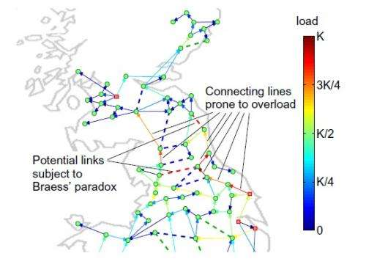
Efficient transmission investment not financeable by LMPs
Persistent nodal price differences indicate value of grid reinforcement
Congestion revenue does not cover optimal expansion – economies of scale/network effects
Braess paradox – adding apparently profitable link can increase total congestion
need system designer
https://phys.org/news/2012-10-power-grid-blackouts-braess-paradox.html
D Newbery
21

Slide 22
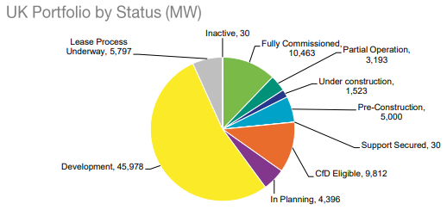
Off-shore “pipeline” claimed at 86 GW
excluding plant operating, actual pipeline is 68 GW, of which 56 GW are in planning, under development or yet to secure a lease

Slide 23
Silly ideas
BEIS “we are exploring reforms that move away from marginal pricing. These options are novel, and in some instances only theoretical” (see objections on BEIS p67)
UCL/OUIES has been pushing “Two-market” solution
for “on-demand” or “as available” (VRE) power
consumers buy each separately (two meters)
Supposed to be consumer-led and drive innovation (!)
But: high transaction costs,
loses economies of integration
Raises WACC, unlikely to deliver required investment
BEIS: “splitting the market could potentially enable all types of investors to recoup their costs through market revenues alone (though a mechanism to ensure security of supply is likely to continue to be needed indefinitely) (?!!)
Good contract design can provide these claimed benefits at lower cost
D Newbery
23

