Slide 1
Rethinking Electricity Market Design and Pricing
Richard Schmalensee
CEEPR & EPRG European Energy Policy Conference
September 1, 2022

Slide 2

MITEI’s Future of Energy Storage study (released in May) explored the potential roles of energy storage in future decarbonized power systems. There are three main messages from the study: 1. Federal R&D policy should focus on long-duration storage technologies to support affordable, reliable future electricity systems. 2. Storage can make regionally-tailored, net-zero electricity systems affordable. 3. Market designs and regulatory policies need to be reformed to enable equitable & efficient decarbonization. I’ll focus on #3, with an emphasis on retail pricing

Slide 3
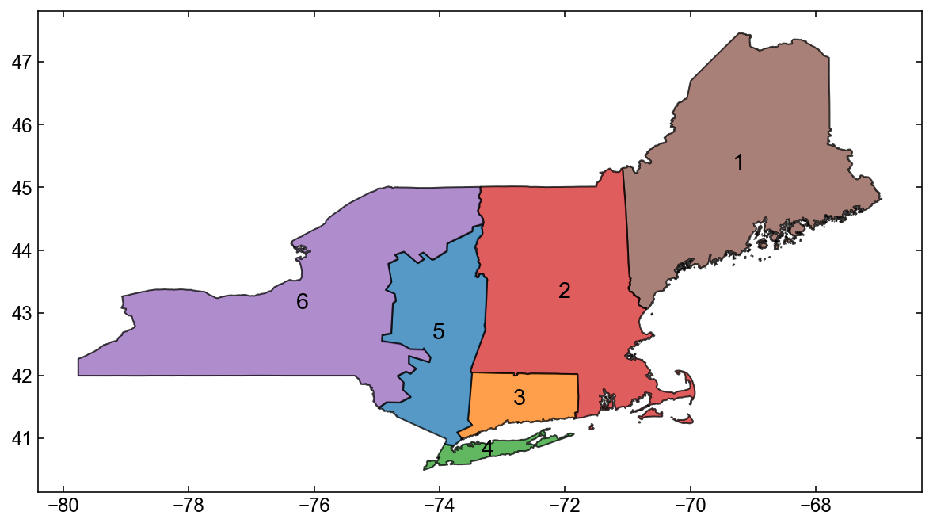
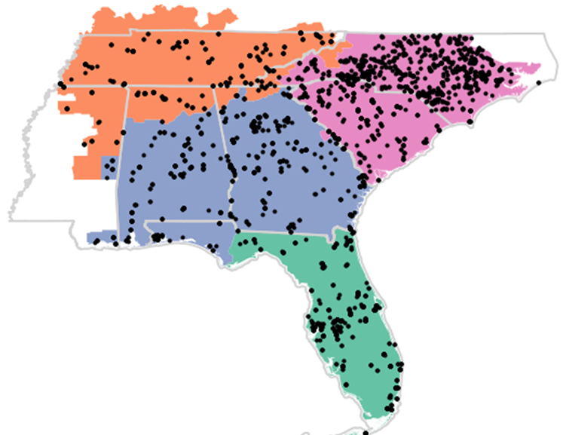


The FoES study modeled carbon-constrained, mid-century power systems in three US regions: jointly optimized capacity, hourly operation
U.S. Northeast
U.S. Southeast
Texas
U.S. Regions
Grid CO₂ emissions intensity (2018)¹:
232 gCO₂/kWh
392 gCO₂/kWh
482 gCO₂/kWh
Used a wide range of technological, cost, and policy assumptions, including
CO₂ emissions intensity limits ranging from 50 gCO₂/kWh to 5 gCO₂/kWh
Projection of substantial increase in hourly electricity demand consistent with a highly electrified economy
Simulated hourly solar PV and wind capacity factors for seven weather years
Continued cost reductions for VRE and Li-ion storage by 2050; modeled impact of other technologies
Continued availability of existing zero-carbon supply (e.g. nuclear in Southeast, hydro in Northeast), natural gas + CCS
Perfect foresight assumed throughout. No tractable alternative, but may understate the value of storage
Data from Independent System operators and EIA State Electricity Profiles
3

Slide 4
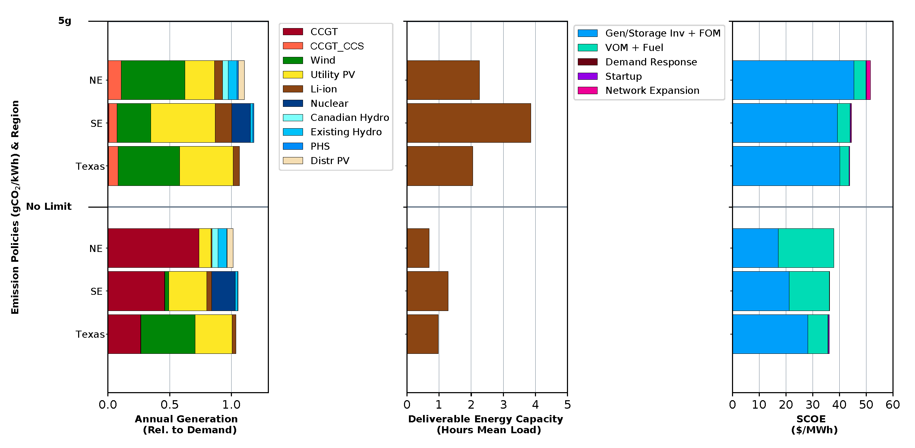
2050 Scenarios
Optimization modeling for the FoES study suggests near-complete decarbonization of these three major US regions by mid-century is feasible without sacrificing reliability or incurring significant cost penalties using VRE and Li-ion storage – and a little gas
Annual generation mix
System cost of electricity

Slide 5
System cost of electricity (SCOE) in 2050
Northeast
Texas
Emerging Long-Duration energy storage (LDES) technologies could moderately reduce the cost of getting to near zero; greater cost benefits at zero, when gas cannot be used at all.
Scenarios with LDES
CO2 emissions intensity (gCO₂/kWh) & storage technologies
Scenarios with LDES
BC= Li-ion only
L = Li-ion
R = Redox flow battery
Th = Thermal
Ma = Metal-air
H2 = Hydrogen
Notes:
Add legend for L, L+R, BC, …
LDES
In the 2050 scenarios, in absolute terms, the deliverable storage capacity of installed Li-ion batteries corresponds to 167–639 GWh in the 5 gCO2/kWh case across the three regions. Footnote 17 in chapter 6.
Footnote 20 notes the 797-1307 GWh of deliverable storage capacity is deployed in the 0gCO2/kWh case. Note 1 TWh for these three regions ~ 2.5 TWh by scaling with population. Do I need to multiply by 3 to account for the three regions?

Slide 6
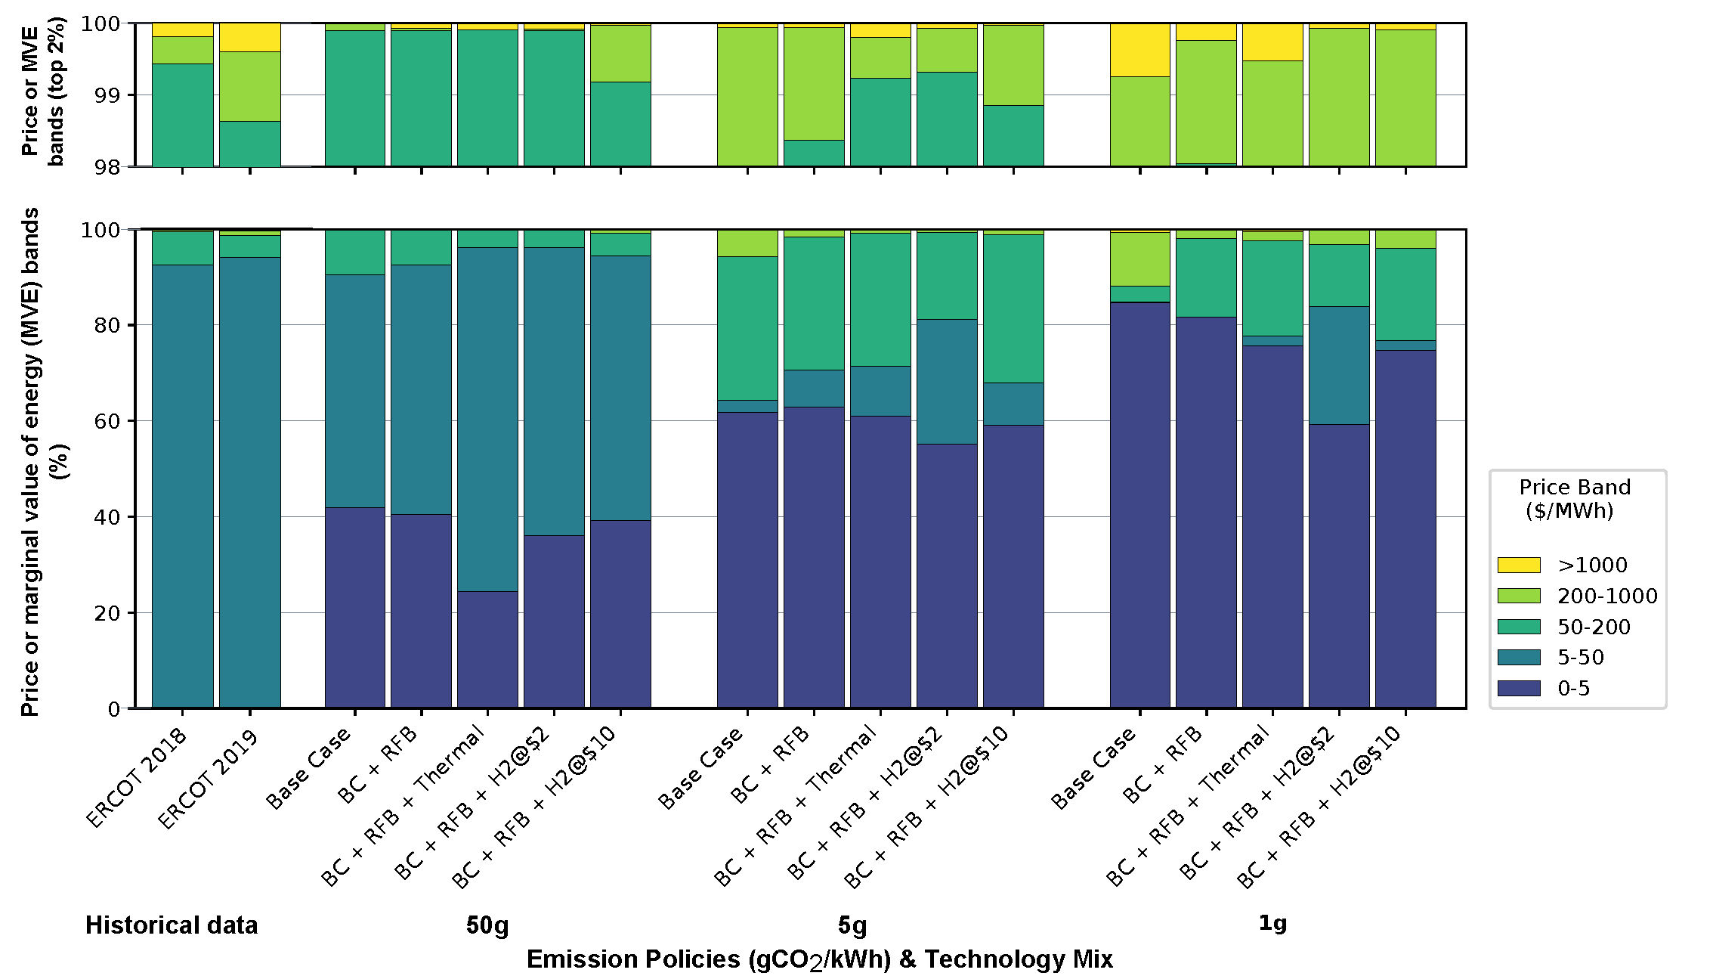
A Very Robust Prediction: Decarbonized 2050 Energy-Only Spot Prices will be MUCH More Volatile than Today’s Spot Prices
Optimization ≈ an energy-only market; the shadow price on supply ≥ demand ≈ the spot energy price.
VRE capacity substitutes for storage, so curtailment is often efficient => zero spot energy price
Figure: actual spot price distributions in ERCOT v. various simulated 2050 distributions
For any available technologies, more near-zeros as carbon constraint tightens & less gas is allowed
To cover higher investment costs, need more frequent high prices than today (Figure) or capacity payments
Longer-duration technologies tend to reduce the incidence of high prices but not eliminate them

Slide 7
Market Design Problems Posed by Greater Variability of Efficient Spot Prices
Energy-only markets without price caps would be lots riskier than at present, with most earnings in only a few hours: likely to be even less attractive than currently
Aggressive decarbonization goals in some US states plus inadequate carbon pricing likely to lead to more state intervention in electricity markets, especially as regards investment – hybrid systems
How to set price caps & how to manage markets for capacity/reliability or centralized procurement?
How to measure the contributions of VRE generation and, especially, storage to reliability?
How to integrate storage, generation, and transmission planning & investment?
How to reward capacity/reliability via contract without distorting spot energy prices?
How to efficiently integrate behind-the-meter generation & storage? A wholesale/retail problem
Paul and David will discuss some of the hard wholesale-level problems. I’ll focus on the retail level…

Slide 8
Retail Rate Problems Posed by Greater Variability of Efficient Spot Prices
Standard theory: for economy-wide efficiency all customers now and in the future should make electricity-related investment & operation decisions by optimizing against spot wholesale energy prices (RTP)
Fixed wires (& capacity?) costs should be recovered via differentiated fixed charges (or taxes?)
Increased price volatility means that (a) efficiency costs of time-invariant rates will be higher than now, but (b) real-time pricing will be even less attractive than now because of higher bill risk.
Real-time pricing (RTP) widely feasible now, and standard theory, with instantaneous optimization, price variation → higher utility. But no visible rush by small customers to RTP even for EVs. Why?
1) Optimization takes consumer energy, electricity is only about 2.5% of US household spending, and spot prices mostly don’t move much.
So the per-hour return from most optimization under RTP would be trivial – rational inattention?
2) Sometimes, though, particularly in markets with significant VRE penetration, prices spike in rare scarcity events, and inattention could be very costly!

Slide 9
Might Time-of-Use (TOU) Pricing be an Attractive Compromise?*
For fully rational, attentive consumers, efficiency losses if TOU prices don’t track spot prices
And ρ[TOU prices (prior years’ spot prices), current year’s spot prices) generally very low
But today, ρ mainly reflects scarcity events; adding them to TOU (via “real-time CPP”) helps a bit
*Ongoing research with Tim Schittekatte, Dharik Malapragada, and Paul Joskow.

Slide 10
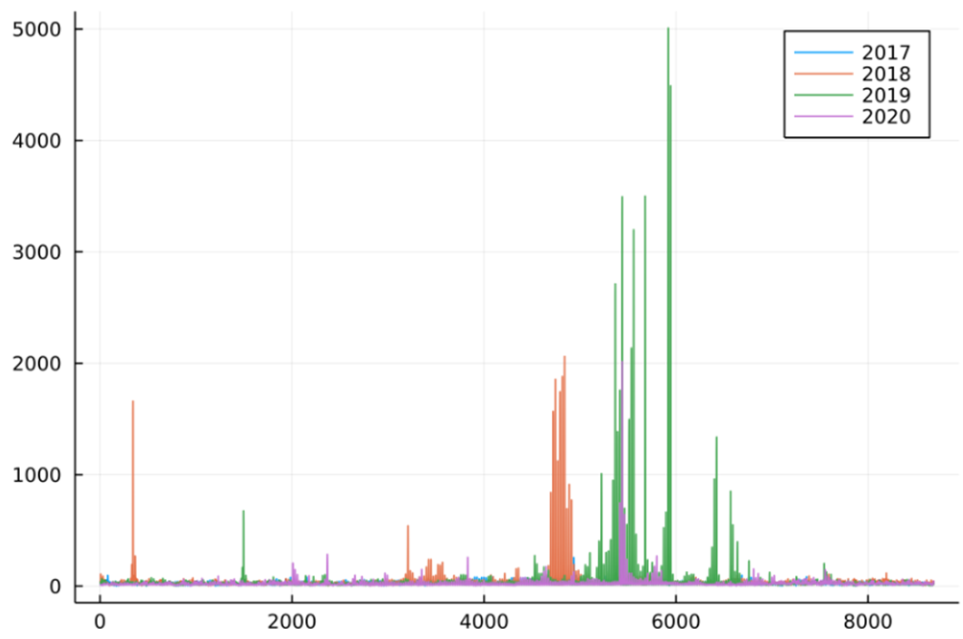
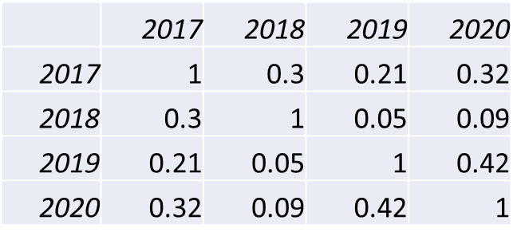
Spot Energy Prices in ERCOT, 2017-2020: Spikes, Low Year-to-Year Correlations
Scarcity events mainly in June & July, but much year-to-year variation in timing
Scarcity events drive year-to-year correlations, variation → low correlations
Dropping scarcity events (defined by price) raises correlations substantially
Same patterns for CAISO (mainly solar) as for ERCOT (mainly wind)

Slide 11
What TOU Prices, What Criteria?
For boundedly rational consumers, the main question is whether TOU gives incentives for intra-day demand shifting in the efficient direction. Magnitudes may matter less – e.g., Bell System 9pm discount
Responding to stable TOU pricing is easier than to RTP – can set routines for, e.g., EV charging rather than optimizing against day-ahead spot prices every day.
To properly evaluate TOU pricing, have constructed best simple tariffs – 3 or 4 periods, weekday/weekend, 4 seasons – constructed based on a few prior years data
For evaluation, can add scarcity event prices to simulate demand reduction from real-time CPP
To see if TOU pricing generally induces shifting in the right direction, one metric is intra-day rank correlation[best simple TOU prices (prior years’ spot prices), year t spot prices].
Have also constructed an activity-based model of cost of & limits on load shifting; can compare cost savings induced by TOU + CPP pricing with optimal cost savings from RTP pricing.

Slide 12
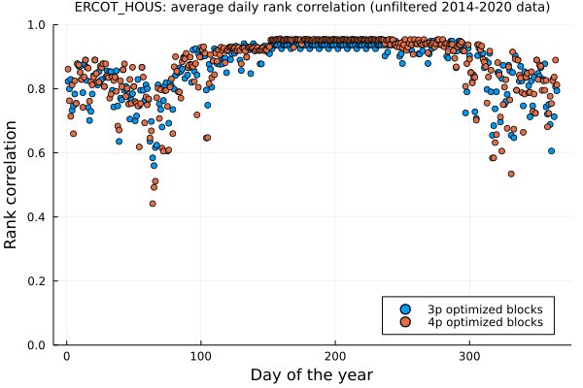
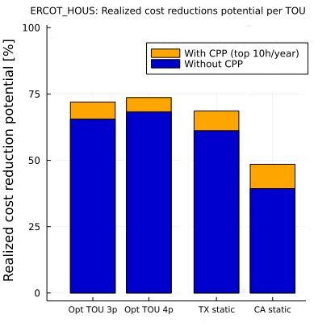
TOU+CPP typically implies directionally efficient demand shifting, especially when load is high
In addition, simulated demand shifting induced by TOU+CPP typically yields 50-75% of first-best cost reduction potential

Slide 13
Back to the Future: How to Encourage Efficient Electrification ca. 2050?
Consumers must see marginal energy prices for all uses that generally reflect spot wholesale prices (esp. low ones!), but bill risks must be kept to politically tolerable levels despite MUCH more variable spot prices
Wires costs & other fixed costs must not be recovered via per-kWh charges; use fixed charges or taxes
Role of and possible limits on retail competition are open questions…
Classic Hedging: Suppose a customer can buy quantities Q^{H}(t) at prices P^{H}(t) (best simple TOU prices?) in advance for T hours. If actual period t demand is Q(t) and spot price is P(t), cost = P[Q – Q^{H}] + P^{H}Q^{H}
No bill risk if Q^{H} is feasible, but opportunity to do better if P ≠ P^{H} – esp. in scarcity events
Might work for large customers with predictable, stable demand, low cost of monitoring spot price
Complexity of choosing Q^{H}(t) vectors & costs of monitoring spot prices too much for small customers?
Hedging monthly average price can cut bill risk, but hard to get hourly demand incentives right

Slide 14
Suppose TOU+CPP Prices Work as Well in 2050 as Today (Speculation!)
TOU+”CPP”: Unhedged consumers face best simple TOU prices except in declared scarcity events.
Without insurance: In scarcity events they face the wholesale spot energy price. Might rule this out?
With insurance: for a fixed charge depending on P* & recent load profiles and acceptance of automated load control during scarcity events, they pay no more than P*. No reason not to have multiple P*s, competition here?
With real consumers, can’t expect optimal response from all at all times; looking for best feasible & acceptable
This is all very speculative; not clear what will work for real consumers & policy-makers. The problem is important, and there is plenty of room for innovation and great need for experiments to test proposals.

Slide 15
Questions, Comments?

