Slide 1
Update Title, Name of Presenter, Date and Venue
Is nuclear power green?
Simon Taylor
EPRG, Cambridge Judge Business School

Slide 2
Agenda
Another “nuclear renaissance”?
Is nuclear green?
The greening of the finance industry

Slide 3
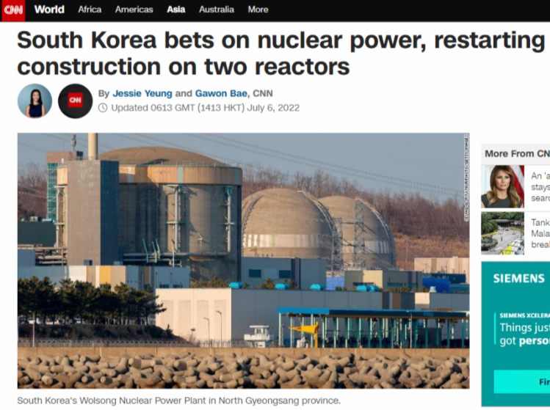
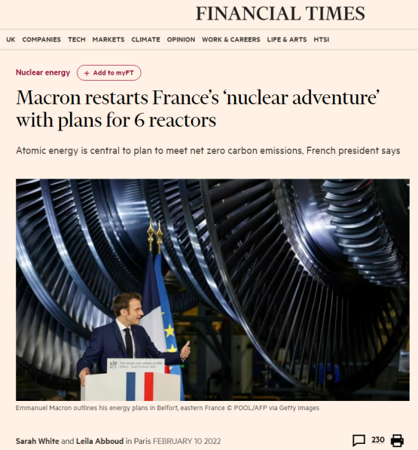
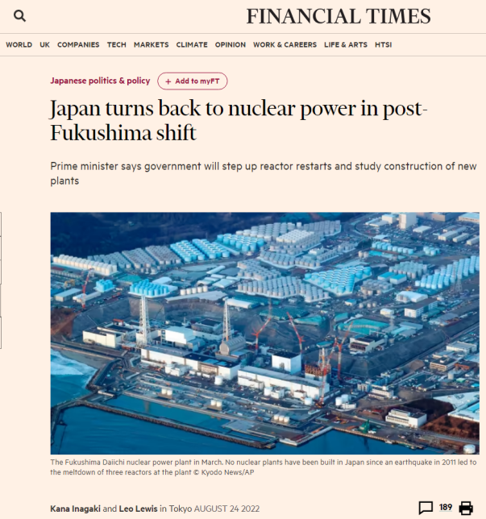
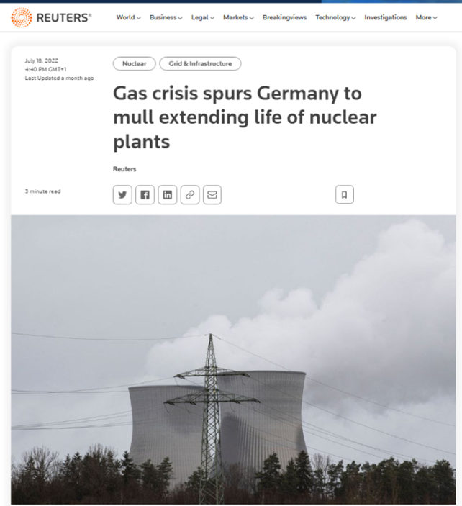
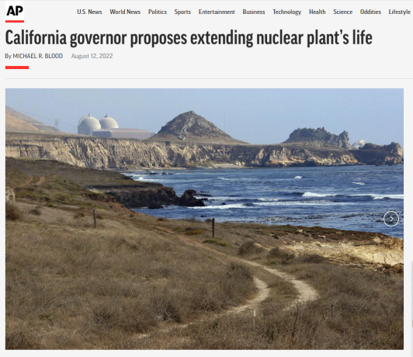
A new nuclear renaissance?

Slide 4
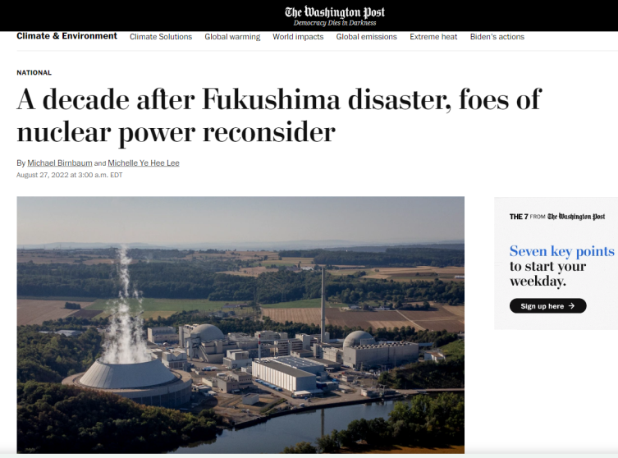
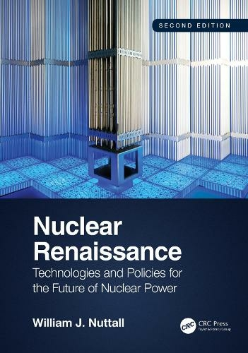
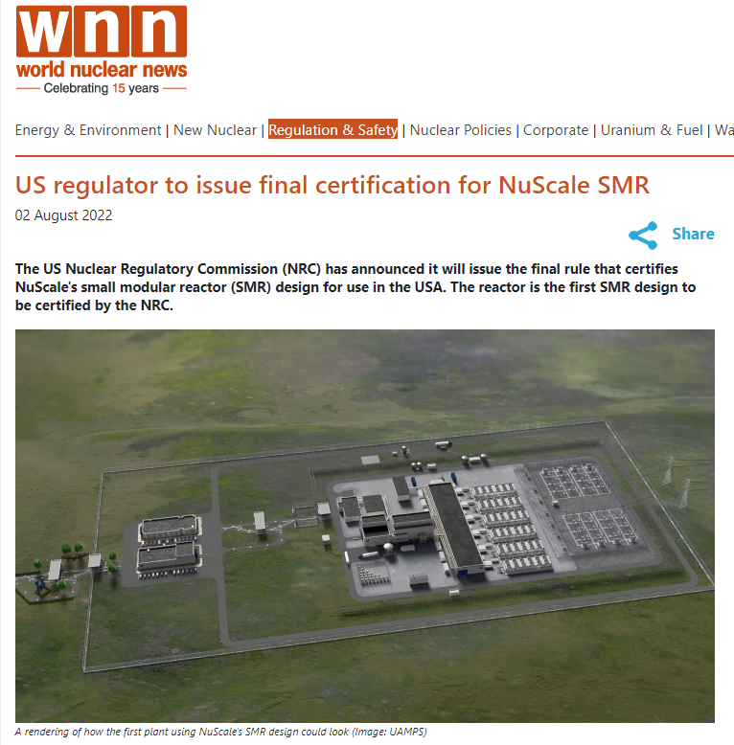
A new nuclear renaissance?

Slide 5
Most European nuclear countries are planning or building more reactors
Country | Nuclear share of electricity generation (%) | Policy status
France | 77 | One EPR under construction; at least eight more planned
Ukraine | 54 | New plants planned
Slovak Republic | 54 | New plants under construction; more planned
Hungary | 48 | New plants proposed
Belgium | 47 | Stable – no new stations planned; phase out originally in 2025 now put back to 2035
Switzerland | 38 | Stable – no new stations planned
Czech Republic | 37 | New plants proposed
Slovenia | 36 | New plant under consideration
Finland | 35 | Stable – one EPR close to finish; additional Russian reactor order now cancelled
Bulgaria | 34 | New plant proposed
Sweden | 30 | Stable – no new stations planned
Spain | 20 | Stable – no new stations planned
Romania | 19 | New plants planned
UK | 17 | Major expansion/replacement planned; one station under construction
Germany | 12 | Planned phase out nearly complete; hiatus possible
Netherlands | 3 | New plant under consideration
Poland | 0 | New plant contracted
Turkey | 0 | New plant under construction
Source: World Nuclear Association, author estimates https://world-nuclear.org/information-library.aspx

Slide 6
Nuclear and the energy trilemma
✓
Reliability
Affordability
Sustainability
X
?

Slide 7
Big nuclear remains costly
Nuclear costs remain high for big nuclear

Slide 8
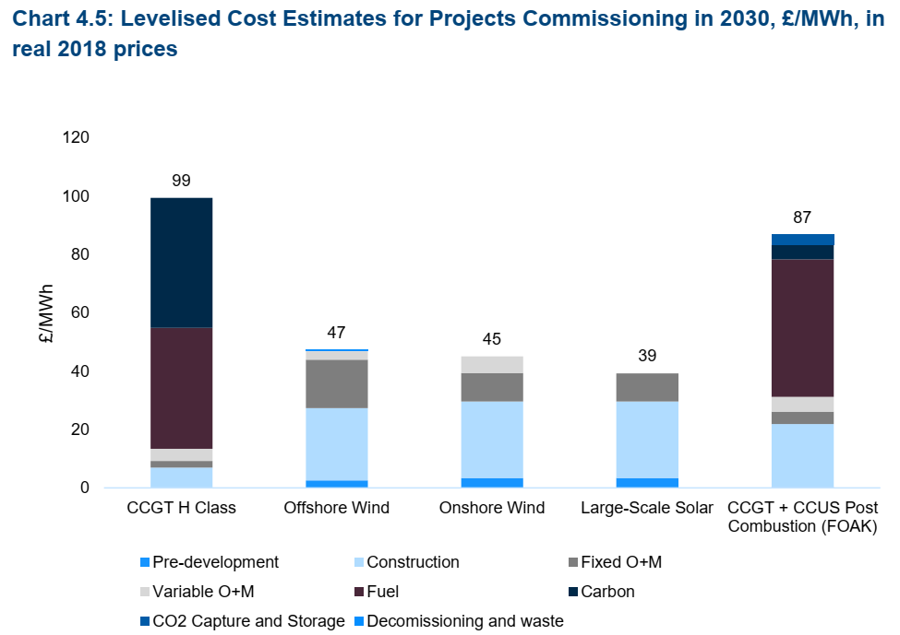
Can nuclear compete on cost?
Hinkley Point C
Sizewell C?
Source: UK Government (BEIS) August 2020 https://assets.publishing.service.gov.uk/government/uploads/system/uploads/attachment_data/file/911817/electricity-generation-cost-report-2020.pdf

Slide 9
Big nuclear remains costly
Nuclear costs/ quantum needed for big nukes
SMRs – let’s wait and see

Slide 10
The greening of finance
UN PRI
TCFD
NGFS
Green finance
ESG

Slide 11
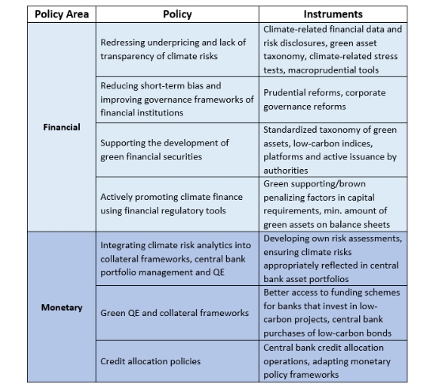
Financial policies can help with climate policy
IMF: policy tools for climate change mitigation (2019)
Source: IMF https://www.imf.org/en/Publications/WP/Issues/2019/09/04/Macroeconomic-and-Financial-Policies-for-Climate-Change-Mitigation-A-Review-of-the-Literature-48612?cid=em-COM-123-39373

Slide 12
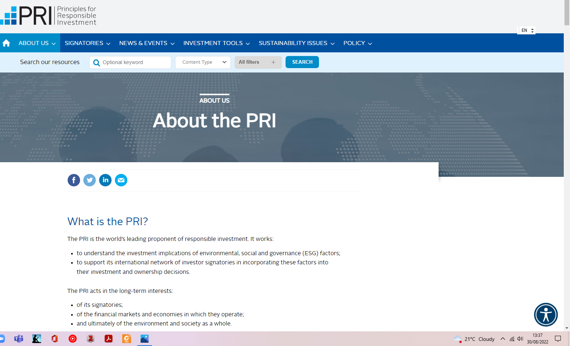
UN Principles for Responsible Investment

Slide 13
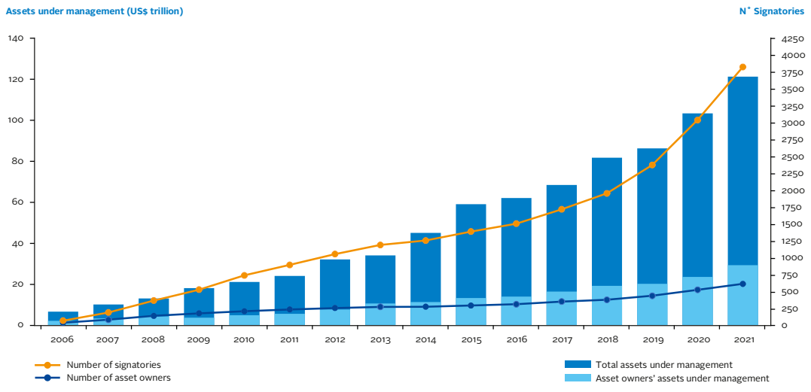
UN Principles for Responsible Investment
Source: https://www.unpri.org/download?ac=10948

Slide 14
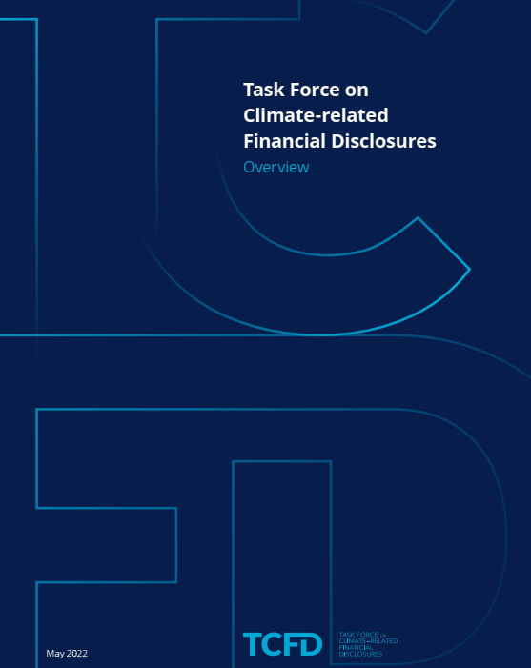
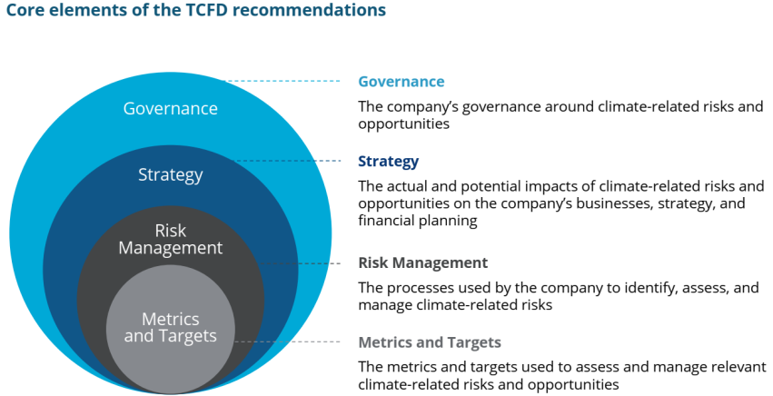
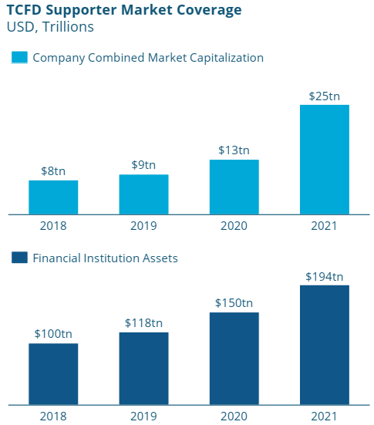
Task Force on Climate-related Financial Disclosures
Source: https://assets.bbhub.io/company/sites/60/2022/03/GPP_TCFD_Status_Report_2021_Book_v17.pdf

Slide 15
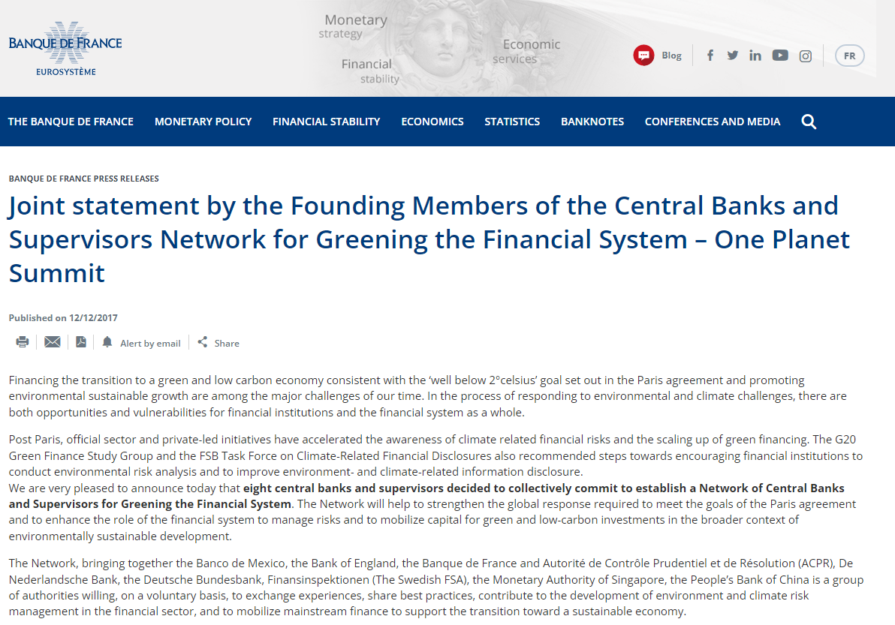
Network for Greening the Financial System
116 members (Central banks & regulators)
19 observers (IMF, OECD, World Bank)

Slide 16
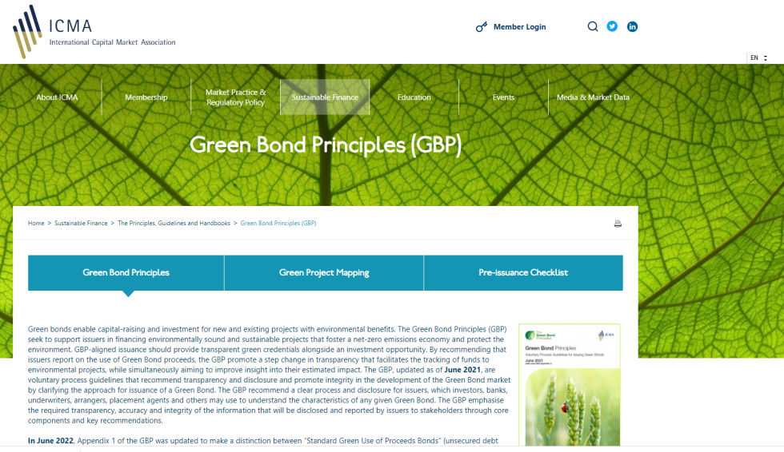

Green finance - debt
Debt finance
Bonds
Loans
Source: https://www.icmagroup.org/sustainable-finance/the-principles-guidelines-and-handbooks/green-bond-principles-gbp/
Source: https://www.lsta.org/content/green-loan-principles/

Slide 17
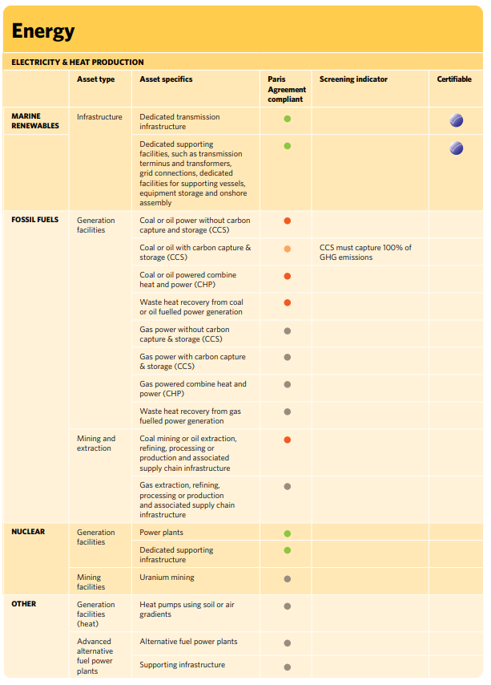
Climate Bond Initiative won’t certify nuclear as green
Source: Climate Bond Initiative Taxonomy https://www.climatebonds.net/files/files/Taxonomy/CBI_Taxonomy_Tables-08A%20%281%29.pdf

Slide 18
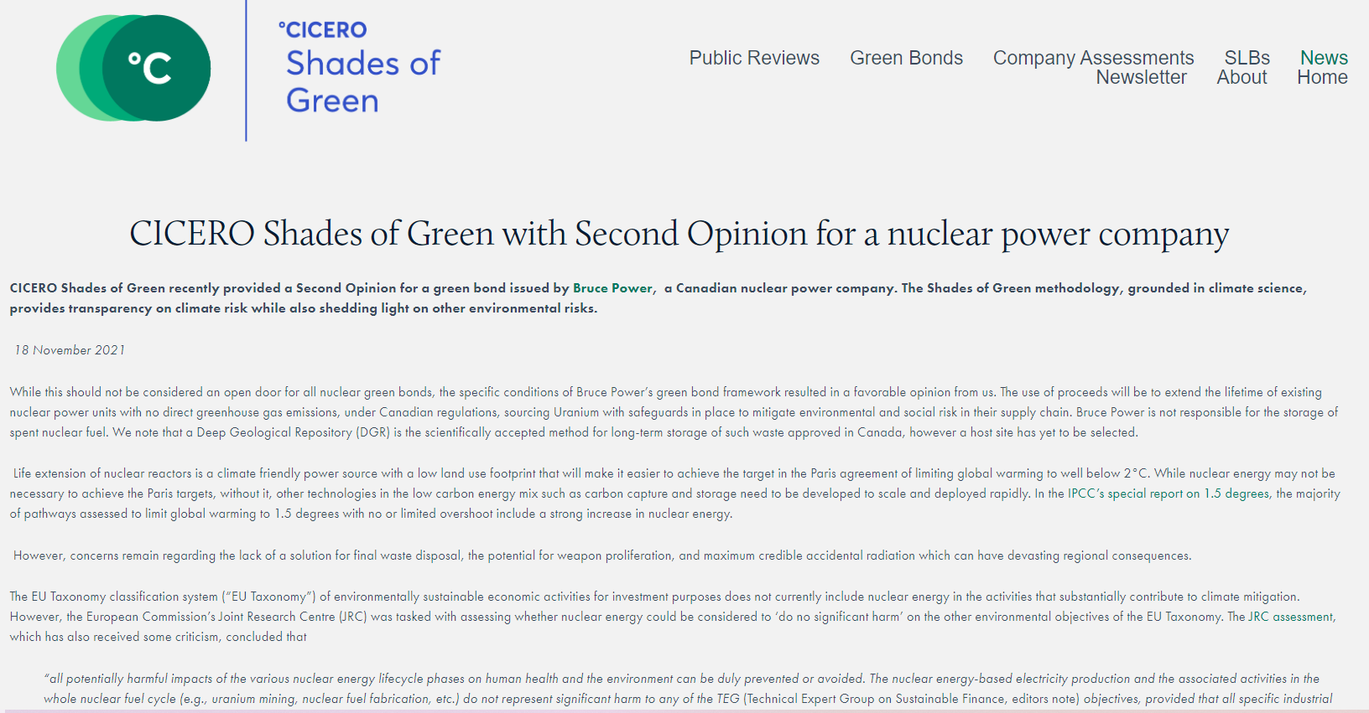
But a nuclear green bond has been approved by another certifier

Slide 19
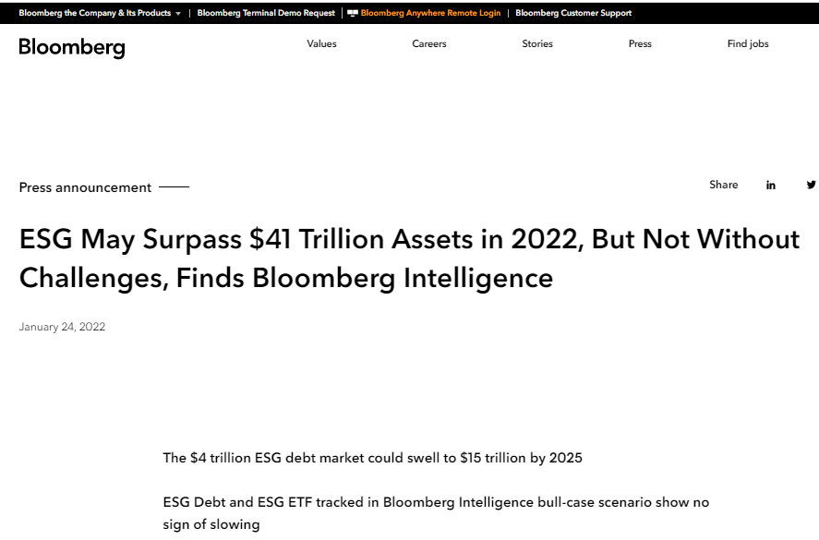
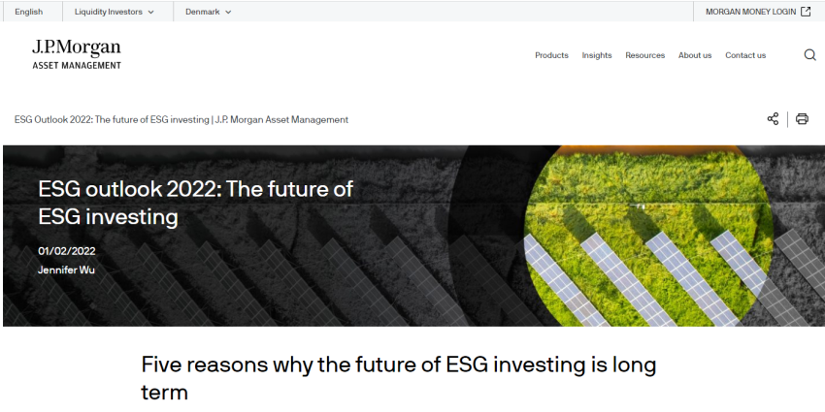
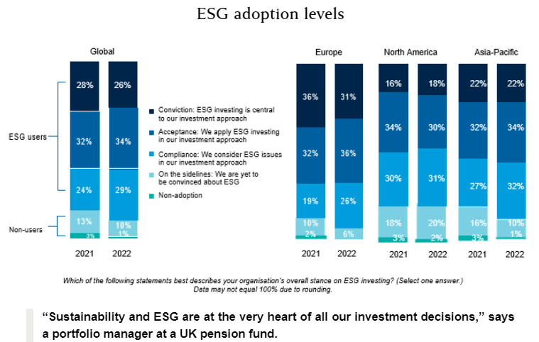
Equity investing: ESG
Source: https://corpgov.law.harvard.edu/2022/06/17/esg-global-study-2022/

Slide 20
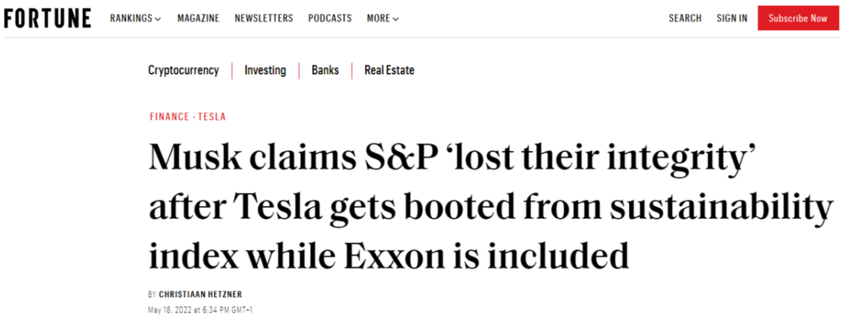
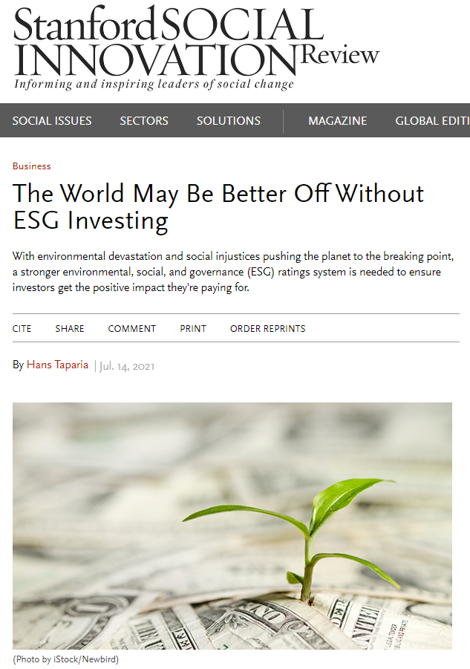
The ESG backlash is fully underway
Source: https://fortune.com/2022/05/18/tesla-sp-esg-index-exxon-elon-musk/
Source: https://ssir.org/articles/entry/the_world_may_be_better_off_without_esg_investing#

Slide 21
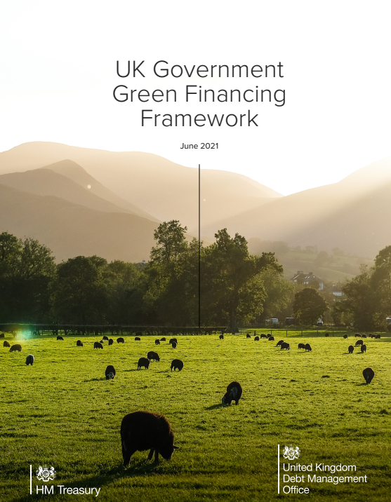
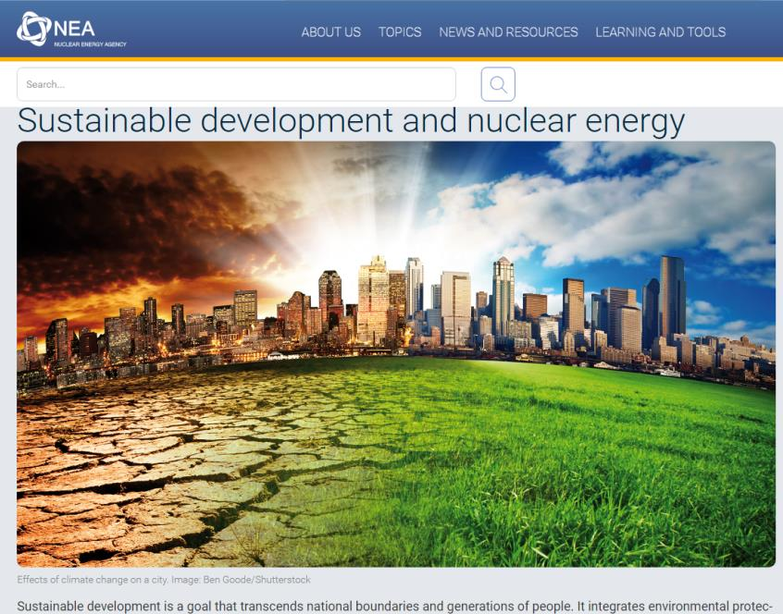
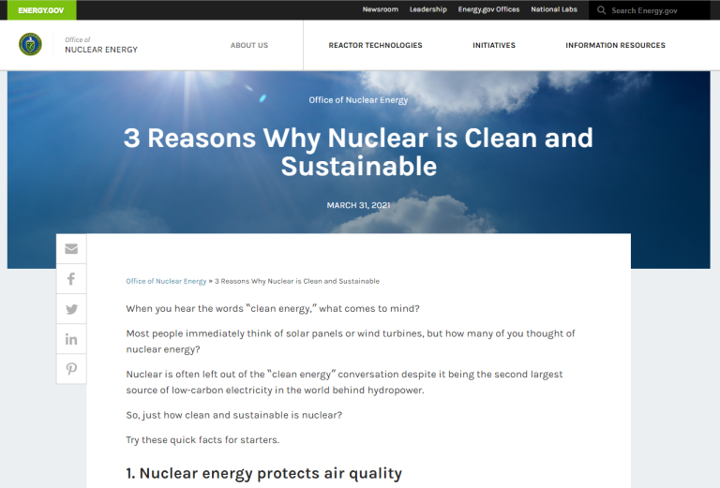
Government and other views
Source: https://www.energy.gov/ne/articles/3-reasons-why-nuclear-clean-and-sustainable
“Recognising that many sustainable investors have exclusionary criteria in place around nuclear energy, the UK Government will not finance any nuclear energy-related expenditures under the Framework.”
“The analysis of nuclear energy characteristics within a sustainable development framework shows that the approach adopted by the nuclear energy sector is generally consistent with the fundamental sustainable development goal of passing on a range of assets to future generations while minimising environmental impacts.”
Source: https://assets.publishing.service.gov.uk/government/uploads/system/uploads/attachment_data/file/1002578/20210630_UK_Government_Green_Financing_Framework.pdf
Source: https://www.oecd-nea.org/jcms/pl_33568/sustainable-development-and-nuclear-energy

Slide 22
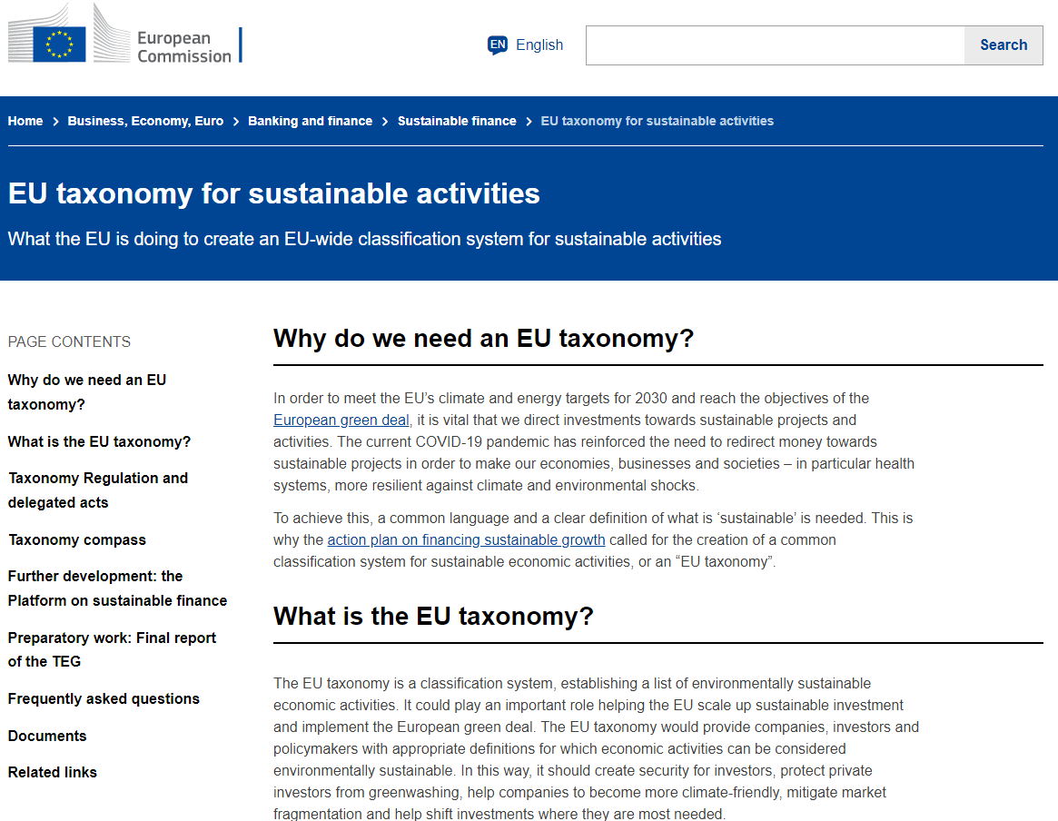
The EU: is nuclear “green”?
Source: https://ec.europa.eu/info/business-economy-euro/banking-and-finance/sustainable-finance/eu-taxonomy-sustainable-activities_en

Slide 23
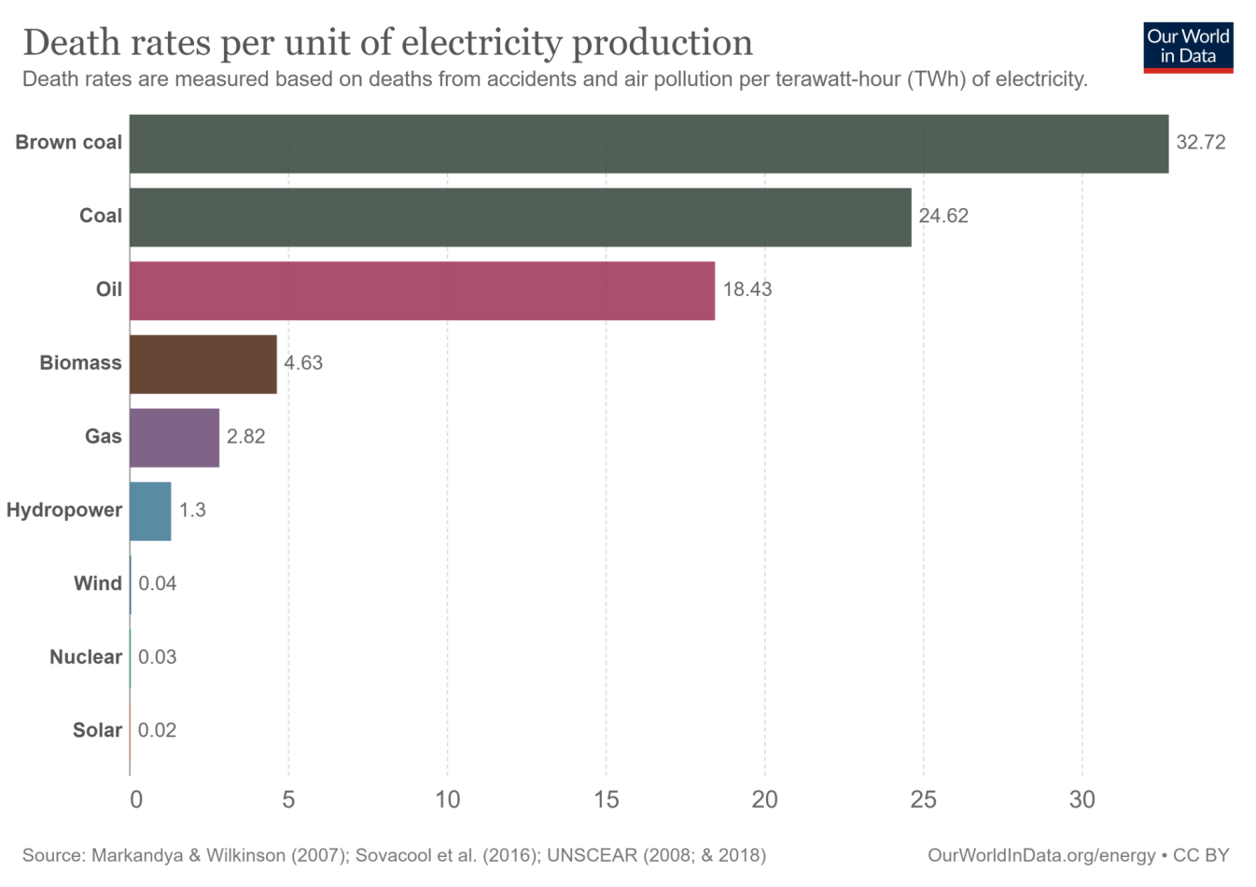
Is nuclear energy safe?

Slide 24
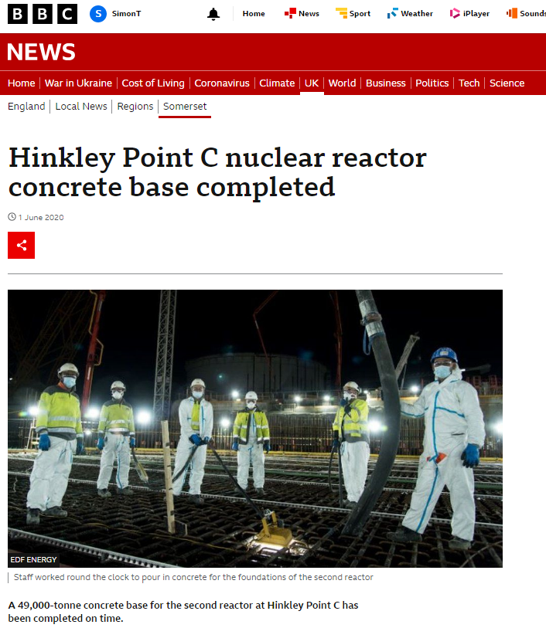
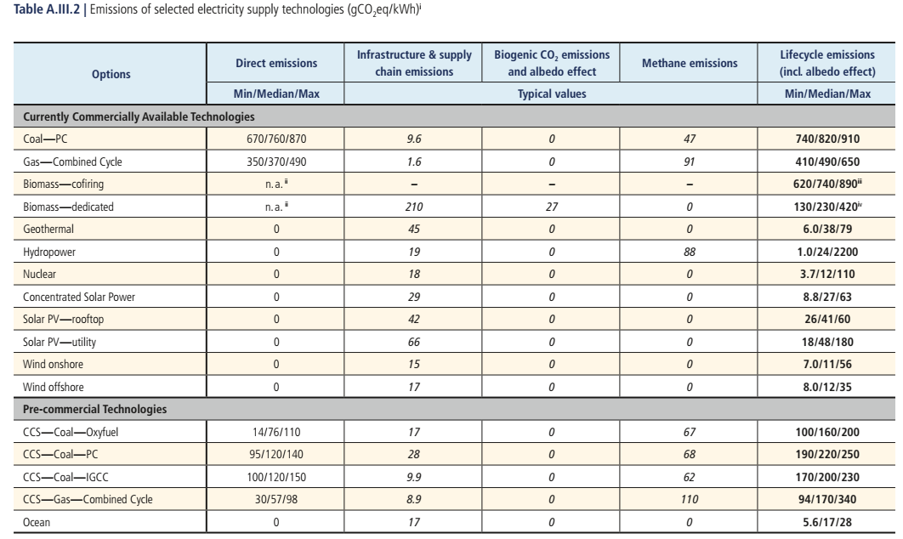
Is nuclear energy green?
Source: IPCC (2014) Annex III https://www.ipcc.ch/site/assets/uploads/2018/02/ipcc_wg3_ar5_annex-iii.pdf#page=7
Source: https://www.bbc.co.uk/news/uk-england-somerset-52882999

Slide 25
Is nuclear energy sustainable?
Annual uranium mining c.60,000t
Identified resources 8 mt
Source: Nikolaus Muellner, Nikolaus Arnold, Klaus Gufler, Wolfgang Kromp, Wolfgang Renneberg, Wolfgang Liebert,Nuclear energy - The solution to climate change?, Energy Policy, Volume 155,2021,112363, https://doi.org/10.1016/j.enpol.2021.112363.

Slide 26
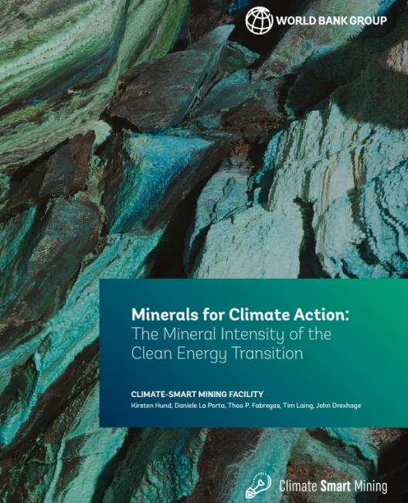
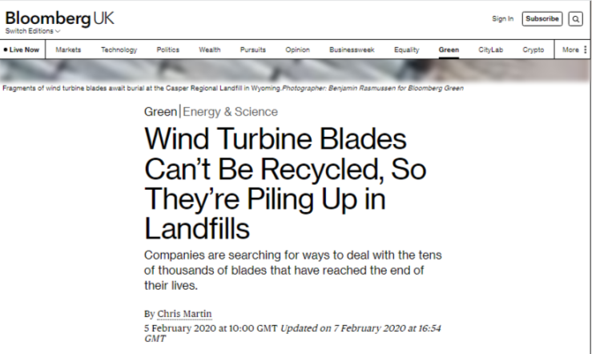
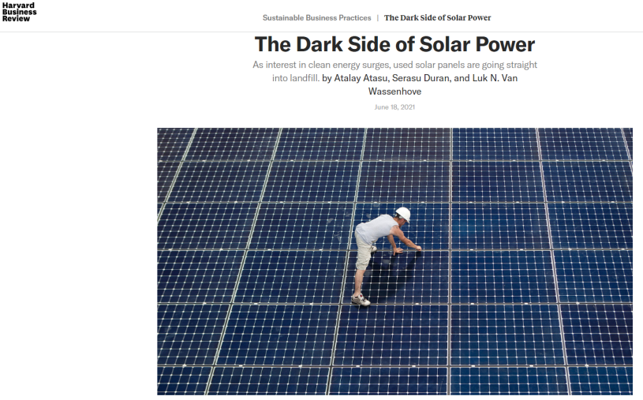
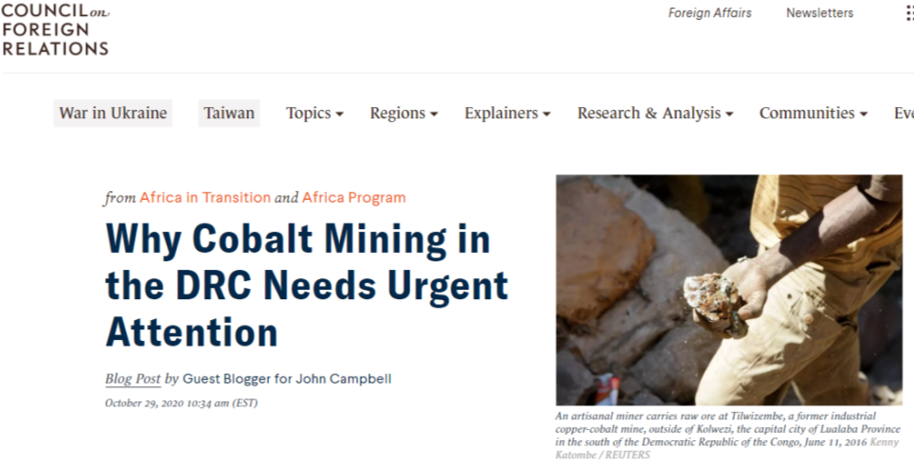
Problems with renewable energy
Source: https://www.bloomberg.com/news/features/2020-02-05/wind-turbine-blades-can-t-be-recycled-so-they-re-piling-up-in-landfills#xj4y7vzkg
Source: https://pubdocs.worldbank.org/en/961711588875536384/Minerals-for-Climate-Action-The-Mineral-Intensity-of-the-Clean-Energy-Transition.pdf
Source: https://hbr.org/2021/06/the-dark-side-of-solar-power
Source: https://www.cfr.org/blog/why-cobalt-mining-drc-needs-urgent-attention

Slide 27

Wind power and birds
“Every year, an estimated 75 to 110 Golden Eagles are killed by the wind turbines in the Altamont Pass Wind Resource Area (APWRA). Some lose their wings, others are decapitated, and still others are cut in half. The lethal turbines, numbering roughly 6,000, are arrayed across 50,000 acres of rolling hills in northeastern Alameda and southeastern Contra Costa counties.”
Source: https://goldengateaudubon.org/conservation/birds-at-risk/avian-mortality-at-altamont-pass/

Slide 28


Windfarms may not be the main problem here
Estimated annual bird deaths, by cause
Windfarms in Denmark
Cars in Denmark
Cats in the UK
Source: https://www.withouthotair.com/c10/page_64.shtml quoting Lomborg (2001)

Slide 29
Conclusion
Nuclear is gaining support on grounds of climate policy and reliability
Private financial investors may be able to accept the economic case..
..but it’s not clear if enough will buy the ESG case for nuclear.
The lack of clarity on what is “green” carries over to other areas of climate innovation (carbon capture and storage, direct air capture, fusion, climate repair, geo-engineering).

