Slide 1

Overcoming Political Opposition to Carbon Pricing Based on Economic Concerns: The Macroeconomic Effects of a Carbon Tax Gilbert E Metcalf MIT and Tufts University
CEEPR-EPRG European Energy Policy Conference
Brussels, Belgium
September 2022

Slide 2
Opposition to Decarbonizing the Economy
Two levels of opposition based on economic grounds
Sector specific losses from greening the economy (lost fossil fuel jobs, higher costs of energy)
General concern about its impacts on the economy
The first concern speaks to need for transitional assistance
The second concern is overblown
Emerging real-world evidence undercuts this second concern
Carbon pricing is not a job or economy killer

Slide 3
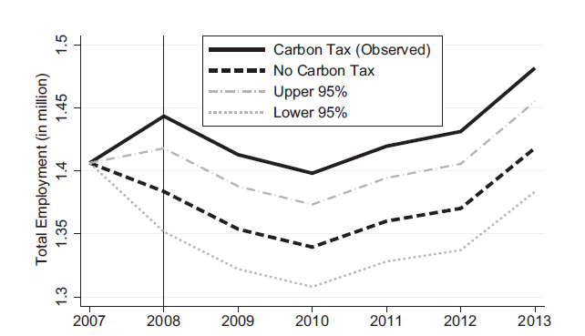
British Columbia Carbon Tax Employment Impacts
0.74 percent higher employment
Yamazaki (2017)

Slide 4
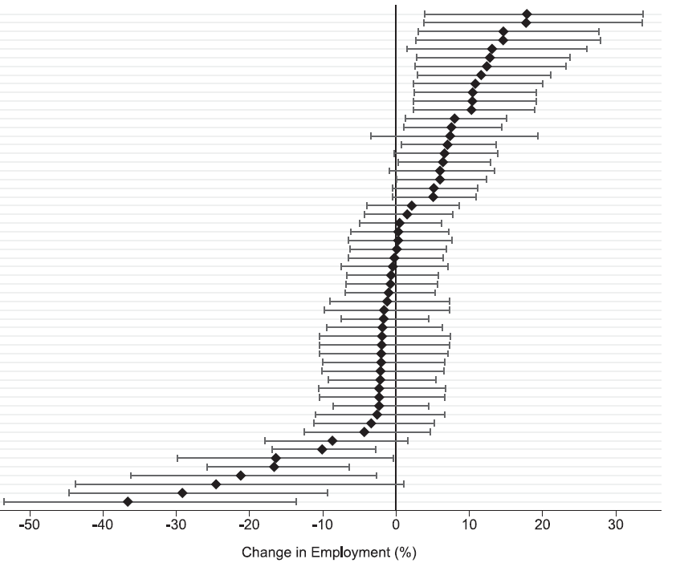
BC Carbon Tax: Sectoral Shifts
Low Carbon Intensity
High Carbon Intensity
Yamazaki (2017)

Slide 5
What is the Economic Cost of Carbon Pricing?
Analysis by Metcalf and Stock, “The Macroeconomic Impact of Europe’s Carbon Taxes,” American Economic Journal: Macroeconomics, forthcoming
Also, some discussion of mechanisms in Finkelstein Shapiro and Metcalf (2022), “The Macroeconomic Effects of a Carbon Tax to Meet the U.S. Paris Agreement Target: The Role of Firm Creation and Technology Adoption,” submitted

Slide 6
History and Coverage
Carbon taxes in 2018
Source: World Bank
https://carbonpricingdashboard.worldbank.org/
Country | Year of Adoption | Rate in 2018 (USD) | Coverage (2019)
Finland | 1990 | $70.65 | 0.36
Poland | 1990 | 0.16 | 0.04
Norway | 1991 | 49.30 | 0.62
Sweden | 1991 | 128.91 | 0.40
Denmark | 1992 | 24.92 | 0.40
Slovenia | 1996 | 29.74 | 0.24
Estonia | 2000 | 3.65 | 0.03
Latvia | 2004 | 9.01 | 0.15
Switzerland | 2008 | 80.70 | 0.33
Ireland | 2010 | 24.92 | 0.49
Iceland | 2010 | 25.88 | 0.29
UK | 2013 | 25.71 | 0.23
Spain | 2014 | 30.87 | 0.03
France | 2014 | 57.57 | 0.35
Portugal | 2015 | 11.54 | 0.29

Slide 7
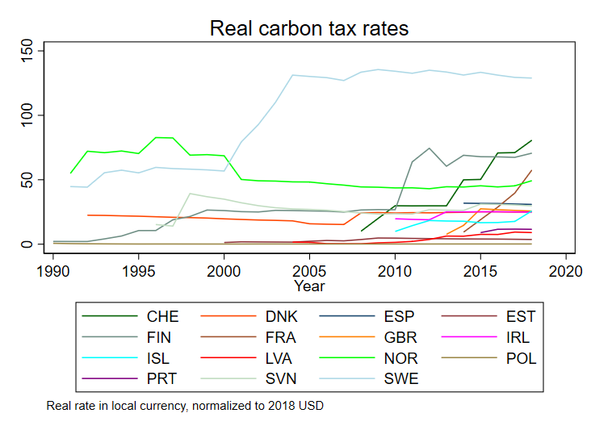
Evidence from European Carbon Taxes
Carbon tax history for the 15 countries with carbon taxes
Data source: World Bank (carbon price data in press)
Carbon tax rates are real local currency, scaled to 2018 USD using 2018 PPP
GDP growth: World Bank (except as noted below)
Metcalf and Stock (2020, NBER)

Slide 8
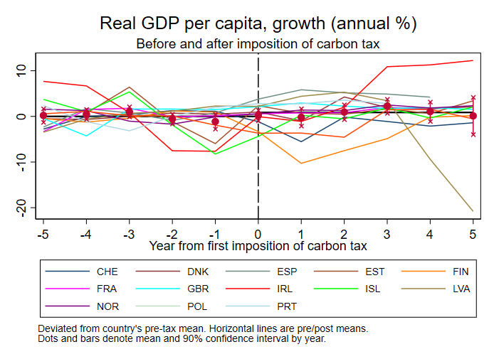
Data description – No Controls

Slide 9
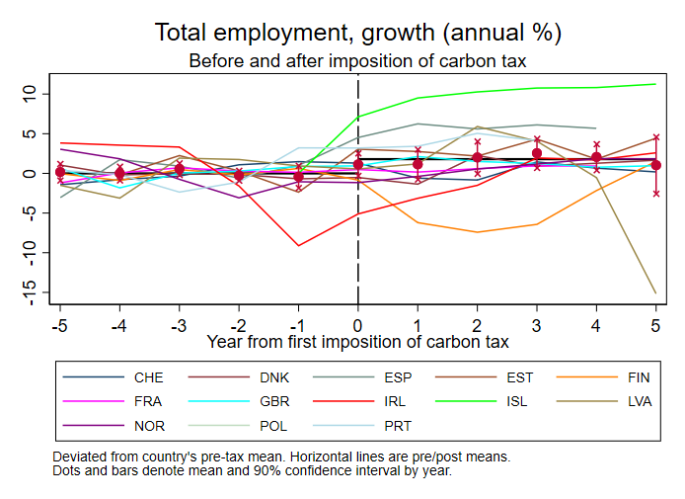
Data description – No Controls

Slide 10
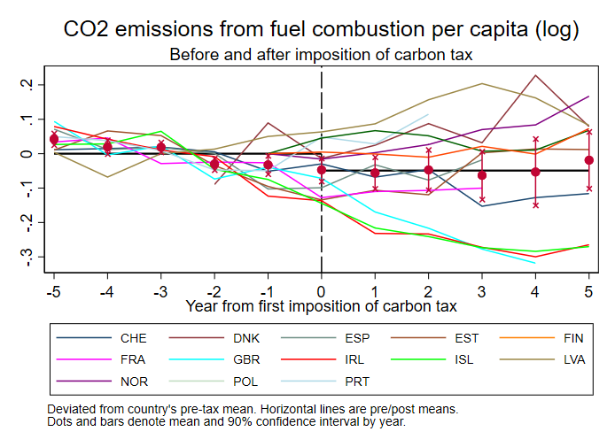
Data description – No Controls

Slide 11
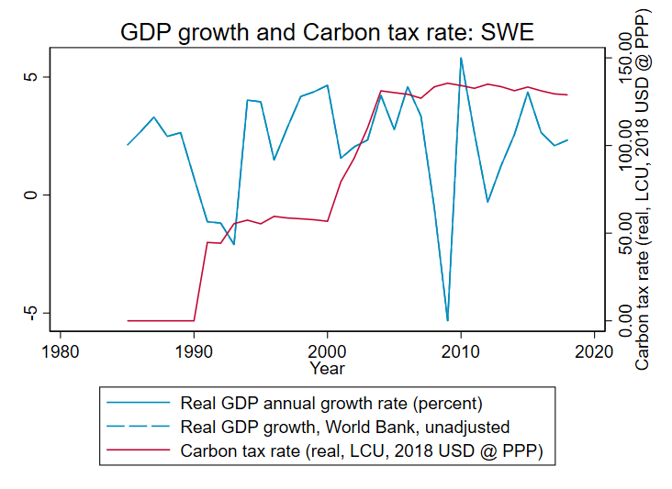
Case Study
Sweden

Slide 12
Metcalf and Stock Approach
Estimand: cumulative dynamic causal effect of change in tax rate on real variables
Two methods, one exogeneity condition (identifying assumptions)
Local projections (panel)
Exogeneity condition:
Note: is h-period ahead cumulative impulse response function in VAR jargon
Panel VAR: Same identifying assumption as LP
Restricted or unrestricted: Impose zero long-run effect on growth (restricted), or not (unrestricted)
Identification is coming from the time series variation: think “SVAR”, not “event study”

Slide 13
Methods – Additional Details
All regressions include country & year fixed effects
Carbon tax enters weighted by coverage share
Standard errors: heteroskedasticity-robust for SVAR and LP (Plagborg-Møller and Wolf (2019))
Effects calibrated to $40 carbon tax at 0% real increase; tax covers 30 percent of emissions
Tax innovations are solved from IRF of tax shock to tax rate IRF (Sims (1986) method)
4 lags of control variables used (base case)

Slide 14
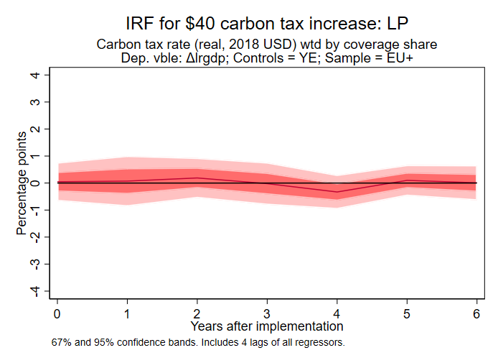
Empirical Findings Based on Statistical Analysis
Simulation of a $40 per ton carbon tax applied to 30 percent of emissions (average for EU)
Figure shows impact on GDP
Metcalf and Stock (2022)

Slide 15
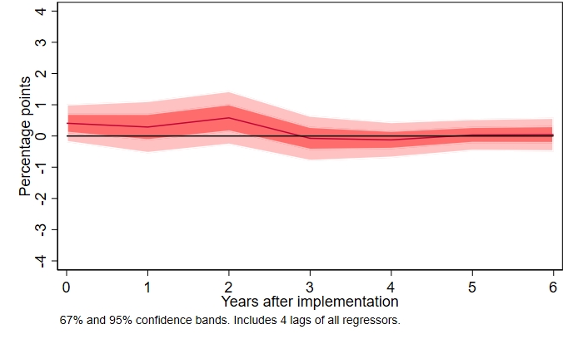
Employment Growth Impacts
Metcalf and Stock (2022)

Slide 16
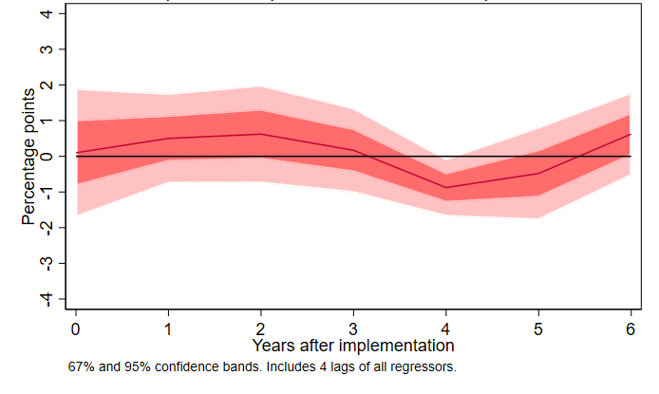
Manufacturing Employment Growth Impacts
Metcalf and Stock (2022)

Slide 17
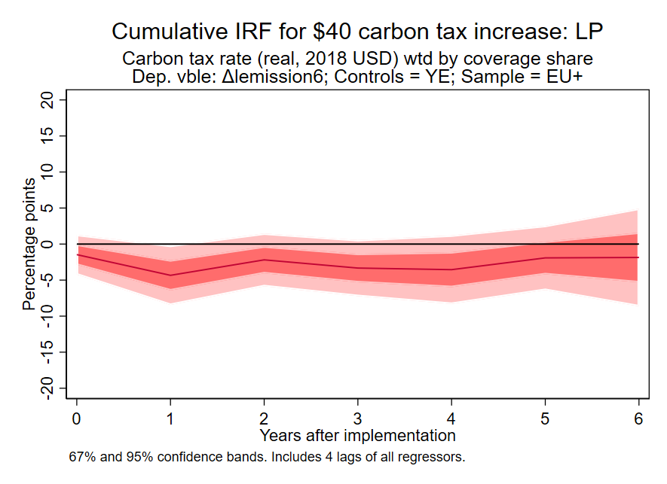
Emissions Impacts
Cumulative impact of carbon tax impulse on the level of emissions
Emissions from fuel consumption

Slide 18
Results: Additional Questions & Sensitivity Analysis
Are the results driven by:
Scandinavia?
No: results for SCA-only, or EUxSCA, are similar to overall results, just noisier
Countries that have low taxes?
No: very similar results if you use only countries with tax of at least $10/ton share-weighted ($40/ton x 30% coverage = $12/ton share-weighted)
Carbon tax data decisions?
No. Essentially no difference in results if we use the Dolphin et al. (2019) carbon tax rates, see the paper
Are the positive GDP and employment results a consequence of how the country uses the revenue?
No. Essentially no difference in results if we focus on revenue recycling countries only

Slide 19
Why is the impact so muted?
Finkelstein Shapiro and Metcalf (2022) build a CGE model to assess the impact of a carbon tax in a world with
Frictional unemployment
Endogenous firm creation
Endogenous technology adoption
Model builds on the Dixit and Stiglitz (1977) model of endogenous product variety and increasing returns

Slide 20
Modeling Illustrates Key Points
Failure to account for firm entry/exit and technology adoption distorts labor market outcomes
More realistic market structure yields positive impacts:
Negates adverse impacts on GDP and employment
Lower carbon tax needed to achieve desired emission reduction
Welfare cost of achieving the U.S. Paris Agreement goal modest (to zero), allowing for innovation and firm entry/exit
Intuition: Dixit-Stiglitz market equilibrium is a second-best equilibrium. Carbon tax can help offset inefficiently low degree of product variety

Slide 21
Sticks vs. Carrots
A carbon price penalizes emissions
Subsidies to clean energy reward clean investment
Most economists have promoted carbon pricing
Inflation Reduction Act (IRA) mostly avoids penalties and rewards clean investment
A clear winner politically… but at what cost?

Slide 22
Emission Reduction Required for Biden NDC
35%
EIA Annual Energy Outlook (2020)
Notes:
Note: 2019 emissions were 5130.

Slide 23
Carbon Tax Rate to Achieve Biden Commitment
Comparable to US Treasury Analysis (2017)
Finkelstein Shapiro and Metcalf (2022)

Slide 24
Inflation Reduction Act: Key Elements
Clean Electricity Production (s.45Y) and Investment (s.48D) Credits
Full credit if prevailing wage and apprenticeship requirements met
Bonus credits for meeting domestic content and energy community criteria
Clean Vehicle Credit
Full credit if critical battery materials extracted/processed in “Free Trade Agreement Countries” and final assembly in North America
Lots of other provisions
Methane fee for fugitive emissions
Credits for clean technology advanced manufacturing
Credits for existing nuclear and CCS
Home energy credits
Energy justice provisions

Slide 25
Projected Impacts of Inflation Reduction Act
Projected to cut emissions 42 percent in 2030 relative to 2005 (REPEAT Project)
980 million metric tons reduction
Power Sector Savings (37% of total reduction)
Transportation Savings (29% of total reduction
Major driver is tax credits
Power sector investment and production
EV purchases
Advanced clean manufacturing
Cost of tax incentives ~$40 billion in 2030 (CBO)

Slide 26
Summary
European carbon taxes have had no measurable effect on GDP or employment growth
Emission reductions are on the order of 4 to 6 percent for a $40 per ton carbon tax covering 30 percent of emissions
Note that European carbon taxes tend to be on high marginal abatement cost sectors
Transportation
Building sector (heating)
Carbon pricing cuts emissions cost effectively (and raises revenue)
But tax credits are politically feasible

Slide 27
Thank you
Gilbert (Gib) Metcalf
MIT CEEPR

