Slide 1
Setting the Regulatory Framework for the Future Network
Michael Pollitt
Judge Business School
Eurelectric Annual Conference,
Stockholm, 14th June 2011

Slide 2
Plan
What do we know about network regulation?
Future challenges
Themes in Future Regulation:
Negotiation
Tendering
Access Terms
Innovation
Unbundling and Ownership

Slide 3
Lessons from network regulation
Incentive regulation +ve (Jamasb and Pollitt, 07)
Unbundling +ve (Pollitt, 08a)
Privatisation +ve (Jamasb et al., 04)
Competition and regulation related (Green et al., 06)
Quality can improve if incentivised (Ter-Martirosyan, 03)
Easy to get it wrong, sometimes badly
(e.g. Netherlands, New Zealand) (Nillesen et al., 07; Bertram, 06).
Evolution of RPI-X under way (e.g. RPI-X to RIIO in UK, Ofgem, 2010b)

Slide 4
An uncertain future? – LENS
See: Ault et al., 2008.

Slide 5
Issues to be addressed
Key emerging issues in policy:
Cost effectiveness of new investment
Who decides on new investment
Efficient use of existing assets
Legitimacy of governance arrangements
We identify five themes in future regulation which are already present…

Slide 6
Negotiations

Slide 7
More use of Negotiation
Core questions:
Is creation of buy side for network services possible?
What facilitates sensible/timely negotiation?
Experience (e.g. Doucet and Littlechild, 06; Littlechild, 07; Littlechild et al., 08):
Successful in Canada, US and Argentina
Used in Airports in UK, New Zealand and Australia
Increasing use for electricity and gas in UK
Transferability:
Clear in electricity and gas transmission
Market structure changes likely to be necessary in energy distribution

Slide 8
Auctions

Slide 9
Extension of Auctions
Core issues:
Minimising build cost
Inducing new entry and innovation
Experience (Littlechild and Skerk, 2008, Littlechild and Ponzano, 2008):
Extremely successful in Argentina transmission and sub-transmission (132kV lines and substations)
Widely used for transport systems and public services
Transferability:
Already offshore transmission auctions in UK (Ofgem, 2010a)
Extension to high value distribution projects, e.g. £700m (34 projects) > £15m out of £6.6bn (Ofgem, 2009b)

Slide 10
Access Terms

Slide 11
Attention to Access Terms
Core issues (Jamasb et al., 05):
Encouraging efficient new connections
Elimination of barriers to experimentation
Experience (Pollitt, 09; Heng, 10):
Extremely successful in fixed line telecoms
Good experience emerging in water in Scotland
New unbundled products encourage innovation
Transferability:
Local wire unbundling proposed for electricity distribution
Nodal pricing in distribution being used some areas

Slide 12
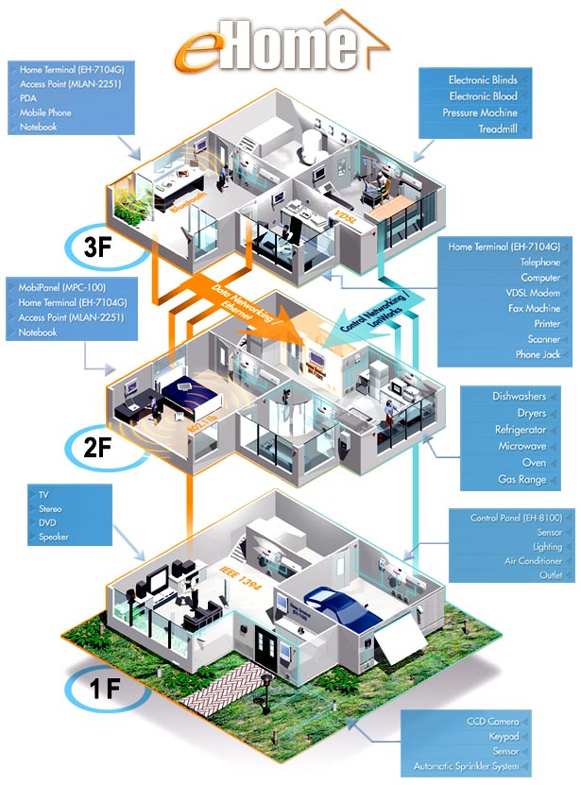
Innovation

Slide 13
Innovation in/across networks
Core questions:
How to encourage innovation in use of networks?
How to get incumbents to facilitate new business models?
Experience (Hausman and Sidak, 07; Cave, 09; Jamasb and Pollitt, 09; Pollitt, 09):
Extremely successful in telecoms
Currently however innovation in other networks low
Transferability:
More R&D and experimentation is required e.g. Low Carbon Networks Fund (Ofgem, 2010c)
Need to change business model e.g. from MWhs to MBits

Slide 14
Unbundling

Slide 15
Role of Unbundling and Ownership
Core questions:
What do new challenges mean for optimal degree of integration?
What is the role of public and cooperative ownership?
Are new entrants on the horizon?
Experience (Pollitt, 2008a, 09):
Unbundling in electricity and telecoms successful
Ownership unbundling sometimes necessary
Public/co-operative ownership reduces need for regulation (e.g. in New Zealand)
Transferability:
Energy distribution networks might require ownership unbundling
Municipal ownership of ‘last mile’ might allow reduction of regulation

Slide 16
Conclusions
Network regulation needs to evolve to meet new challenges at reasonable cost and with appropriate levels of customer engagement.
Telecoms leading the way, with convergence in regulation possible.
Extent of use of competition and market mechanisms to maintain legitimacy will continue to be the distinguishing feature of national policies.

Slide 17
References
Ault, G., Frame, D. and Hughes, N.(2008), Electricity Network Scenarios in Great Britain for 2050, Final Report for Ofgem’s LENS project, London: Ofgem.
Bertram, G. (2006), ‘Restructuring the New Zealand Electricity Sector 1984-2005’, in Sioshansi, F.P. and Pfaffenberger, W. (eds.) (2006), Electricity Market Reform: An International Perspective, Oxford: Elsevier. pp.203-234.
Cave, M. (2009), Independent Review of Competition and Innovation in Water Markets: Final Report, London: DEFRA.
Commerce Commission (2008), Regulatory Provisions of the Commerce Act 1986 Discussion Paper 19 December, Auckland: Commerce Commission.
Doucet, J. and S.C. Littlechild, (2006), Negotiated settlements and the National Energy Board in Canada, EPRG Working Paper, No.0629.
Green, R., Lorenzoni, A., Perez, Y. and Pollitt, M. (2006), Benchmarking electricity liberalisation in Europe, EPRG Working Paper, No.0609.
Hausman, J. and Sidak, J.G. (2007), Telecommunications Regulation: Current Approaches with the End in Sight, Mimeo.
Heng, H.Y. (2010), Long-Term Distribution Network Pricing and Planning to Facilitate Efficient Power Distribution, Department of Electrical Engineering, PhD
Dissertation, University of Bath.Jamasb, T. and Pollitt, M. (2009), Electricity sector liberalisation and innovation: an analysis of the UK patenting activities, EPRG Working Paper, No.0901.
Jamasb, T. and Pollitt, M. (2007) "Incentive regulation of electricity distribution networks: lessons of experience from Britain." Energy Policy, 35(12): 6163-6187.
Jamasb, T., Mota, R., Newbery, D. and Pollitt, M. (2004), Electricity sector reform in developing countries: a survey of empirical evidence on determinants and performance. EPRG Working Paper, EP 47.
Jamasb, T., Neuhoff, K., Newbery, D. and Pollitt, M. (2005), Long-term Framework for Electricity Distribution Access Charges, EPRG Working Paper, No.0505.
Keisling, L.L. (2009), Deregulation, Innovation and Market Liberalization, Oxford: Routledge.
Littlechild, S.C. (2007). “Bird in hand: stipulated settlements and electricity regulation in Florida,” EPRG Working Paper, No. 0705.

Slide 18
References
Littlechild, S.C. and E.A. Ponzano (2008). “Transmission Expansion in Argentina 5: the Regional Electricity Forum of Buenos Aires province.” Energy Economics, 30(4): 1491-1526.
Littlechild, S.C. and C.J. Skerk (2008). ‘Transmission Expansion in Argentina 1: the origins of policy’, Energy Economics, 30(4):1367-1384.
Nillesen, P.H.L. and Pollitt, M.G. (2007) "The 2001-2003 electricity distribution price control review in the Netherlands: regulatory process and consumer welfare." Journal of Regulatory Economics, 31(3): 261-287.
Nillesen, P. and Pollitt, M.G. (2008), Ownership unbundling in electricity distribution: empirical evidence from New Zealand, EPRG Working Paper No.0820.
Office for National Statistics (2009), UK National Accounts Blue Book 2009, Newport: ONS.
Ofgem (2009a), Regulating energy networks for the future: RPI-X@20 Principles, Process and Issues, Ref.13/09, London: Ofgem.
Ofgem (2009b), Electricity Distribution Price Control Review Final Proposals - Allowed revenue - Cost assessment, Ref.146/09, London: Ofgem.
Ofgem (2010a), Offshore Transmission Connecting a Greener Future OFTO Round 2 Launch Event, Available at: http://www.ofgem.gov.uk/Networks/offtrans/edc/Documents1/OFTO%20Launch%20Day%20Presentation.pdf
Ofgem (2010b), Regulating energy networks for the future: RPI-X@20 Recommendations Consultation, Ref.91/10, London: Ofgem.
Ofgem (2010c), Creating Britain’s Low Carbon Future Today, London: Ofgem.
Pollitt, M. (2009), Does Electricity (and Heat) Network Regulation have anything to learn from Fixed Line Telecoms Regulation?, EPRG Working Paper No.0914.
Pollitt, M.G. (2008a), ‘The arguments for and against ownership unbundling of energy networks’, Energy Policy 36(2): 704-713.
Pollitt, M. (2008b), ‘The Future of Electricity (and Gas) Regulation in Low-carbon policy world’, The Energy Journal, Special Issue in Honor of David Newbery, pp.63-94.
Ter-Martirosyan, A. (2003). The Effects of Incentive Regulation on Quality of Service in Electricity Markets. Department of Economics, George Washington University, Working Paper, March.

