Slide 1
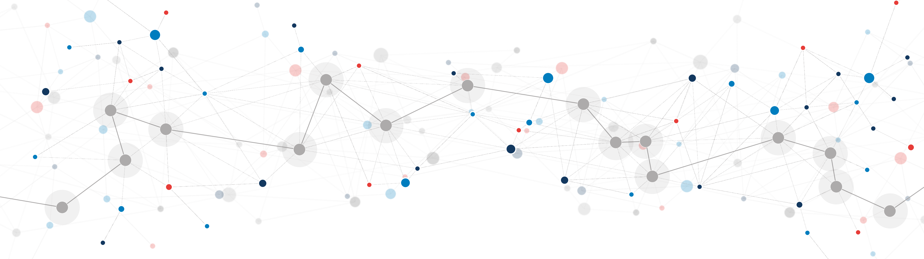
The future of network investment
Cambridge EPRG
Joe Perkins
17 May 2024

Slide 2

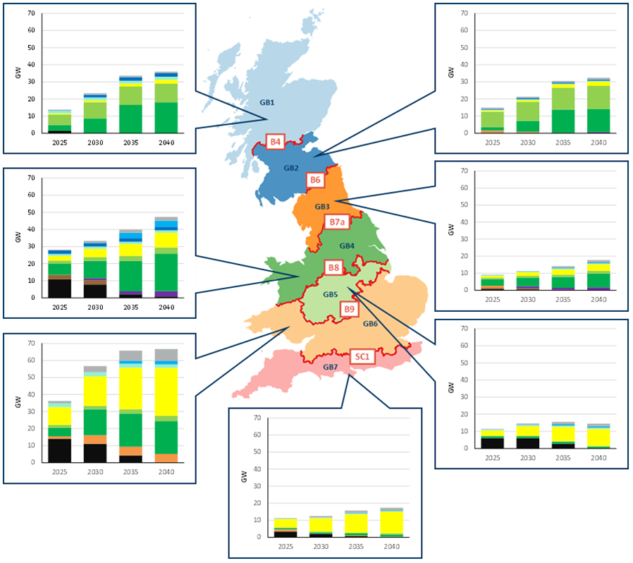



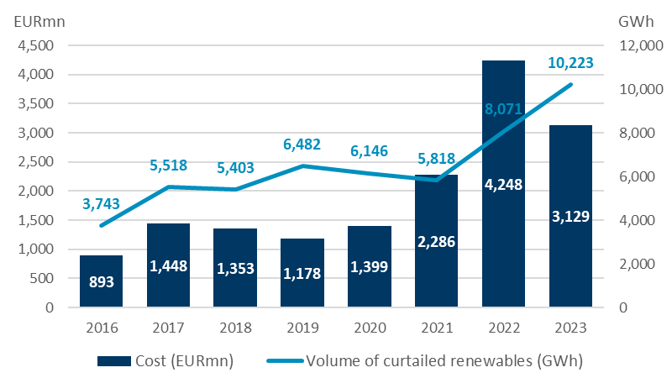

Electricity markets in GB and several other jurisdictions face similar challenges as they progress towards Net Zero
Renewables capacity will increase across GB as it transitions to Net Zero…
This renewables capacity exceeds local demand in those regions…
… leading to rising constraint management costs
RES is predominately located in remote areas (e.g. Scotland)…
..but demand is in the south, requires extensive transmission to bring this power to where it's needed.
Cost and volume of grid congestion in Germany*
North Germany is rich in wind energy resources,
but demand is concentrated in southern regions
Sources: FES 2021
… with the greatest proportion located in Scotland and north England
*Note that for grid congestion data in Germany for 2023, as only three Qs of data are available, we take the average of these figures Q4 to approximate annual Cost and Volume figures.

Slide 3
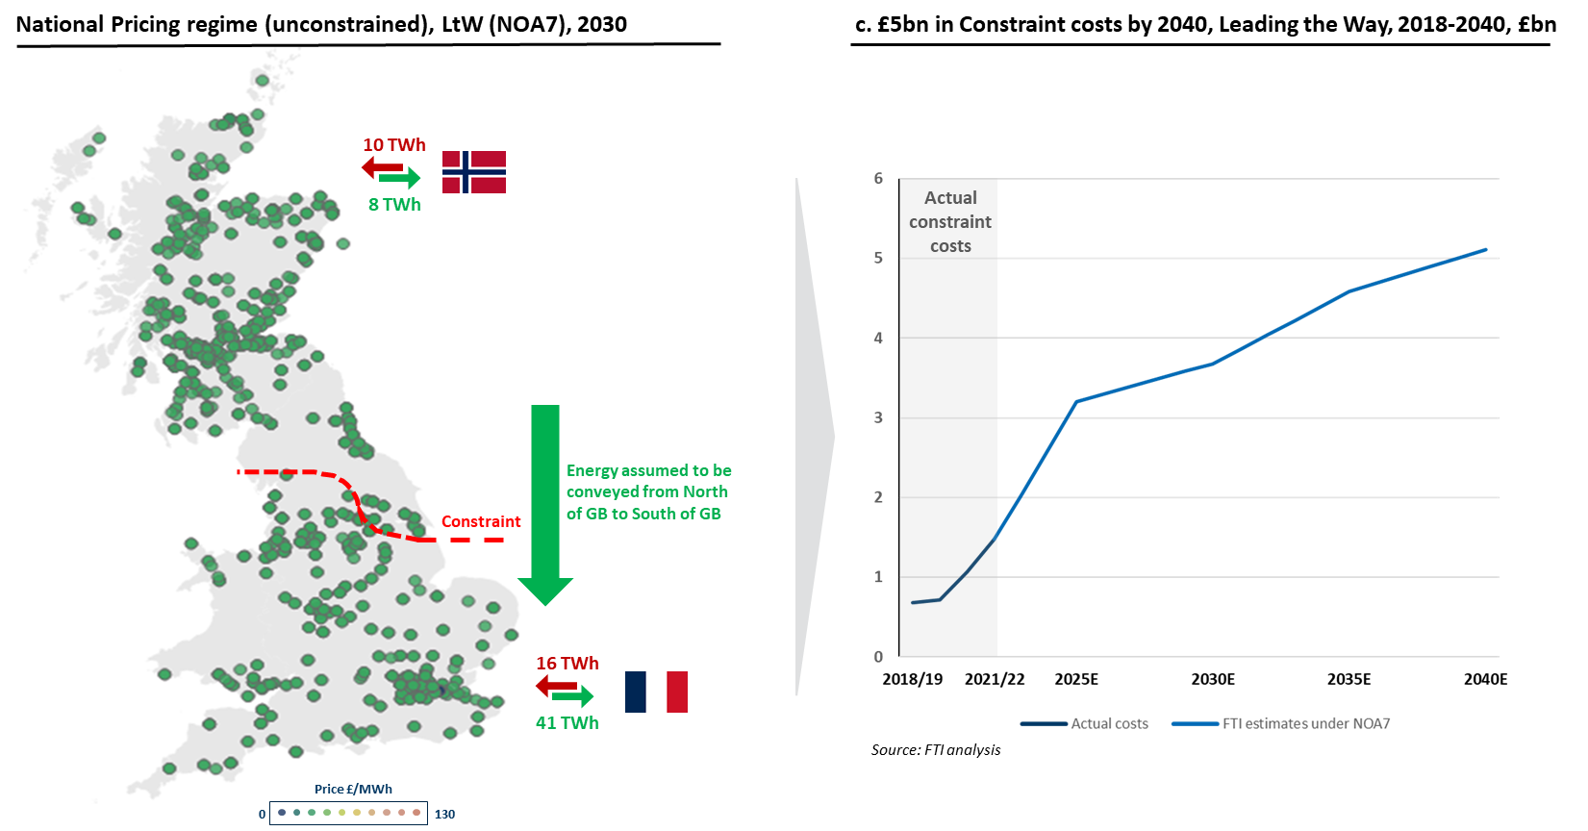
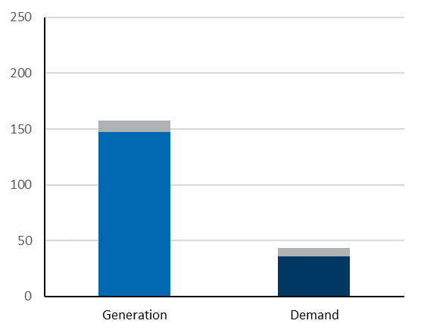
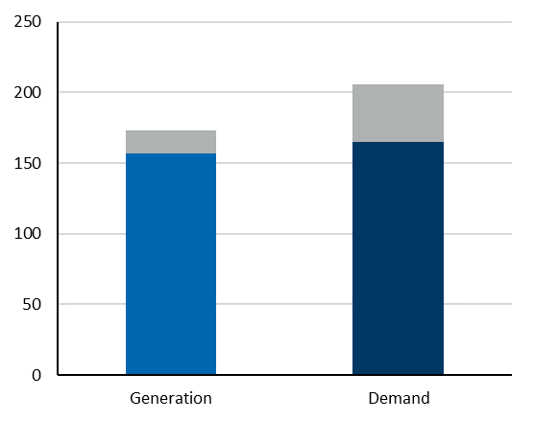
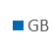
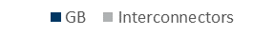
This is because national-price markets like GB do not account for Tx constraints when scheduling electricity supply to meet demand
TWh
North of GB
South of GB
The ESO incurs costs when intervening to account for transmission constraints when balancing the production and consumption of electricity…
… i.e., the costs incurred in switching generators off in regions with excess generation, and switching generation on in regions with excess demand.
TWh

Slide 4
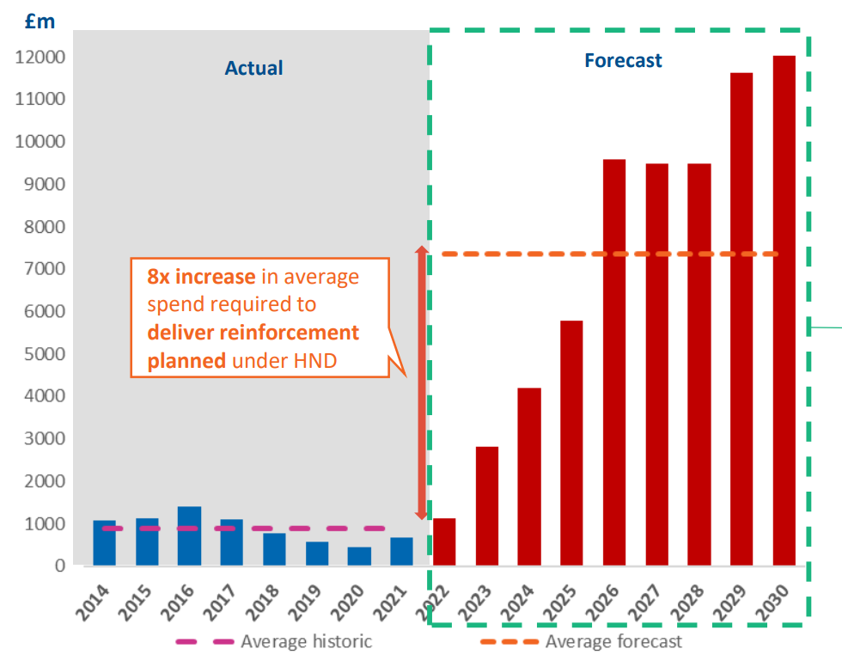
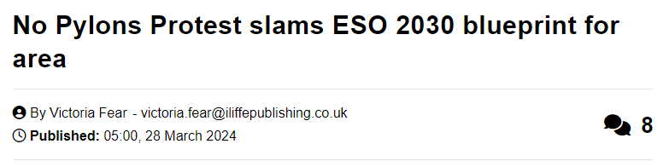


Expanding the transmission (Tx) network is the prevailing solution to rising congestion costs, but current plans are very ambitious and likely infeasible
There are several factors which make the currently envisioned Tx expansion plan challenging.
forecasted spend is significantly larger than the previously achieved planned reinforcement;
this level of increase will likely result in several supply chain constraints that may be difficult to circumvent, therefore increasing the cost and likelihood of delay;
planning and consent challenges associated with new build; and
prevailing political and macroeconomic uncertainty may also hinder the level of investment required.

Slide 5


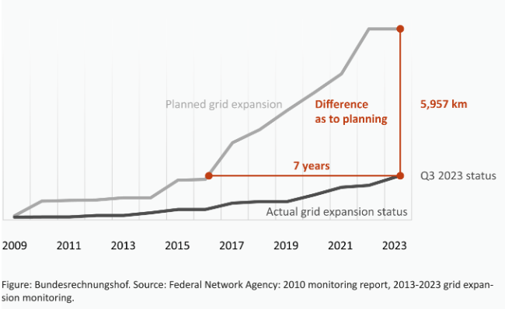
Even the relatively modest planned investments in recent years have rarely been achieved
7800 km

Slide 6

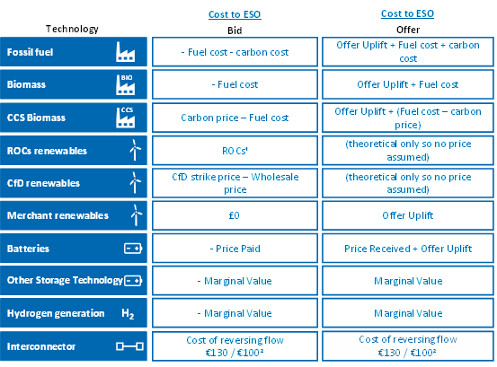

The approach used to determine the case for new transmission assessment (Network Options Assessment) may not be fit for purpose
The benefits of Tx assets are determined via a decrease in forecasted congestion cost, which relies on assumptions regarding:
1
The bid and offer prices in the balancing mechanism
The approach currently taken to assessing the case for new transmission investment relies on the cost of resolving constraints
This means that, if the cost of resolving constraints is forecast to increase (which is indeed the case), the analysis is more likely to suggest that additional transmission investment is needed
This approach does not fully consider the underlying causes for this congestion. De facto, it crystallises expectations of inefficiencies and transfers within the current Balancing Mechanism.
Additionally, this approach only considers the consumer perspective and does not account for GB socioeconomic welfare as a whole
2
Generator and demand siting decisions over the longer term
3
Usage of flexible assets and their ability to respond to price signals

Slide 7
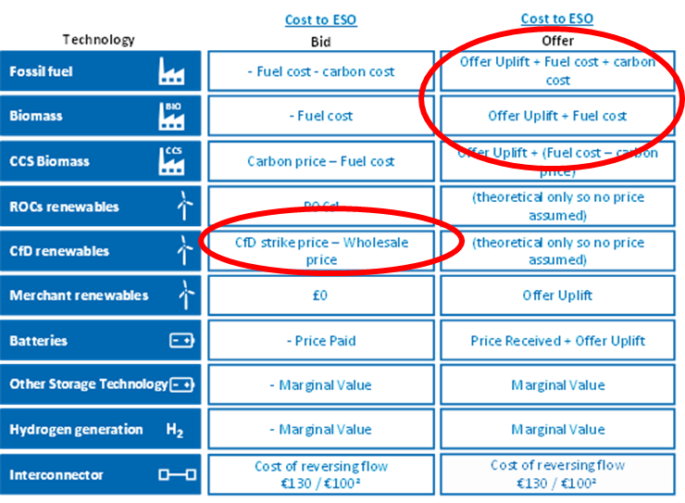
Constraint cost estimates evaluate build from a consumer perspective and not socio-economic welfare
Assumptions on BM bids and offers
Balancing Mechanism bids and offers feed into evaluation of congestion costs…
… part of this cost of resolving congestions represents a real resource cost (e.g., the cost of accepted offers to increase generation)…
… however, the other part is a transfer between consumers and producers (for instance, the difference between wholesale revenue and the cost to a generator of having bids accepted in the balancing mechanism to reduce generation).
This component of constraint costs involve no additional use of resources by society as a whole and it is unintuitive to deploy real resources (build new Tx assets) to secure a benefit that is just a change in transfer from one part of society to another.
Other forms of CBAs in the energy industry consider societal welfare, such as Ofgem’s assessment of which interconnectors should enter the cap and floor regime, or DESNZ’s assessment of the system cost impacts of different levels of large long-duration energy storage.

Slide 8

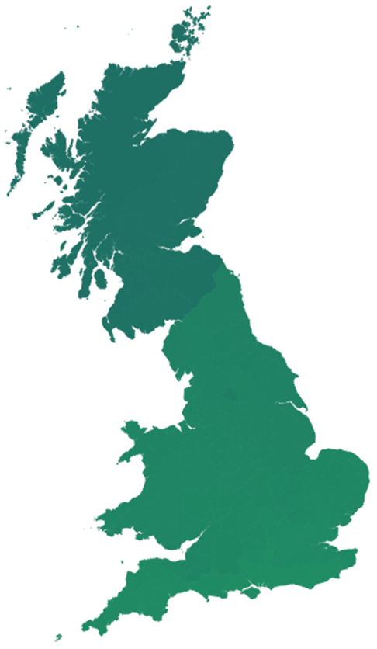


Locational pricing may be another solution to account for Tx constraints and use assets in alignment with system needs as GB transitions to Net Zero
National
Locational
10 TWh
9 TWh
8 TWh
11 TWh
Change in direction of aggregate flows
Energy from the North of the GB is conveyed to the South to…
meet demand in the South of GB; and
allow for export of energy from GB to France
19 TWh less strain on the system
Constraint
Constraint
16 TWh
19 TWh
41 TWh
29 TWh
Price £/MWh
Reduction of 13TWh of exports
0
Price £/MWh
130
0
130
…allowing the North of GB to export excess supply of electricity to Norway, and the South of GB to export less electricity to France, reducing stress on the system and the case for more transmission

Slide 9
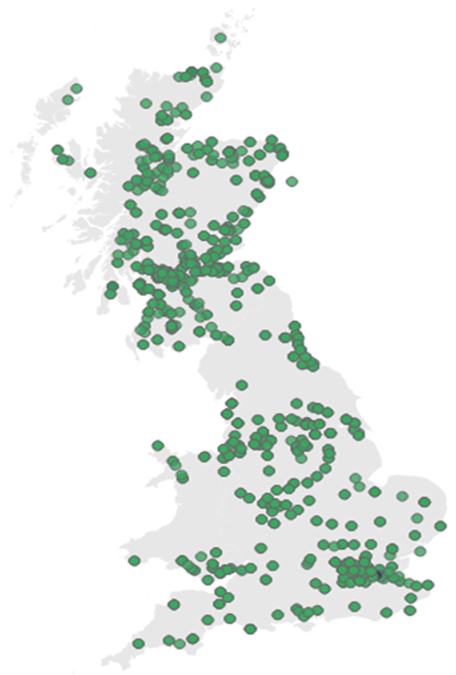
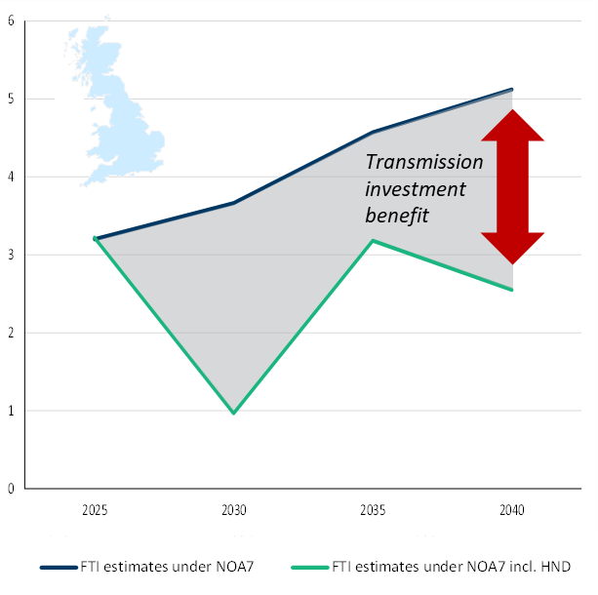
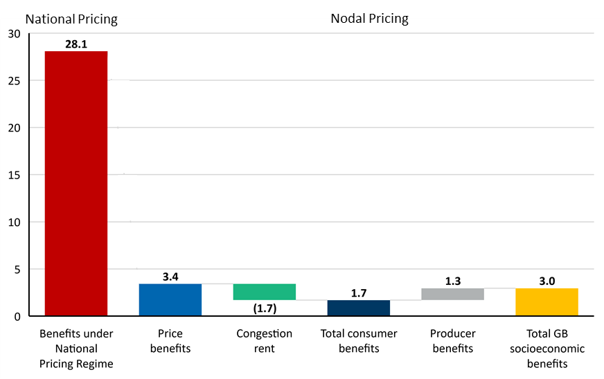
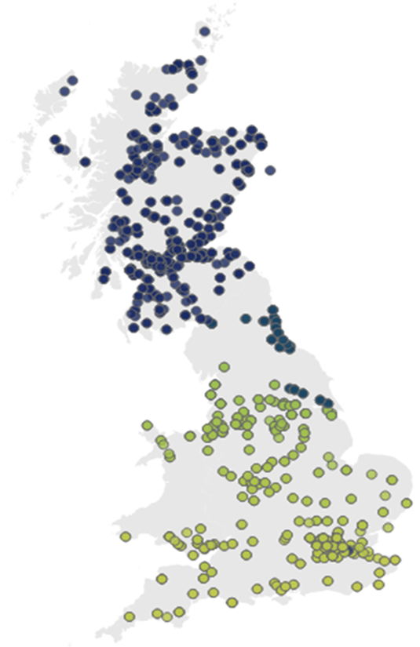


As a result, the benefits of incremental transmission investment generate different benefits under national and nodal pricing regimes
Constraint cost estimates, LtW, £bn
Under a national pricing regime, the benefits of the transmission enhancements will manifest themselves in reduced constraint management costs incurred by the ESO, and therefore by consumers
Total benefit of incremental HND investment, 2025 – 2040 , £bn
Under a nodal pricing regime, transmission constraints are considered in setting the wholesale price and there is therefore no requirement for the ESO to incur constraint management costs…
… however incremental transmission investment under a nodal regime still impacts…
Wholesale prices
Intra-GB congestion rents
Producer Revenues

Slide 10
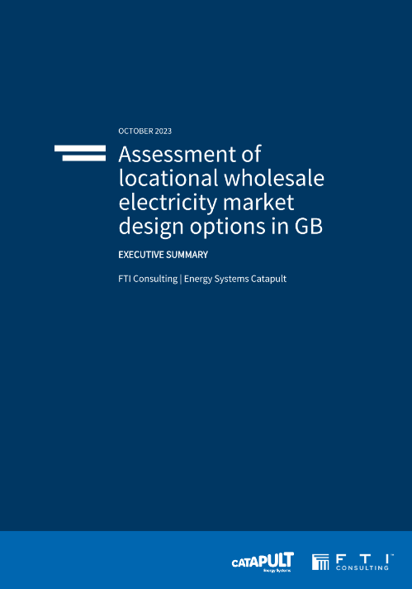
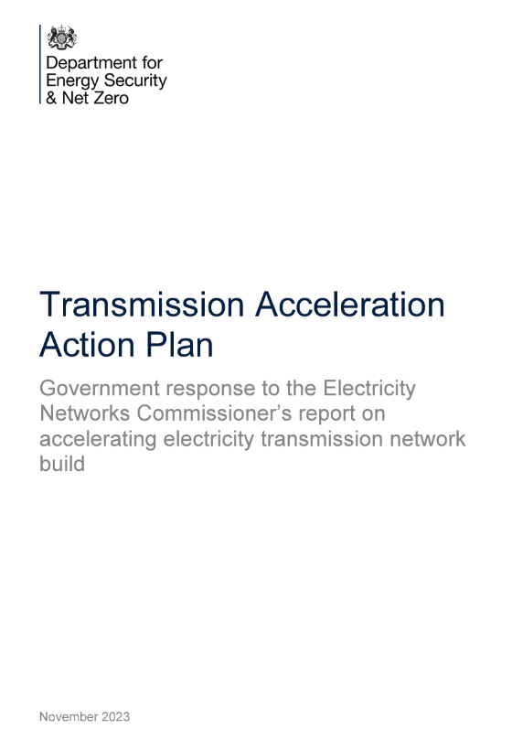
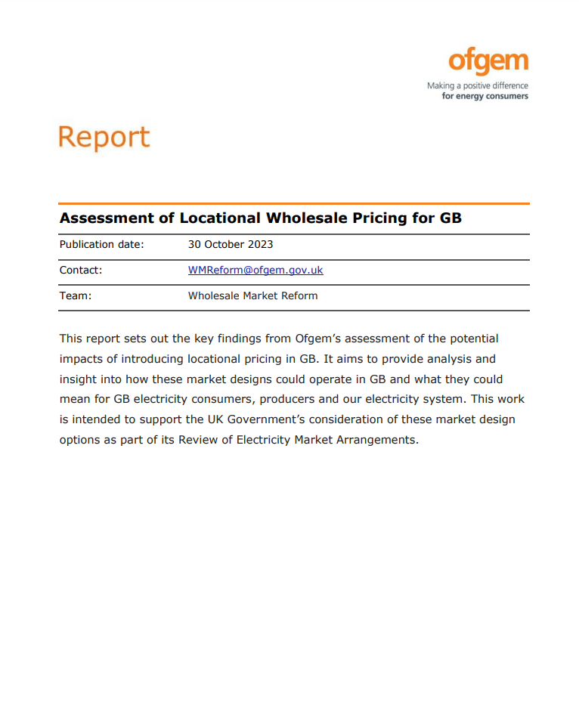
Better coordination – through prices, planning or both – should help to enable Net Zero with incremental Tx build rather than implausible rates of increase
There are fundamental interdependencies between generation and transmission investments….
Generation and storage siting
Transmission investment
Siting generation where it is valued by consumers can reduce the need for more transmission investments
Coordinated approach to generation and transmission investment can unlock savings to consumers
More transmission investment can enable greater volumes of generation to be transported to where demand is located
…and optimal investment in both can be achieved through market signals, policy planning, or a combination of both
Market price signals
Prices that represent the local supply and demand characteristics, for instance via LMPs or TNUoS can therefore provide investment signals for both generation and Tx
Policy and Stakeholder Planning
Top-down approach where a central entity coordinates development of generation and Tx, for example through planning permissions
Notes:
The appropriate scale and locations of Tx investment could be determined via the use of ‘system costs’ in lieu of ‘constraint costs’ in the NOA process.
This would rely on post-gate closure dispatch and therefore the change in the use of real resources which results from a change in transmission capacity – which is frequently referred to as an analysis of “system costs”.
Ofgem has already suggested that the Future System Operator (FSO) should deliver a new transmission network planning output called the Centralised Strategic Network Plan (CSNP). As part of the development of this new output, incorporating system costs and benefits into the assessment would make sure that the right trade-off is being measured.

Slide 11






Summary
Constraint costs have been rising rapidly in several jurisdictions, and are expected to increase further
Transmission network build is the predominant response – with the dream of creating a copper plate
However, this is very costly and implausible to achieve in practice
Better coordination – ideally through planning and prices – would significantly reduce the amount we need to spend and the associated disruption
We should consider the optimal scale of transmission build based on locational pricing – if we do not, there is a real risk of burning money on pylons that become white elephants
There could be wider benefits of transmission network build – e.g., option value – but, if so, these need to be assessed explicitly alongside the costs

