Slide 1
SESSION 2— ROUNDTABLE: EUROPEAN ENERGY & CLIMATE POLICY
EPRG SPRING SEMINAR
17 May 2024
Miguel GIL TERTRE
Chief Economist - DG Energy – European Commission

Slide 2
Prices significantly down compared to last year…

Slide 3
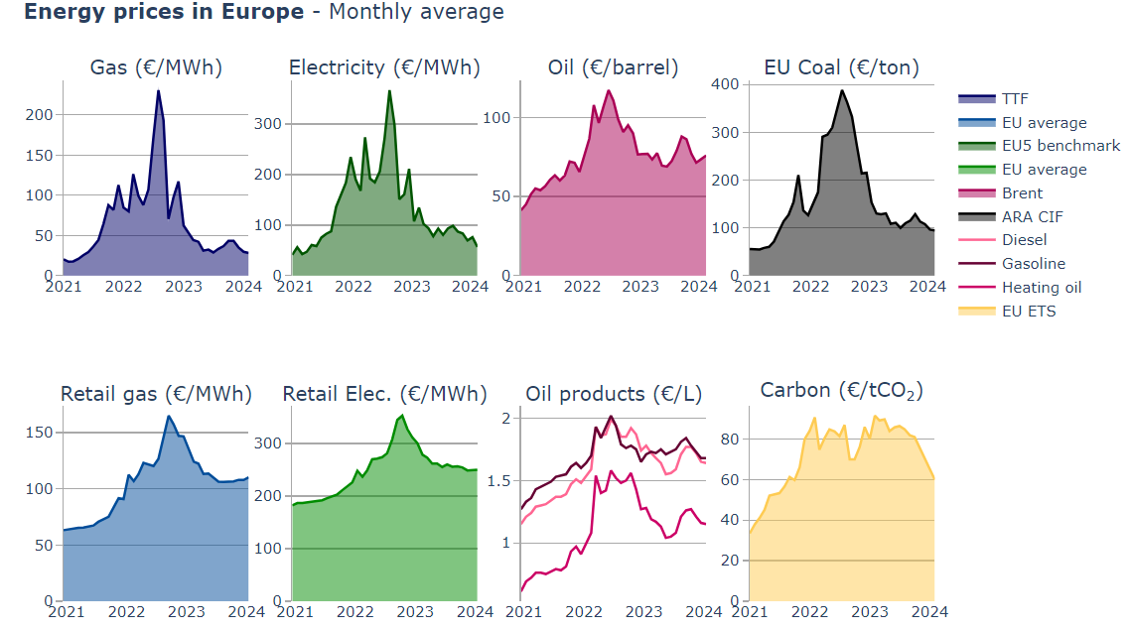
Energy prices – Monthly averages
2023 Average prices:
Gas: 41 €/MWh (-66%)
Retail gas: 115 €/MWh (-16%)
Electricity: 95 €/MWh (-50%)
Retail electricity: 263 €/MWh (-10%)
Oil: 77 €/barrel (-21%)
Oil products:
  Diesel: 1.68 €/L (-8%)
  Gasoline: 1.74 €/L (-4%)
  Heating oil: 1.17 €/L (-16%)
Coal: 119 €/ton (-58%)
Carbon: 83 €/CO₂ (+3%)
EU energy prices in 2023 improved considerably over 2022, but prices remain above pre-crisis levels especially for retail
Two-fold leverage between gas and electricity prices observed during the crisis
Gas power plant efficiency: 2 energy units of gas to produce 1 unit of electricity
Sources: ENER Chief Economist (based on S&P Global Platts, VaasaETT, Weekly Oil Bulletin)

Slide 4
…Better fundamentals since the crisis…

Slide 5
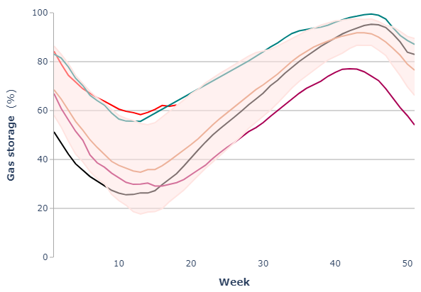
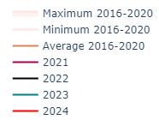
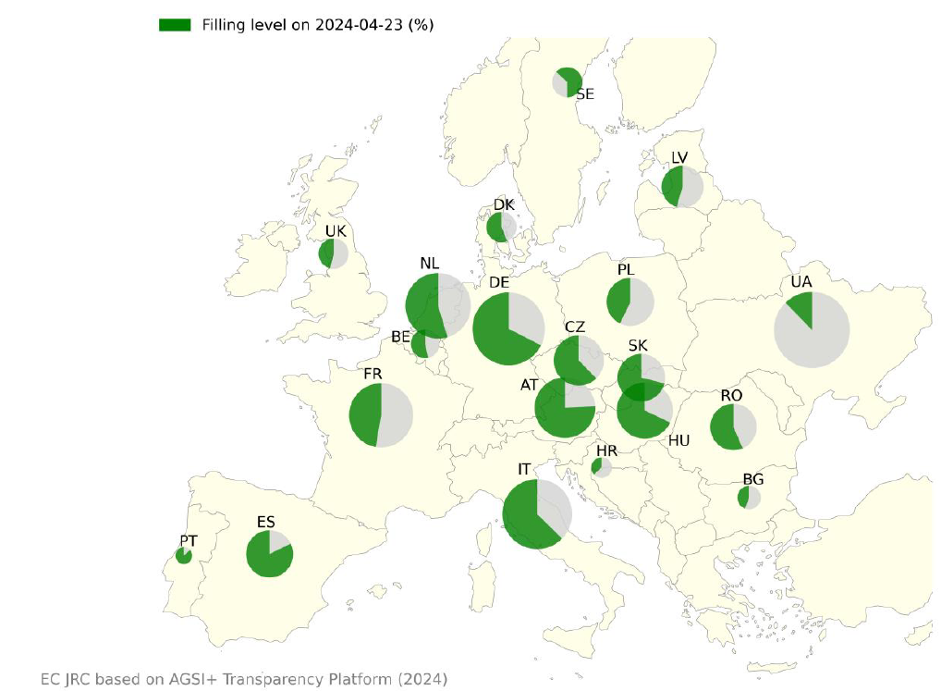
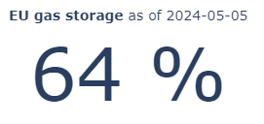
Storages - Improved gas market fundamentals
Source: ENER Chief Economist (based on GIE-AGSI)

Slide 6
Natural gas demand reduction
Change in natural gas demand between August 2022 and March 2024
Monthly EU natural gas demand development
Volumes saved
125 bcm
Demand reduction
18%
Source: DG ENER Chief Economist Team based on Eurostat NRG_CB_GASM

Slide 7
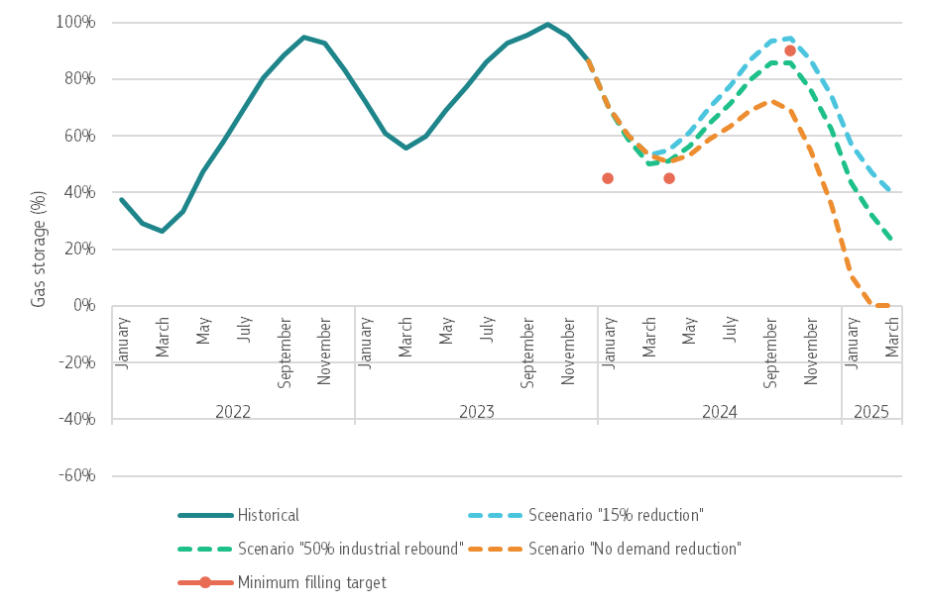
Natural gas storages
Good starting point in storage in 2024: 85%
We can handle Russian pipeline disruption
If “15% demand reduction” :continues in 2024: 53% storage end-March 2024 ; 80% end-September 2024
If half of industrial demand reduction back on lower prices: 50% storage at end-March 2024
But in medium term still can’t afford back-to-normal demand
Downward risks:
Middle East conflict supply/trade disruptions
Chinese natural gas demand recovery (unlikely)
Colder-than-average winter (very unlikely)
Upward risks:
Milder weather
Maintain demand reduction in industry/power sector)
We assume no Russian pipeline gas which is partially compensated by a maximised LNG imports from non-Russian suppliers.
Source: ENER Chief Economist (based on GIE-AGSI)

Slide 8
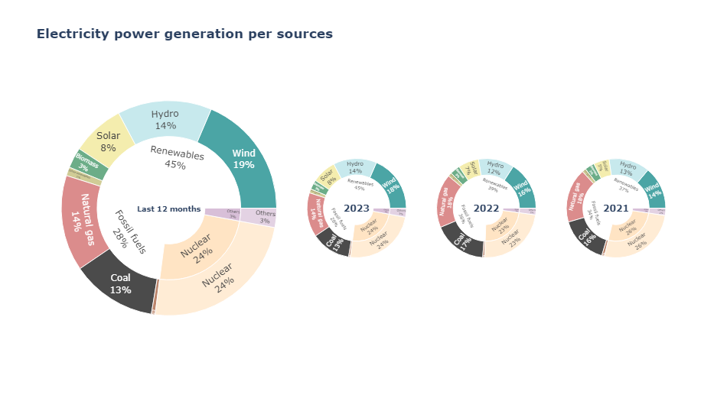
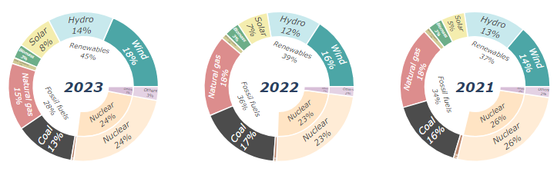
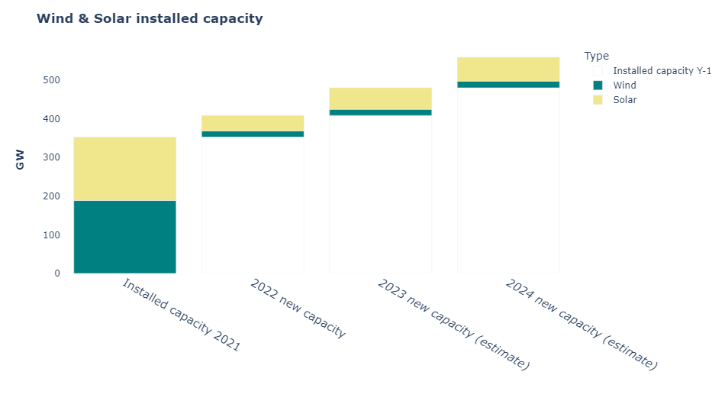
Renewables: record deployment
New RES capacity growing fast
73 GW of new installed RES capacity in 2023* (around 13 bcm of gas saved)
Renewables also helping to reduce gas demand for power generation:
Share of RES in power rising to 45% (2023) from 39% (2022)
Source: ENER Chief Economist (based on Fraunhofer, ENTSO-E, Solar Power Europe, WindEurope). * Estimated

Slide 9
Challenges in the path to energy transition…

Slide 10
The 2040 Target Communication
Recommends a 2040 climate target: -90%;
Responds to the Climate Law;
Policies for 2030 remain unchanged (e.g. Fit for 55);
Legislative proposal for the 2040 target – next Commission;
The design of the post-2030 policy framework – in the coming years;
An impact assessment informs the Communication;
This Communication launches a debate
Notes:
Opportunities for investment, quality jobs and a strong industrial ecosystem
Lead in developing the clean tech markets of the future
Clean, low carbon, affordable energy
Sustainable food and materials
Resilient against future crises
Strengthened open strategic autonomy
Vision
Remaining a global leader and trusted partner in climate action

Slide 11
2040: Enabling conditions
The full implementation of the agreed 2030 framework
Competitiveness of European industry and agriculture
Greater focus on Just Transition - leaving no one behind
A level playing field with international partners
Open Dialogue on the post 2030 framework

Slide 12
2040: Industry decarbonisation deal
EU competitiveness needs stable and affordable clean energy, and is a basis for technological sovereignty and economic security;
Attention for Energy Intensive Industries
Need an enabling framework to mobilise private capital and investment;
Need to ensure more attractive incentives for clean tech manufacturing so that the EU retains industrial capacity;
Growing need for industrial carbon management and carbon removals;
Notes:
A need to…

Slide 13
The new challenges of EU electrification
With the electrification to the economy, the EU is building a different energy system.
Key to success of the EU’s green transition: minimising the costs of transforming the energy system through strategic investments reducing overall system cost.
In order to avoid bottlenecks or soaring balancing cost (in a system with a large majority of renewables), massive investments will be needed in grids, in storages, batteries, demand flexibility, innovation and system integration
Interconnections and a diversified portfolio of technologies are crucial for a more resilient system
These can only be delivered by a coordinated approach at EU level.

Slide 14
A comprehensive investment agenda
Average annual energy system investment needs (% GDP)
(excl. transport)
The transition is an investment agenda
High level of investment needs to be sustained over several decades:
  +1.5 pp of GDP vs. 2011-2020
  €660 billion / year in 2031-2050
Investment/GDP ratio not exceptional for the EU, and investment needed in any case.
Still achievable compared to historical trends of overall investment in the economy (with a historical low value over 2011-2020)
Figure 103 of the CTP2040 Impact Assessment, Annex 8, section 2.2.1
Investment means returns and benefits:
  Domestically produced energy
  Better homes
  New businesses and jobs, etc.

Slide 15
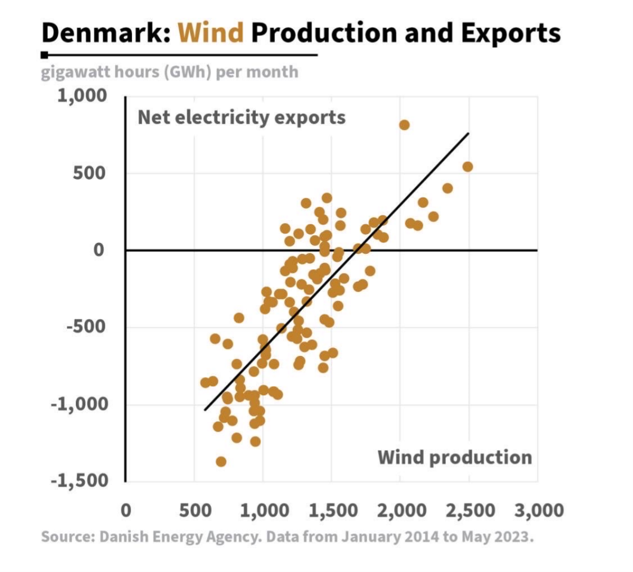
Investments need to address bottlenecks
Green Transition is progressing on individual installations: RES, HP, EV.
BUT need for System Integration:
Grids, Storage and Flexibility
40% of our grids have more than 40 years.
The optimal location for renewables generation often being distant from demand centres.
Bottlenecks to be tackled to deliver the promise of secure and affordable energy.
Substantial investments on distribution and transmission grids of EUR 500 billion this decade

Slide 16
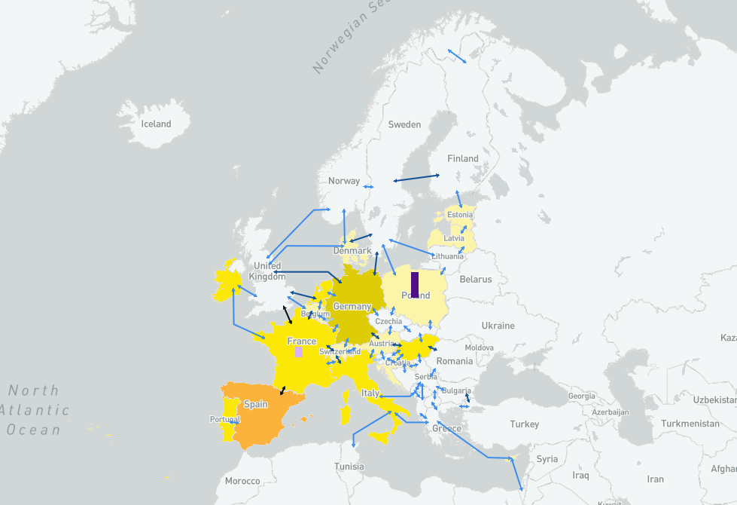
Grids and electrification
Additional interconnections by 2040 (ENTSO-E’s System Needs study)
European Transmission System Operators see need for 64 GW of new interconnection by 2030 (compared to 2025), requiring investments of 2.5 bn per year
Additional 24 GW of interconnection and 41 GW of storage required by 2040

Slide 17
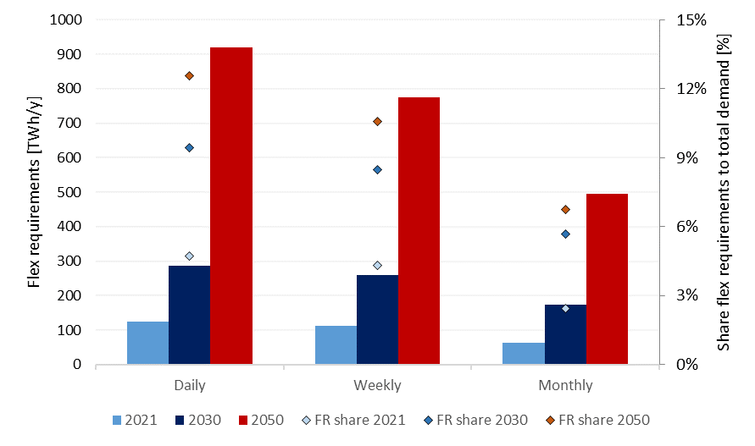
Increased flexibility needs
Flexibility requirements will increase in all EU MS towards 2050
Total needs equal to 30% of total electrical EU demand in 2050, up from 24% in 2030 and 11% in 2021
Figure: Daily, weekly and monthly flexibility requirements and their share to total demand (FR share) in the EU for 2021, 2030 and 2050.
Source: ENER Chief Economist
Notes:
Flexibility requirements will increase in all EU MS towards 2050
Total needs equal to 30% of total electrical EU demand in 2050, up from 24% in 2030 and 11% in 2021

Slide 18
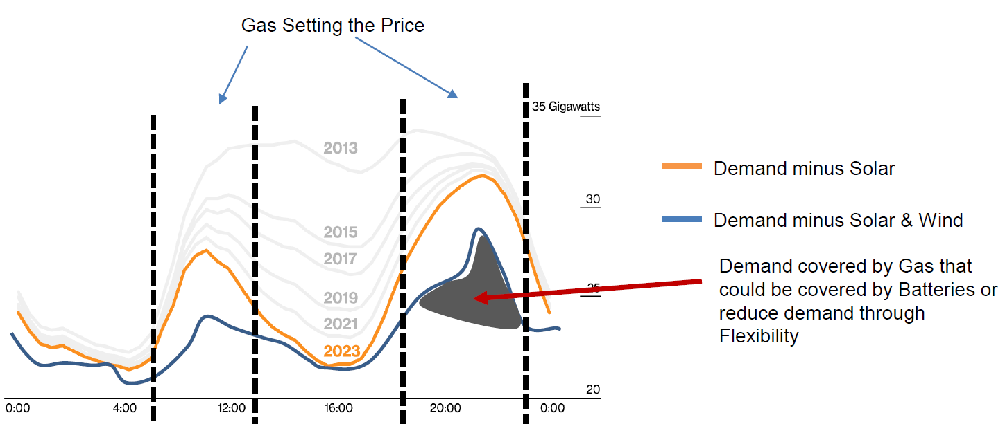
Increased flexibility needs
Combination of flexibility sources and storage will lower the dependence on gas prices
Source: ENER Chief Economist

Slide 19
Increasing cost of power back-up
Need to invest on batteries/storage/demand-side reponse flexibility.
System integration is key.
Running back-up (e.g., gas) plants a few hours per year might become extremely expensive.

Slide 20
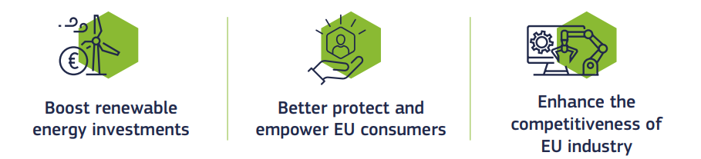
EMD and Long-term contracts
3 pillars EMD
Long-term markets and price contracts, incl. Power Purchase Agreements (PPAs) and Contracts for Difference (CfDs), may help guarantee predictable and stable prices for customers, secure predictable revenue streams for investors and ensure the bankability of new generation projects.

Slide 21
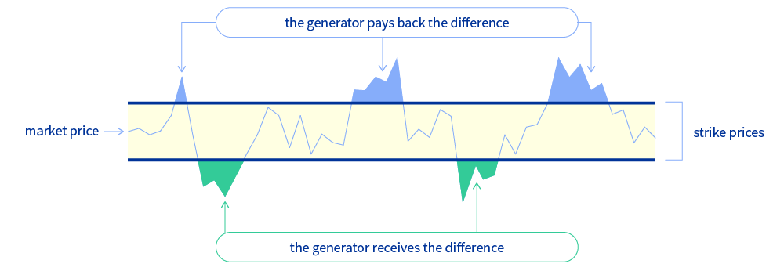
Contracts for Difference
All public support for new investments in infra-marginal and must-run renewable and non-fossil electricity generation will have to be in the form of two-way Contracts for Difference (CfDs).

Slide 22
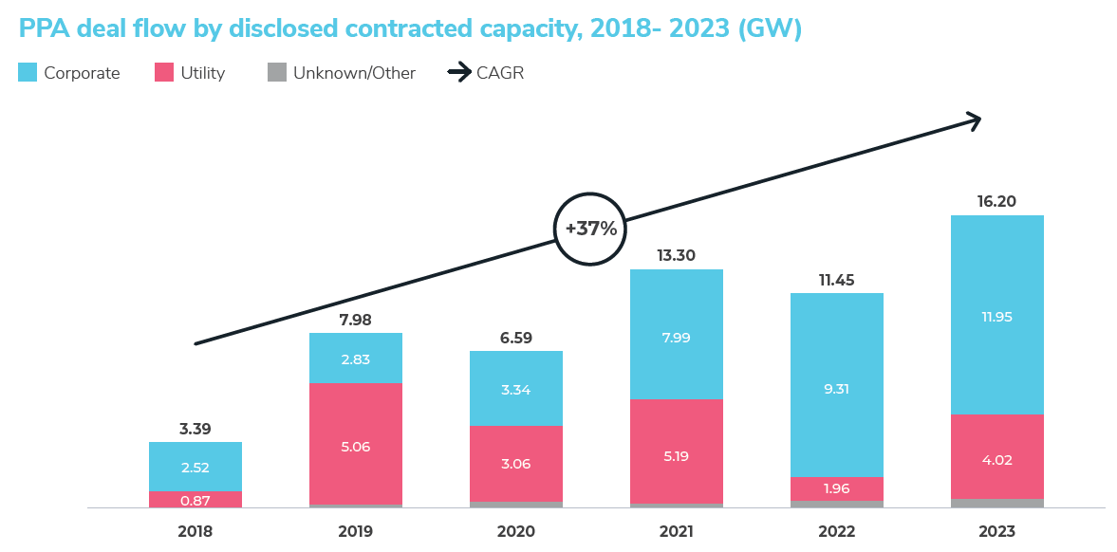
Power purchase agreements (PPAs)
More stable long-term contracts such as Power Purchase Agreements (PPAs) – through which companies establish their own direct supplies of energy and thereby can profit from more stable prices of renewable and non-fossil power production.
Source: Pexapark

Slide 23

Thank you
Comments/Questions
Miguel GIL TERTRE
Chief Economist
e-mail: miguel.gil-tertre@ec.europa.eu
© European Union 2020
Unless otherwise noted the reuse of this presentation is authorised under the CC BY 4.0 license. For any use or reproduction of elements that are not owned by the EU, permission may need to be sought directly from the respective right holders.
Notes:
Update/add/delete parts of the copy right notice where appropriate.
More information: https://myintracomm.ec.europa.eu/corp/intellectual-property/Documents/2019_Reuse-guidelines%28CC-BY%29.pdf

Slide 24
Wholesale electricity price differentials
Monthly average day-ahead wholesale electricity price: EU vs USA, UK, Japan and China
EU electricity wholesale prices 2 to 4 times higher than in the US (July 2021 to July 2023)

Slide 25
…but a higher competitiveness spread…

Slide 26
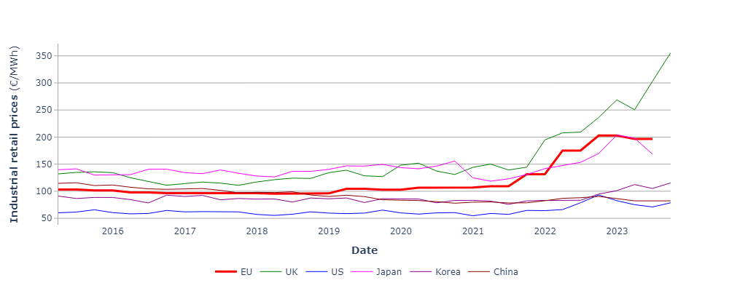
Industrial competitiveness
EU electricity industrial retail prices 2 to 3 times higher than in the US (2021 to 2023) while they were 1.5 - 2 times higher in the past.
Source: ENER Chief Economist

Slide 27
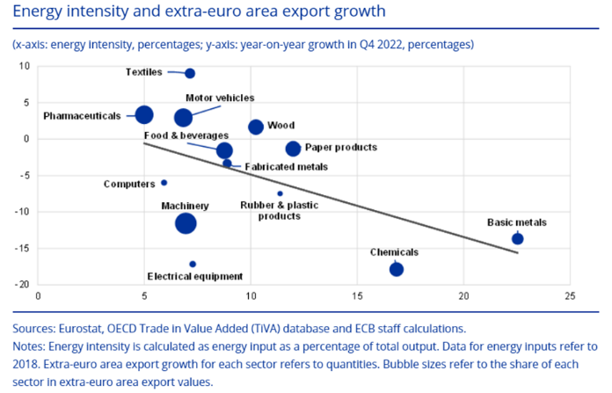
Impact on energy intensive industries
Export growth
Energy Intensity
Source: ECB

Slide 28
…Ensuring the right conditions for electrification …

Slide 29
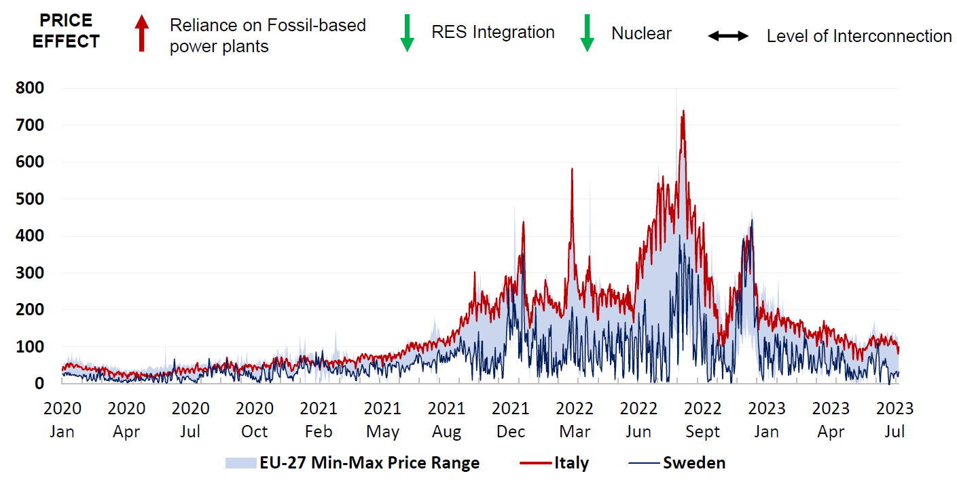
Displacing fossil fuels from the power mix leads to positive competitiveness effects (I)
Russia's weaponisation of EU gas deliveries lead electricity prices to record highs during 2021 and 2022
EU wholesale electricity prices differences driven by generation mix and interconnection level differences
Summer 22 Limited FR nuclear availability; Russia shuts down NS1
Feb 22 Russia invades Ukraine
Dec 22 Cold spell
Dec 21 Cold spell
Aug 21 Russia limits exports through pipelines
Oct 22 Warmest October on record
Summer 23 Gas storages are filled ahead of target
Source: ENER Chief Economist and Joint Research Centre
Notes:
Let’s have a more detailed look with the example of the crisis
On the highlighted events in the gas market in relation to electricity prices
The rising in the gas price were the main driving force behind the increasing electricity market prices.
Natural gas-fired power plants are often the marginal technology units in the merit order, setting the price in the market.
As such electricity markets are directly exposed to shocks in the gas price
On the relation of the power mix on the price
The range on the graph shows the difference between the highest and lowest electricity price across all Member States
It can be observed that Italy consistently ranked among the highest prices, while Sweden was amongst the lowest
Having a cleaner power generation mix (next slide) thus directly impacts lower prices

Slide 30
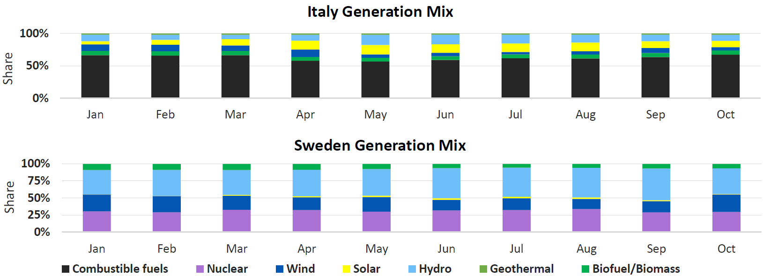
Displacing fossil fuels from the power mix leads to positive competitiveness effects (II)
Power mix drives MS electricity price differentials:
  Italy relies predominantly on combustible fuels
  Sweden has almost 99% of non-fossil generation
Marginal fossil-based generation set the electricity price in the merit order
Source: ENER Chief Economist and Joint Research Centre
Notes:
Speaking points:
So why does Sweden have lower prices as Italy?
Almost 99% share of non-fossil fuel electricity generation with lower production marginal price:
Abundant renewables sources, in particular hydropower and wind
Abundant nuclear power generation with low generation cost
Almost zero exposure to fossil-based generation on the margin
Good interconnection capacity with Norway and Finland which also enjoy low power prices

Slide 31
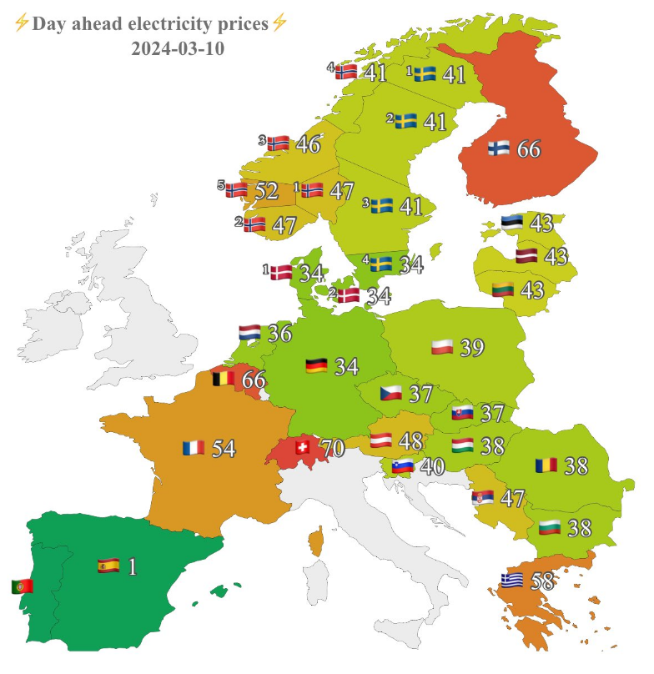
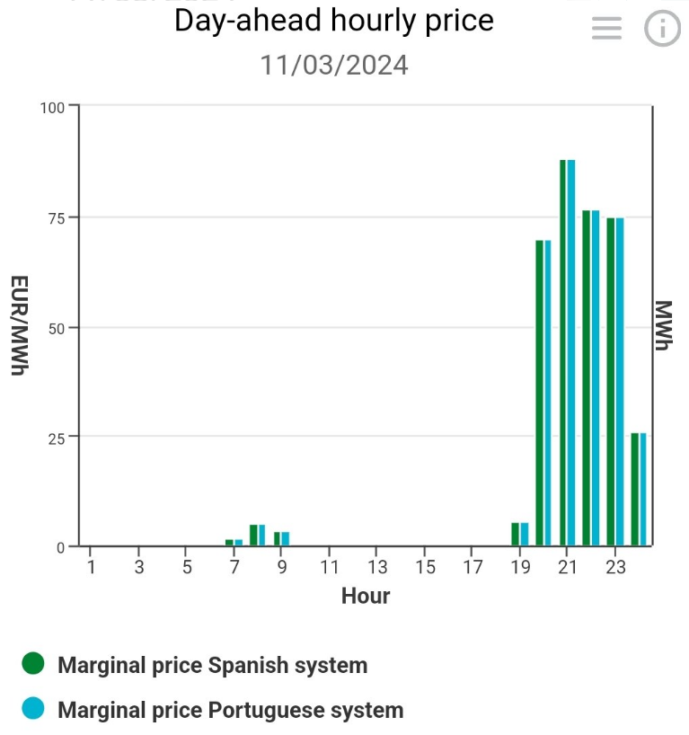
Variability in power prices and diminishing returns for RES in mature markets

Slide 32
…2030 legislation is in place, but we need to start the debate about the next decade…

Slide 33

2040: The EU’s energy system is central
Electrification of the economy remains key to decarbonization
The power sector is the first to decarbonize (by 2040)
Renewable energy will become the backbone of the energy system
However, all low carbon energy solutions are necessary (including, nuclear, energy efficiency, storage, CCS, CCU, carbon removals, etc.)
Need for Industry Decarbonisation Deal
Notes:
The 2040 Target Communication:
Recommends a 2040 climate target: -90%;
Responds to the Climate Law;
Policies for 2030 remain unchanged (e.g. Fit for 55);
Legislative proposal for the 2040 target – next Commission;
The design of the post-2030 policy framework – in the coming years;
An impact assessment informs the Communication;
This Communication launches a debate
Enabling conditions:
The full implementation of the agreed 2030 framework
Competitiveness of European industry and agriculture
Greater focus on Just Transition - leaving no one behind
A level playing field with international partners
Open Dialogue on the post 2030 framework
Energy:
By 2040, most fossil fuels used for non-energy purposes. In 2040, the consumption of fossil fuels for energy will be around 80% less than in 2021,
We should make the transition away from fossil fuels smooth in collaboration with the partner countries
The Impact Assessment looks into the in nuclear energy by several Member States
Transition will significantly lower Europe’s dependence on imported fossil fuels
Energy consumption continues to decrease up to 2040, but reaches plateau post-2040
Industry decarbonization Deal
EU competitiveness needs stable and affordable clean energy, and is a basis for technological sovereignty and economic security;
Attention for Energy Intensive Industries
Need an enabling framework to mobilise private capital and investment;
Need to ensure more attractive incentives for clean tech manufacturing so that the EU retains industrial capacity;
Growing need for industrial carbon management and carbon removals;

Slide 34
The Green Transition is an investment agenda.

Slide 35
2040: A comprehensive investment agenda
€ 710 bn per year in 1st decade (2031-2040) for energy, and then less in 2041-2050. Equivalent to € 660 bn per year on average between 2030 – 2050
1,5% of GDP above the investment in 2011-2020 for energy, and 0,2% of the GDP higher for transport;
Share of GDP is comparable to this decade;
The 2040 target gives regulatory certainty for long-term investments implementing the 2030 targets
Average annual energy system investment needs (% GDP)
Figure 103 of the IA Annex 8, section 2.2.1
Notes:
Still achievable, and comparable to historical trends of overall investment
It’s 1.7% of GDP more that in the 2011-2020 decade, but which was a decade with relatively low investment in energy

Slide 36
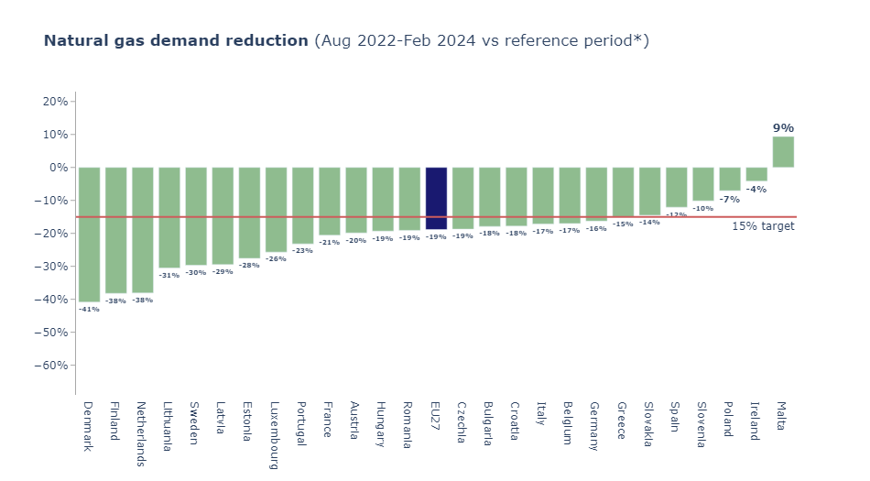
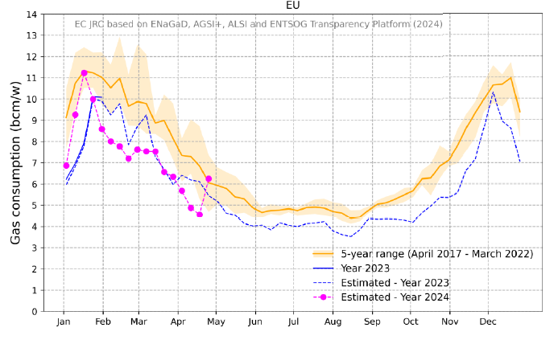
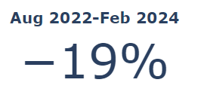

Natural gas demand reduction
Source: ENER Chief Economist (based on Eurostat)

