Slide 1
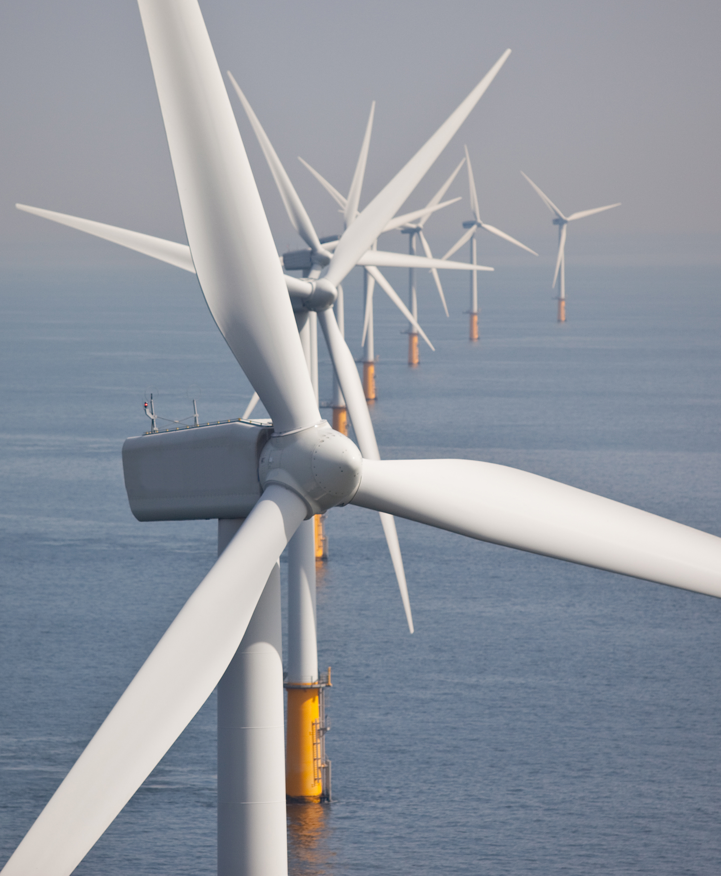

EPRG Session 2
Roundtable: European Energy & Climate Policy

Slide 2
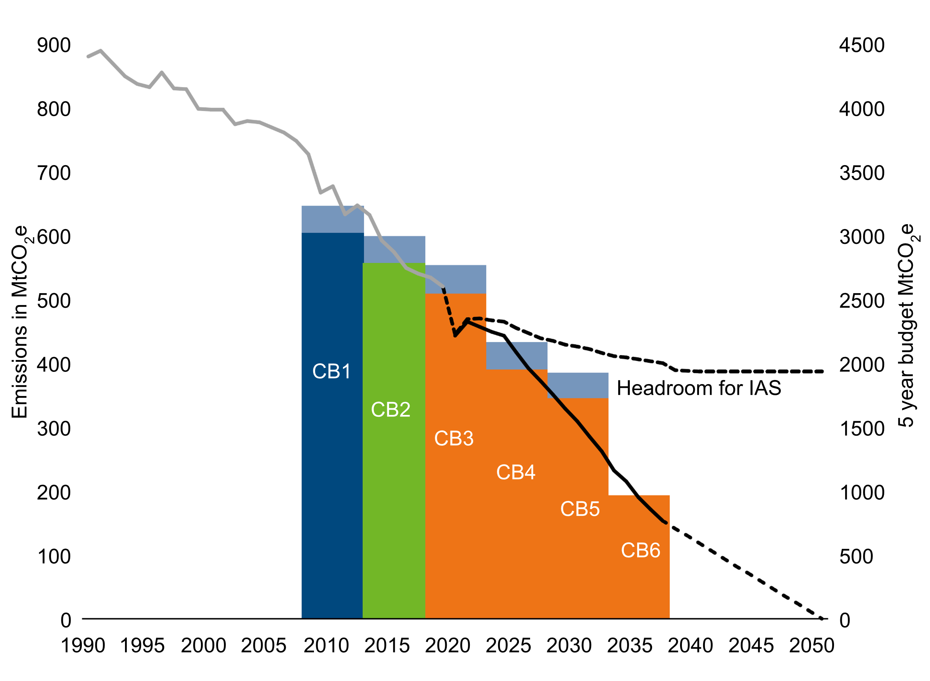



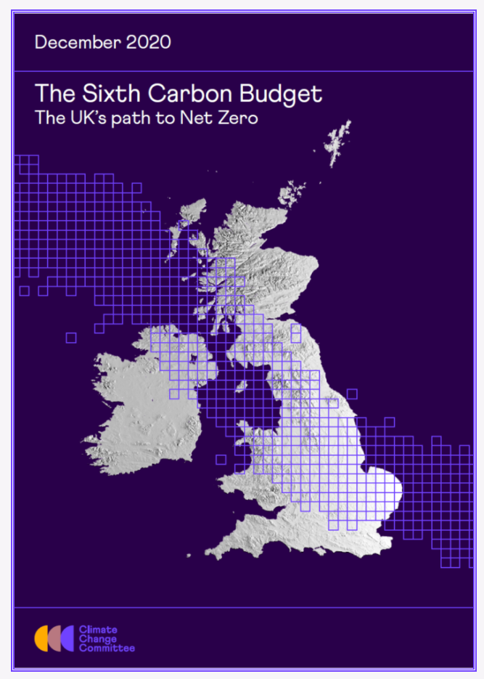

The UK’s ambitious carbon reduction targets are built around a strong policy framework
The 2008 Climate Change Act introduced ‘Carbon Budgets’ – a five-year, legal limit on total greenhouse emissions for that period. We are entering Carbon Budget 4 (2023-2027).
The 2008 Act also established the Climate Change Committee – an independent body to provide advice and scrutiny on UK progress against the carbon budgets.
In 2019, the UK signed net zero into law. In 2021 we set stretching targets for Carbon Budget 6 (77% reduction by 2035). This was the first carbon budget set since we committed to reach net zero.
The Net Zero Strategy, published in 2021, set out policies and proposals to bridge the gap towards meeting this ambition.
2025 – 55% reduction (excluding international aviation and shipping emissions)
2030 – Nationally Determined Contribution target for at least 68% reduction (excluding international aviation and shipping)
2035 – 77% reduction (including international aviation and shipping)
2050 – 100% reduction To meet whole-economy net zero target
First legally binding climate mitigation set by a country
2019 – first major economy to commit to Net Zero by 2050
2020 – ambitious 40GW offshore wind target by 2030 (now 50GW)
2020 – strategic approach for wider energy system
2021 – CB6 passed into law setting 78% emissions reduction target by 2035
Source: DESNZ analysis – Net Zero Strategy

Slide 3
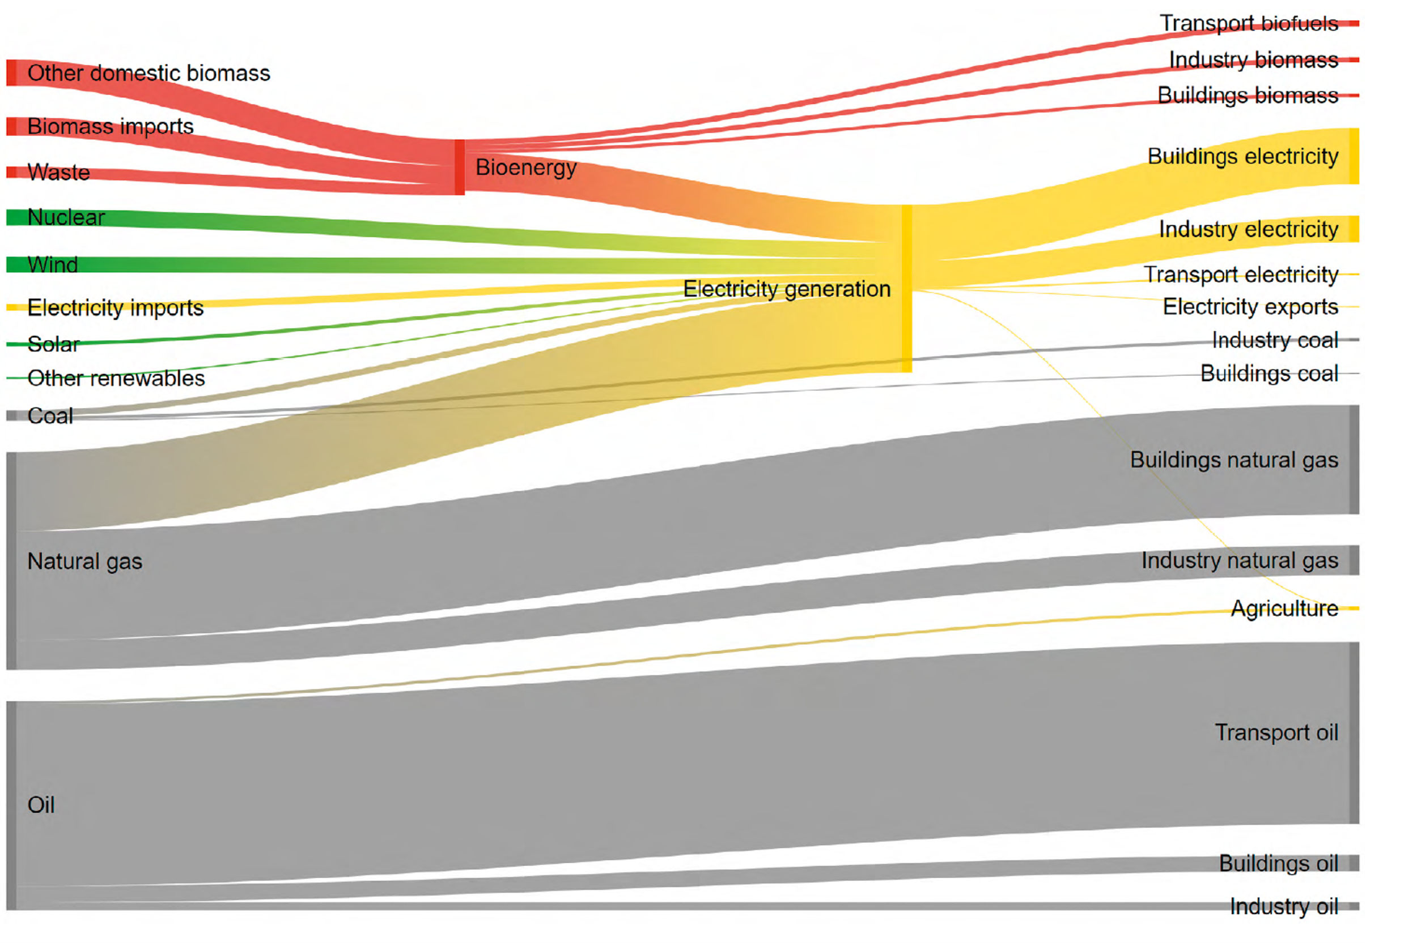
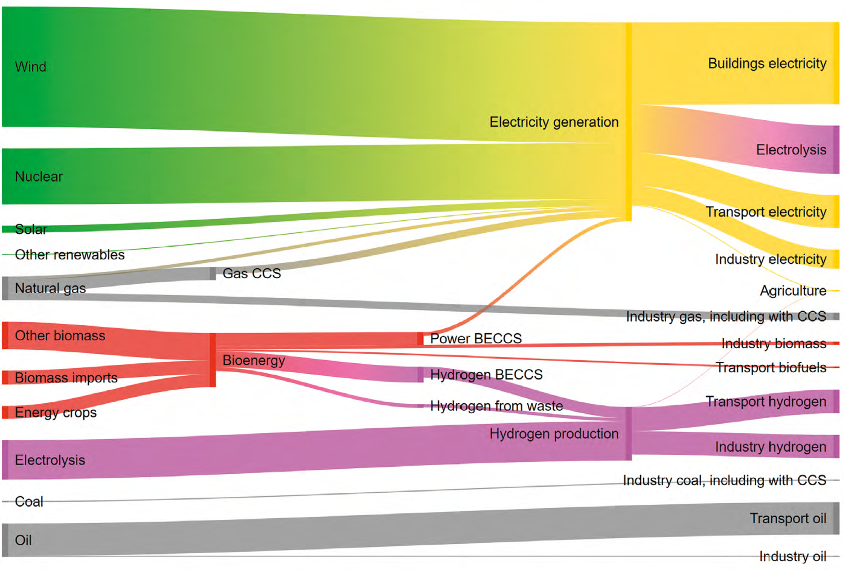
Power is central to net zero ambition for the UK – to meet net zero, we must fundamentally modify our technology mix, decarbonise it and keep it affordable whilst demands on the system increase
Where we are
Where we likely need to get to for us to meet legally binding net zero commitments
2019 energy generation and end uses
High electrification scenario: energy generation and end uses in 2050
Source: DESNZ analysis – Net Zero Strategy
To meet our net zero ambition, based on our whole-system modelling, by 2050, emissions associated with power could need to drop by 95-98% compared to 2019, down to 1-3 MtCO2e. Further, in 2021 the Government set an ambition for all electricity generation to be decarbonised by 2035, subject to security of supply.
All the while, electricity demand is expected to increase between 40-60%, and peak demand is also expected to increase substantially.

Slide 4






The centrality of the power sector in our decarbonisation approach means we will need to bring forward significant volumes of low-carbon generation, as well as the infrastructure to support their delivery
The what: Build a lot of low C capacity
Deliver up to 50 GW of offshore wind capacity by 2030, including 5GW of floating offshore wind
Deliver up to 70 GW of solar capacity by 2035
Moving to a power system that relies primarily on low carbon technologies is a crucial step towards delivering clean, reliable and low-cost energy.
To achieve this, our policy programmes drive the deployment of new capacity and deliver our technology-specific ambitions.
We have set up Great British Nuclear to deliver up to 24GW of new nuclear capacity by 2050
The how: Ambitious supply and demand policy levers to enable fast and affordable low C technologies
Supply
REMA – we are reforming our electricity markets to drive competition and innovation to benefit consumers, and provide price signals which guide decisions on electricity supply and demand, investment in new generating capacity and flexibility, and the efficient operation of the electricity system.
Networks - we are working closely with Ofgem and industry to accelerate the deployment of electricity transmission infrastructure and speed up network connections.
Planning – We are reforming the planning system so that it can keep up with demand.
Nuclear – we are scaling-up our nuclear programme by launching Great British Nuclear.
Renewables – we are accelerating the deployment of renewables with ambitious aims for offshore wind.
Low carbon flexibility - such as power CCUS, storage, interconnection and hydrogen to power.
Future system operator – the Energy Act 2023 has enabled the establishment of the Future System Operator who will be tasked with undertaking strategic network planning and market strategy across both gas and electricity to provide a whole energy system view.
SSEP - The Government has committed to the production of the first ever spatial plan for energy infrastructure, giving industry certainty over where it will be and giving every community a say.
Demand
The Government has set an ambitious target to reduce final energy demand from buildings and industry by 15% by 2030.
Social Housing Decarbonisation scheme – working closely with social landlords to upgrade energy efficiency of social homes to EPC C
Home Upgrade Grant – working with local authorities to improve the energy efficiency of homes off the gas grid
Energy Company Obligation scheme – working with energy suppliers to provide energy efficiency measures in low income households
Great British Insulation Scheme – delivering vital energy efficiency upgrades
Industrial Energy Transformation Fund - supporting industry to cut their energy bills and carbon emissions through investing in energy efficiency and low-carbon technologies.
Heat Networks – continuing to provide capital support to facilitate the continued growth of low carbon heat networks
Clean Heat – supporting the manufacturing of heat pumps in the UK
Fuel price rebalancing – making it easier for consumers to make the switch to green products by rebalancing prices to remove price distortions.
Demand side response– DSR is centered on consumers and is about incentivising changes in electricity consumption patterns that creates benefits in terms of bill savings, but also in terms of important system efficiencies.

Slide 5
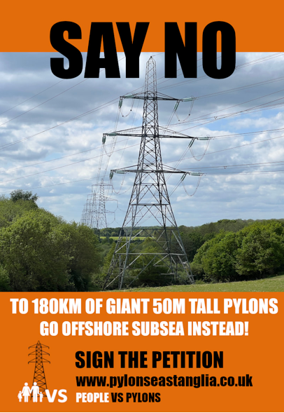
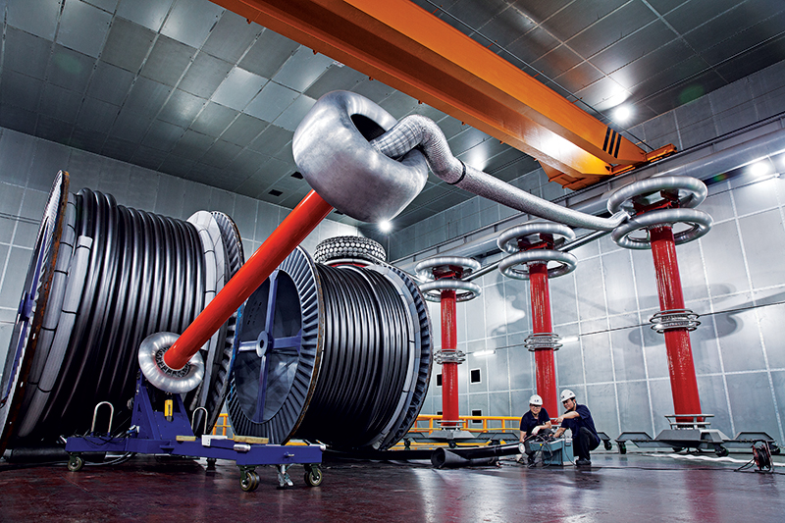

We are addressing key strategic & cross-sector challenges to increase our confidence in delivering these ambitions
Community Acceptance
Supply Chains & Manufacturing
Grid Coordination and Planning
Electricity networks transformation - our electricity network needs to be transformed at a scale and pace not seen for decades to accommodate increased demand and the required growth in low carbon generation. Our recently published Transmission Acceleration Action Plan and Connections Actions Plan set out our ambitious plans to significantly accelerate connections.
Accelerating the planning and development process - we are reforming our planning system and consenting process to make the system work more effectively for applications, local authorities and communities and to enable the process to deliver against our ambitions for new energy infrastructure.
Reforming our markets to support the UK’s future power system - a range of market failures mean the current electricity market framework is not best-suited to deliver a secure, clean and low-cost electricity system as it rapidly evolves. Our Review of Electricity Market Arrangements (REMA) programme is at the heart of our plans to reform the markets to decarbonise our power sector.
Addressing bottlenecks in our supply chains - we announced the Green Industries Growth Accelerator in 2023 to address blockages in our power sector supply chains. Through this work, we intend to shore up our power sector delivery as well as secure the economic benefits of the low-carbon transition.
Community understanding
Communities impacted not directly benefiting
Scale of transformation
Tough global competition for supply chain capacity
Major global investment, e.g. US Inflation Reduction Act
Marine Spatial Planning and Holistic Network Planning
Critical National Priority in planning system
Need for anticipatory investment
PACE OF DELIVERY
Image Sources: Pylons East Anglia campaign material, LS Cable & System 525kV HVDC Cable, Policy Exchange North Seas Economic Map

Slide 6
Summary
Electricity is expected to be play an increasingly important role in our energy mix, with a majority of final energy consumption coming from electricity in 2050.
Electricity demand is expected to increase significantly. Peak demand is also expected to rise significantly.
At the same time, we have committed to fully decarbonise the electricity system by 2035, subject to security of supply.
This means we need to accelerate the build out of low carbon capacity, as well as the supporting infrastructure and market and governance arrangements, as well as continue to explore innovative technologies to maximise optionality.
There are significant challenges in the transition ahead, shared with other countries. We are actively implementing policies to accelerate this transition across the sector and address those.

Slide 7
Publications
Net Zero Strategy: https://www.gov.uk/government/publications/net-zero-strategy
Powering Up Britain – Energy Security Plan: https://www.gov.uk/government/publications/powering-up-britain/powering-up-britain-energy-security-plan
Energy and Emissions Projections, Annex O: net zero and the power sector scenarios: https://assets.publishing.service.gov.uk/media/6225dc108fa8f5490e284e85/annex-o-net_zero-and-the-power-sector-scenarios.pdf
Modelling 2050 – electricity system analysis: https://www.gov.uk/government/publications/modelling-2050-electricity-system-analysis
Digest of UK Energy Statistics (DUKES): https://www.gov.uk/government/collections/digest-of-uk-energy-statistics-dukes
Energy Trends: https://www.gov.uk/government/collections/energy-trends

