Slide 1

Redesigning electricity markets to deliver EU policy objectives
Cambridge Electricity Policy Research Group Spring Seminar
Fabien Roques, Compass Lexecon and University Paris Dauphine
17 May 2024

Slide 2
Contents
Introduction
Towards a new target model? Key features of hybrid markets
System needs definition
Product definition and contracting approaches
Distribution of costs and benefits to consumers
Competition issues associated with long term contracts

Slide 3






















Introduction - Compass Lexecon’s EMEA energy expertise
We have offices across Europe, a team of 100+ experienced energy sector consultants and support the energy industry, the financial community and law firms with a broad range of services
London
Helsinki
Power
Gas
Emissions
Heat
Paris
Jason Mann
Petr Spodniak
Fabien Roques
Berlin
Martina Lindovska
Charles Verhaeghe
Anton Burger
Market modelling Price projections, valuations, policy impact assessment … | Regulation Market design, infrastructure regulation, renewables support …
Strategy Strategy in regulated industries, Policy action recommendations … | Contract design Contract valuation, PPA & long-term contract (re-)negotiation, procurement review …
Environment & decarbonisation Decarbonisation scenarios, carbon market design … | Competition & State Aid State aid clearance support Investigations of market abuse and competitive behaviour …
Transactions Regulatory & commercial due diligences, deal valuation, reports for IPOs & financing … | Arbitration & disputes RES support revisions, damage quantum analysis, energy supply contract arbitration …
Nicholas Brooks
Gerald Aue (Paris & Berlin)
Ljubo Mitrasevic
Yves Le Thieis
Boaz Moselle
Guillaume Duquesne
Lorenzo Coppi
Dmitri Perekhodtsev
Main energy offices
Madrid
Other Compass Lexecon or FTI offices
Blanca Perea
Antón Garcia
Emmanuel Grand
* incl. experts from our parent company FTI Consulting

Slide 4
Towards a new target model? Hybrid markets
There is a growing literature on hybrid power markets (e.g., Roques & Finon, 2013, 2017; Keppler et al, 2021; Joskow, 2022, etc.) that puts forward different alternatives to address the various market and institutional failures affecting electricity markets:
Additional “modules” to internalize policy interventions to define the generation mix, the level of security of supply though the introduction of complementary planning and long-term hedging / contracting mechanisms…
…whilst preserving efficient competition in energy markets, and introducing further hedging instruments to protect consumers
Filling the gaps to complete the market
Historical focus of market design
Decarbonisation / technology deployment targets
1
2
Long term contracts to support investment
Framework to assess/ plan the future system needs
Wholesale energy market
Balancing & ancillary services markets
Retail markets
Security of supply policy targets
Infrastructure development plans
3
Cost allocation and fostering demand participation

Slide 5
The key design choices of hybrid markets
Holistic planning of system needs
1
Who defines the system needs?
Assess system needs alongside multiple dimensions (adequacy, different types of flexibility, etc.)
Need to define harmonised methodologies and criteria
Not defined
Individuals
SO / State agency
Energy only
Capacity Subscription
Competition “for” the market – investment framework and long-term contracts (LTCs)
2
a
What contracting approach?
Tendering of LTCs, can be technology neutral or specific, centralised or decentralised
Puts competitive pressure where it matters: CAPEX
Years ahead
D/H ahead
Decentralised
Centralised
PPA / Supplier obligation
Competition “in” the market – building on existing internal market
2
b
What product definition?
Ensures efficient resource use and system optimisation
Reforms underway to enhance integrated day ahead, intraday and balancing markets, more needed
Separate products
Multi-attribute
CRM + CfDs for RES + flexibility support contracts?
Optimisation based on different tech. attributes
3
Which type of tariff / cost pass through differentiated by consumer?
Framework for consumer protection and engagement
Pass through of costs / benefits of LTCs
Should be differentiated by type of consumer
Centralised auctions of LT contract slices
Charges in the grid tariff
Supplier charges
General tax system

Slide 6
The assessment of power system needs requires a new approach
1
Scope of system needs across timeframes
In addition to reaching decarbonisation targets, system needs include security of supply concepts across several dimensions, including firm capacity, flexible capacity, and network infrastructure
With the evolution of the system (variable renewables, exit of dispatchable fossil fuel, rising congestions, rise in electrification…), flexibility is holding an ever-increasing role in securing electricity supply and support efficient congestion management
The European framework already includes flexibility considerations, but so far mostly focuses on adequacy. The current metrics are designed to quantity firm capacity.
Despite several initiatives across Europe (ENTSOE, TSOs…), there are not yet precise guidelines or mandate around the evaluation of flexibility needs.
Long term (Investment)
Short term (Operation)
Hedging mechanisms / Investment framework
Physical wholesale markets / Ancillary Services
Labour, raw material & robust supply chains to deliver electricity, necessary infrastructure and capacity
Low-carbon energy and RES
Ensuring a stable base for system adequacy
Firm capacity
Ensuring a stable base for system adequacy
Flexible capacity
Secure flexible resources to handle system volatility, provide inertia and voltage control etc.
Network infrastructure
Enabling the transport and safe operation of the system
Resilience
Climate change, cybersecurity, physical security, fuel security, decentralisation, raw materials access

Slide 7
The design of long term contracts matters – example of CfDs
2
The ‘traditional’ two-sided CfD design faces multiple design issues…
… for which a range of options are available to improve CfD design along key contractual feature dimensions
1
2
One or two slides summarising our CfD study
Traditional CfD design can distort dispatch incentives
Referencing the CfD on the day-ahead market can draw liquidity away from other markets
Product type
Energy profile
Key issues
with the
‘traditional’
CfD
Reference index
The potential substitution of private LTCs can lead to a ‘crowding out’ effect
An efficient risk allocation across developers and consumers needs to address trade offs
Strike Price
5
CfD Allocation method
3
Cost & Benefits allocation
The allocation of the costs / benefits of CfDs can distort end consumer price signals
Contract length
4
The different options available imply trade-offs to resolve issues with the ‘traditional’ CfD. For example, the choice of energy profile, reference index and strike price in the CfD design should balance dispatch incentives with risk exposure

Slide 8





Which type of tariff / cost pass through ?
3
There are different options to allocate the costs and benefits of CfDs to consumers with central/ governmental counterparties
Levies or charges embedded in grid tariff
Supplier charges, passed on to consumers
Resale of electricity to suppliers/consumers via centralised auctions of long-term contract slices
General tax system (State budget)
Depending on the LT contracts cost and benefit allocation method downstream, distortions could be created in the retail market price, affecting consumers and suppliers
Impact on consumer price signal
If costs and benefits of LT contracts complement energy prices on consumer bills, it may affect consumer price signals, and affect competitiveness, electrification and energy efficiency decisions or purchasing power.
Allocating costs and benefits through suppliers introduces additional uncertainties and risks for them, which would in turn negatively impact consumers (complexity, risk of bad debt…)
If costs and benefits of CfDs are applied to flexible load such as storage assets or some flexible loads in demand, it may reduce incentives for them to optimise their consumption/flexibility as price spreads between peak and off-peak may be reduced.
LT contracts allocating costs and revenues through suppliers can create negative interferences with the retail market and creating distortions between competitors – for example by allocating costs and benefits without controlling for consumer switching
Risk allocation impact on suppliers
Reduce incentives for flexible assets
Retail market distortion and the dynamics of retail competition
Levies or charges embedded in grid tariff
Resale of electricity to suppliers/consumers via centralised auctions of long-term contract slices
2
Supplier charges, passed on to consumers
General tax system (State budget)
3
4

Slide 9
Competition issues associated with long term contracts: do we need to revisit the historical approach?
The historical approach to assessing Long Term contracts is the balancing test weighing pro- and anti-competitive effects
Competition authorities perceived long term contracts in the 2000s as standing in the way of liberalisation
Under specific pre-conditions, the European Commission conducts an in-depth case-by-case assessment of the potential anti-competitive effects of the contracts
With the historical approach, the assessment of long-term contracts on a case-by-case basis could create substantial uncertainty and delays
Assessing the effects on competition of a long-term contract requires a comprehensive assessment of pro- and anti-competitive effects.
This could create substantial uncertainty regarding presumptions of legality and regarding the methodologies to be used for assessing effects
Fostering the development of long-term contracts will require to clarify presumptions of legality and define guidelines for assessing effects
Two areas may benefit from more guidance to enhance predictability in the outcome of the competitive assessment :
The identification of situations where long-term contracts are less likely to trigger competition concerns (or should be presumed pro-competitive).
The identification and qualification of concrete efficiencies brought about by long-term contracts relevant for the competitive assessment:
Pro-competitive effects
Anti-competitive effects
Dry up spot market liquidity
Foreclosure of actual or potential rivals
Facilitates / coordinates investment
Mitigate risk of market power abuse in the spot market
1
2
1
Investment incentives
2
3
Investment coordination
Clean portfolio mix development
4
Price stabilisation for customers
5
6
Long-term hedging development
Long-term policy commitment

Slide 10


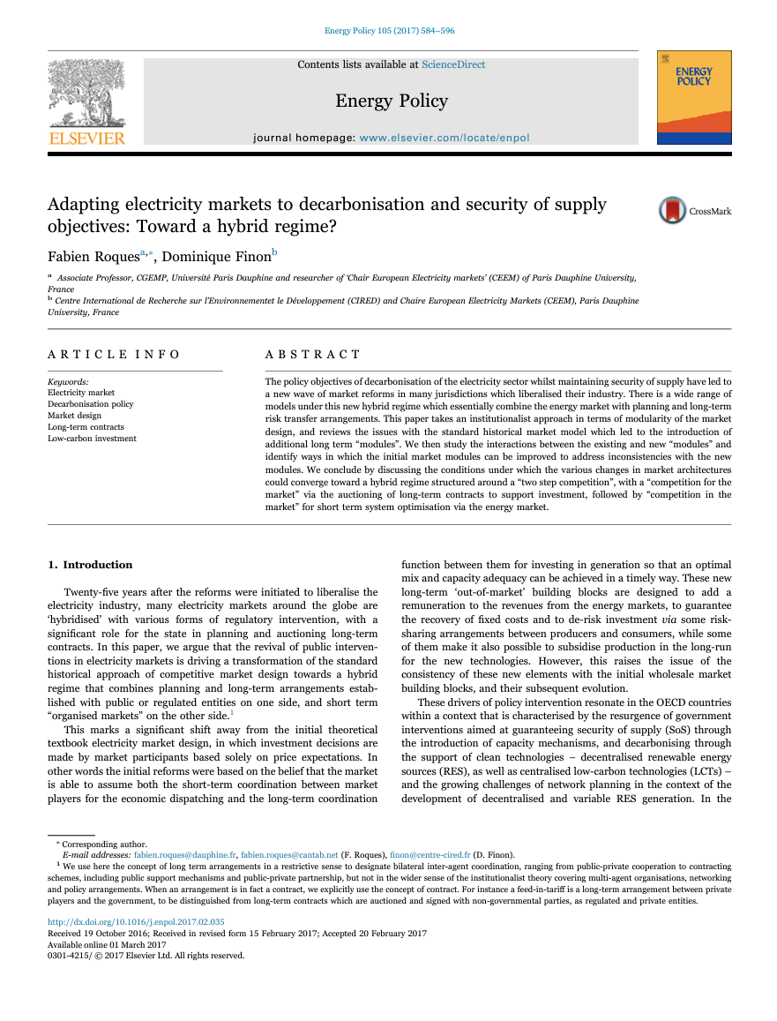

Bibliography
F; Roques & D. Finon (2017) Adapting electricity markets to decarbonisation and security of supply objectives: Toward a hybrid regime?. Energy Policy Volume 105.
Eurelectric (2023) Electricity market design fit for net-zero. Public report.
Eurelectric (2024) Unlocking the power of two-way Contracts-for-Differences (CfDs) to accelerate the energy transition. Public executive summary.
F. Roques & G. Duquesne (2024) The return of long-term contracts for electricity: Implications for competition policy. Policy brief.
Note : publications can be accessed by clicking on each picture

Slide 11


If you have any question about this paper, please contact
Thank you for your attention
Fabien Roques
Scientific Director
CEEM Université Paris Dauphine
+33 (0)1 53 06 35 29
fabien.roques@dauphine.psl.eu
Fabien Roques
Head of Energy Practice, Compass Lexecon
Executive Vice President
+33 (0)7 88 37 15 01
FRoques@compasslexecon.com

